Slide 1
Agriculture’s contribution to a carbon neutral Europe
Agricultural transitions and enabling change
Ben Allen
Institute for European Environmental Policy (IEEP)
IDDRI Seminar, Paris, 15 November 2018

Slide 2


Overview
Emission reductions
New Approach
Increased removals
Coherence
Governance
Impacts on climate
Role of Agriculture
Enabling change
Agriculture & climate
Transitions
Tools
Impacts from climate
Support to other sectors
Pathways
Bio-economy

Slide 3
Agriculture and climate
Emission reductions
New Approach
Increased removals
Coherence
Governance
Impacts on climate
Role of Agriculture
Enabling change
Agriculture & climate
Transitions
Tools
Impacts from climate
Support to other sectors
Pathways
Bio-economy

Slide 4
Role of agriculture
Emission reductions
New Approach
Increased removals
Coherence
Governance
Impacts on climate
Role of Agriculture
Enabling change
Agriculture & climate
Transitions
Tools
Impacts from climate
Support to other sectors
Pathways
Bio-economy

Slide 5
Transitions
Emission reductions
New Approach
Increased removals
Coherence
Governance
Impacts on climate
Role of Agriculture
Enabling change
Agriculture & climate
Transitions
Tools
Impacts from climate
Support to other sectors
Pathways
Bio-economy

Slide 6
Enabling change
Emission reductions
New Approach
Increased removals
Coherence
Governance
Impacts on climate
Role of Agriculture
Enabling change
Agriculture & climate
Transitions
Tools
Impacts from climate
Support to other sectors
Pathways
Bio-economy

Slide 7
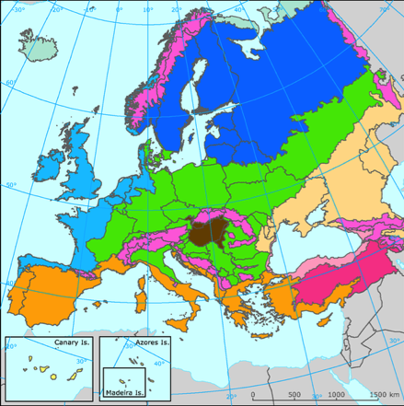
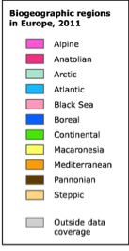
Pressures on farming systems
Temperature variations
Water availability
Water quality
Pests and disease
Animal welfare
Fire risk
Storm damage

Slide 8
Agriculture’s contribution to EU GHG emissions (excluding LULUCF)
Others
Significant variation by country
Agriculture’s contribution will become more significant over time
FR
DE =~44% of all agricultural emissions
UK
11.3%
Agriculture
29.3%
Energy supply
11.5%
Residential &
commercial
19.2%
Transport
19.0%
Industry

Slide 9
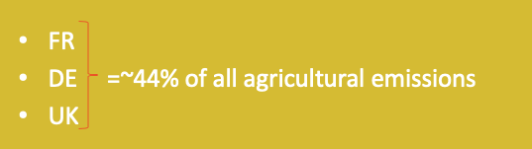
Agriculture’s contribution to EU GHG emissions (excluding LULUCF)
Others
11.3%
Agriculture
29.3%
Energy supply
11.5%
Residential &
commercial
19.2%
Transport
19.0%
Industry

Slide 10
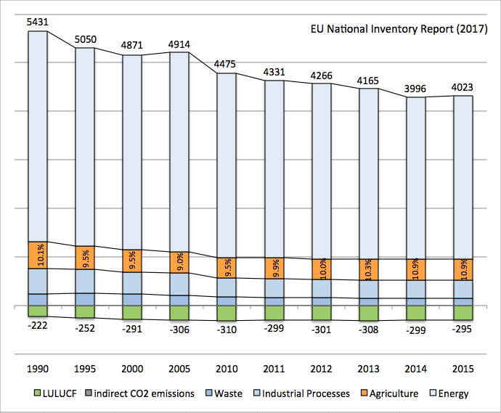
Reductions in other sectors has been more rapid and sustained than in agriculture.
Emission levels have seen sustained increases since 2012
Relative share expected to reach 30% by 2050

Slide 11
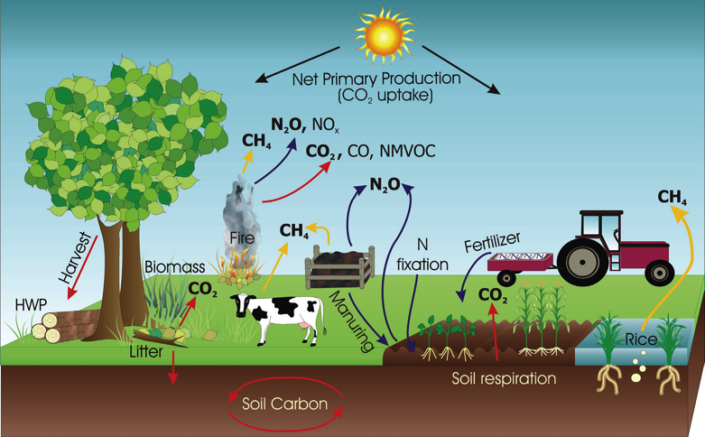
Agricultural GHG emissions (CO2/non-CO2)
38.0%
Soils
15.4%
Manure
42.9%
Enteric
fermentation

Slide 12
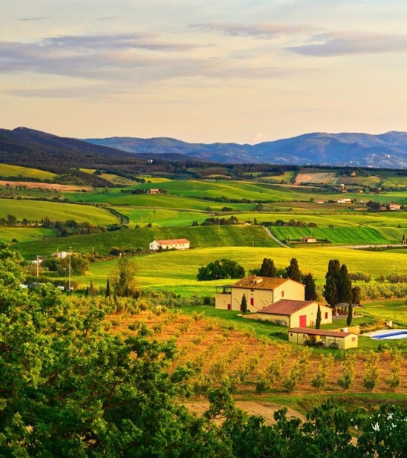
The rationale for action in agriculture
Agriculture is a major source of GHG emissions
EU emissions from agriculture are now increasing, both in absolute and relative terms
EU agriculture production sector has a large land use impact outside its boarders
Susceptible to climate impacts

Slide 13
Role of agriculture
Emission reductions
New Approach
Increased removals
Coherence
Governance
Impacts on climate
Role of Agriculture
Enabling change
Agriculture & climate
Transitions
Tools
Impacts from climate
Support to other sectors
Pathways
Bio-economy

Slide 14
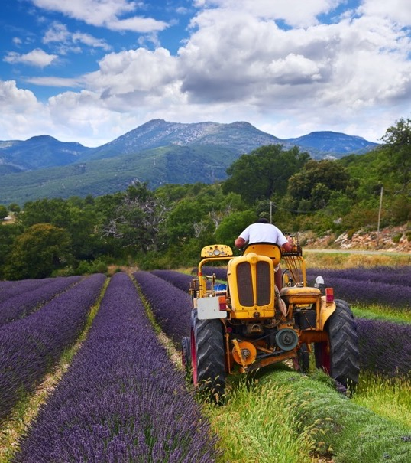
What makes agriculture special?
Potential to compensate for emissions through carbon sequestration and storage
Mitigation actions can deliver co-benefits: economic, environmental & social
Agriculture also has a role in
Ensuring EU food and nutrition security,
Incomes and territorial development,
& the social & environmental benefits delivered by the sector

Slide 15
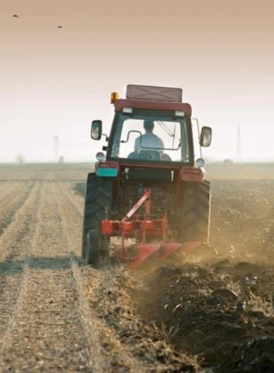

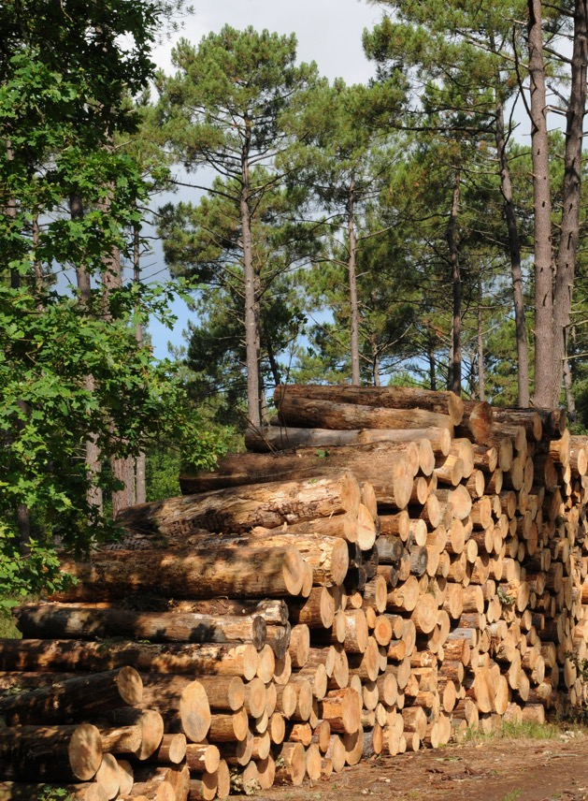
Reduce emissions
Increase removals
Support other sectors
Efficiency gains:
reduce GHG emissions per unit of production
Reduced/change output:
reduced GHG emissions in absolute terms.
Fossil substitution:
Biomass & Biofuels
Space for energy infrastructure
Materials for construction; packaging, etc.
Increased removals
land use change;
building carbon in soils;
Greater vegetation/wood
Notes:
Emissions reduced and allows production gains but risks a rebound effect, e.g. rise in consumption due availability.
Overall emissions reduced but risks leakage to 3rd countries due to demand
Potential income stream and adaptation co-benefits. Potential leakage effect, might not reduce actual emissions from production

Slide 16
Reduce emissions
Key benefits:
Emissions reduced;
Allows production gains;
Can free up land.
Mitigation risks:
Rebound effect, e.g. rise in consumption due to availability.
Leakage to 3rd countries due to demand
Efficiency gains:
reduce GHG emissions per unit of production
Reduced/change output:
reduced GHG emissions in absolute terms.

Slide 17
Increase removals
Key benefits:
Potential income stream & diversification;
Adaptation co-benefits.
Mitigation risks:
Potential leakage effect;
No actual change in production emissions
Increased removals
land use change;
building carbon in soils;
Greater vegetation/wood

Slide 18
Support other sectors
Key benefits:
Potential income stream & diversification;
Natural sequestration
Mitigation risks:
No reduction in agriculture sector GHGs;
Potential increase due to intensification;
Sequestration times could be overall net-negative – depending on use.
Fossil substitution:
Biomass & Biofuels
Space for energy infrastructure
Materials for construction; packaging, etc.

Slide 19
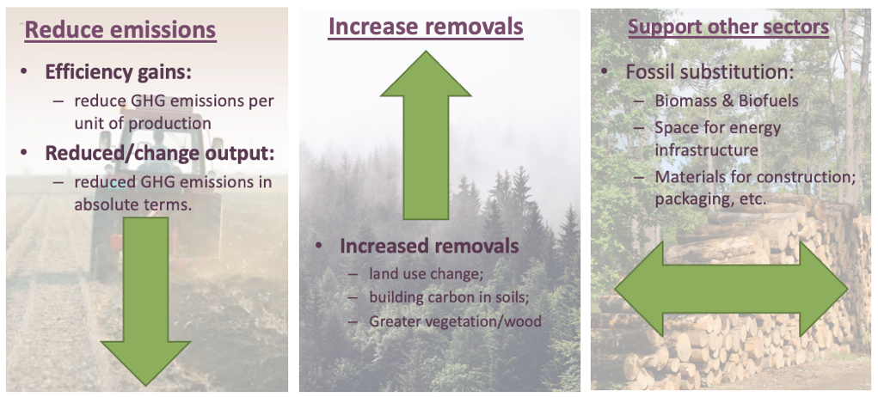
?
+
Production side
Consumption
Notes:
Emissions reduced and allows production gains but risks a rebound effect, e.g. rise in consumption due availability.
Overall emissions reduced but risks leakage to 3rd countries due to demand
Potential income stream and adaptation co-benefits. Potential leakage effect, might not reduce actual emissions from production

Slide 20
Transitions
Emission reductions
New Approach
Increased removals
Coherence
Governance
Impacts on climate
Role of Agriculture
Enabling change
Agriculture & climate
Transitions
Tools
Impacts from climate
Support to other sectors
Pathways
Bio-economy

Slide 21

2050 potential
0%
Quelle contribution** (-30%)
Scenar* (-5.8%)
10%
Vision scenario (-42%)
EU 2011 Roadmap*** (-42-49%)
German Climate Action Plan (-16%)
20%
French LC Strategy* (-45%)
TYFA** (-46%)
EcAMPA (-28%)
30%
Afteres (-54.4%)
ECF Roadmap** (-60%)
Prospective Agriculture Energie (-35.8%)
40%
50%
Gesebov (-40.5%) (by 2035)
60%
70%
80%
Net-Zero
2030 potential
90%
100%
All reductions are in comparison to 2005 figures with the exceptions of: * 2015; ** 2010; ***1990

Slide 22
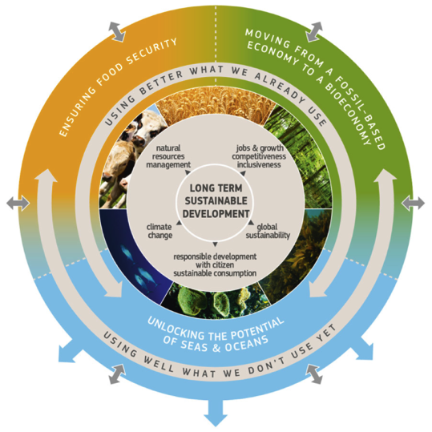
Bio-economy
Objectives:
Social, env, economic gains;
Use natural resources for food, feed, materials, energy;
protection and restoration of biodiversity, ecosystems and natural capital across land and water.
Areas of action – sustainable and circular bioeconomy:
Strengthen and scale-up the bio-based sectors;
Deploy rapidly local Bioeconomies across Europe;
Understand the ecological boundaries of the bioeconomy.
Notes:
Ensuring food security;
Managing natural resources sustainably;
Reducing dependence on non-renewable sources;
Mitigating and adapting to climate change;
Creating jobs and maintaining EU competitiveness.

Slide 23
Bio-economy
Objectives:
Social, env, economic gains;
Use natural resources for food, feed, materials, energy;
protection and restoration of biodiversity, ecosystems and natural capital across land and water.
Areas of action – sustainable and circular bioeconomy:
Strengthen and scale-up the bio-based sectors;
Deploy rapidly local Bioeconomies across Europe;
Understand the ecological boundaries of the bioeconomy.
Notes:
Ensuring food security;
Managing natural resources sustainably;
Reducing dependence on non-renewable sources;
Mitigating and adapting to climate change;
Creating jobs and maintaining EU competitiveness.

Slide 24
Enabling change
Emission reductions
New Approach
Increased removals
Coherence
Governance
Impacts on climate
Role of Agriculture
Enabling change
Agriculture & climate
Transitions
Tools
Impacts from climate
Support to other sectors
Pathways
Bio-economy

Slide 25
CAP
Consumption
Design CAP tools with climate objectives in mind
Improve implementation & uptake
Results-based payments
Education
Sustainable diets
Beyond food
Citizens interests
Research & evidence
Coherence & governance
Existing farming practices
Mitigation potential in different climatic zones & soil types
Trade-offs
Demonstration
Consider biomass use scale
Align policy objectives
High-level scrutiny board
Transparency in decisions
New approaches
Pathways & Targets
Rebalance the cost of food
Safe operating space for livestock
Education for all
Vision & targets
Identify opportunities
NZ2050

Slide 26
Reaching net-zero emissions in the EU, whilst avoiding external impacts, is likely to require a more systematic change in the way we produce and consume food.

Slide 27
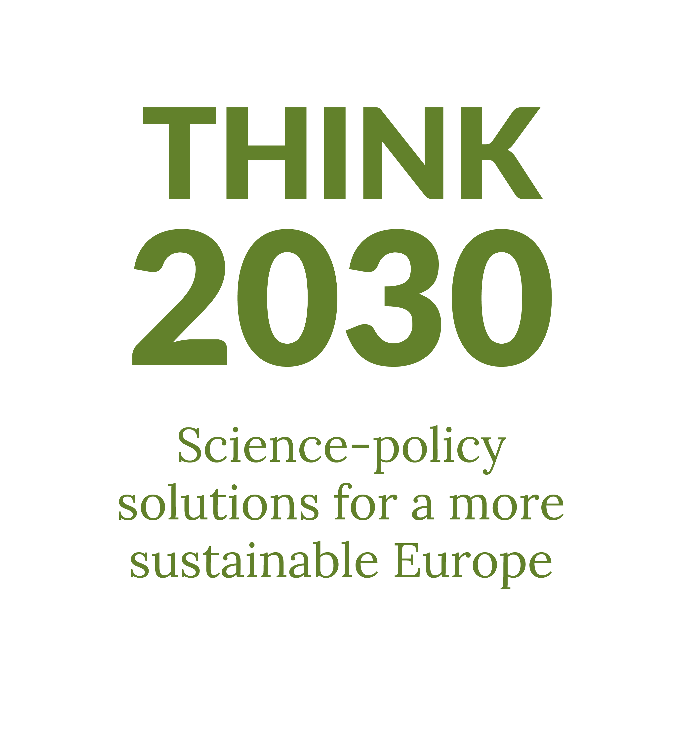
Thank you
For more information about IEEP’s work on climate and agriculture
ballen@ieep.eu

Slide 28
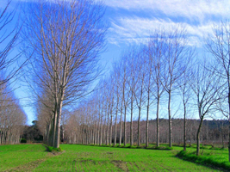
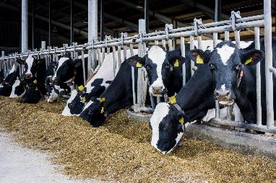
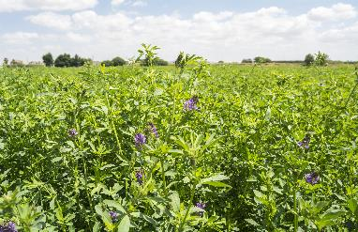
Potential climate actions - agriculture
Land use change
E.g. afforestation, agro-forestry, arable conversion
Crop Production
E.g. Zero/reduced tillage, cover/catch crops, crop residues
Livestock Production
E.g. Disease management, breeding, feed additives etc
Nutrient and Soil Management
E.g. Nitrification inhibitors, improved N fixation etc
Energy
E.g. Carbon audits, energy efficiency, anaerobic digesters

Slide 29

Coherence
High-level food sustainability advisory board
Alignment of agriculture plans to the EU’s long-term strategies.
Consider biomass end use.
Removing all environmental harmful subsidies under the future CAP.
New contract between farmers & society
Rewarding farmers for public goods;
Transition towards CAP multi-annual and results-based payments;
Knowledge transfer, advice and innovation;
Strong accountability and robust monitoring
Appropriate governance
The right bodies & tools at both European and national level to allow citizens interests to be actively reflected in future policy making and monitoring.
Transparency in decision making.
New Approaches
Rebalance the cost of food where sustainable products becomes cheaper and more convenient to consumers, whilst unsustainable ones more expensive.
Safe operating space for livestock production and consumption.
Greater education about our food and farming decisions at all ages and in all sectors of society, particularly through school curriculum.

Slide 30
Environment
Technology
Drives adaptation, not mitigation;
Impacts crops more than livestock
Climate mitigation tech is still rare in agriculture;
Rebound effect is a risk of efficiency gains
Consumption
Markets
Meat consumption and production is a major source of GHGs;
Reducing food waste is essential
EU markets are complex and part of global commodity trade;
Long supply chains limit reinvestment in the sector
Policy
Technology
Targets work;
External policies have significant influence;
Climate tends to be secondary focus of current CAP measures
Better application of existing techniques is as important as new developments;
Public perception is key

Slide 31
A wide range of mitigation potential
Mitigation areas | Selected mitigation actions | Estimated potential – will vary with local conditions, current practice, etc.
Crop production | Use of cover/catch crops | 1,100 – 1,900 kt CO₂eq/yr/%uptake
Nutrient and soil management | Biological nitrogen (N) fixation in rotations and in grass mixes | 1,400 – 2,900 kt CO₂ eq/yr/%uptake
 | Use of nitrification inhibitors | 470 – 1,400 kt CO₂ eq/yr/%uptake
Livestock production | Livestock disease management | 23-230 ktCO₂ eq/yr/%uptake
 | Feed additives for ruminant diets | 37-55 ktCO₂ eq/yr/%uptake
Other | Carbon auditing tools (for both CO₂ & non-CO₂ emissions) | 470 – 940 kt CO₂ eq/yr/%uptake

Slide 32
A significant contribution to non-CO₂ GHG emission reductions in agriculture is possible
Study | Agricultural GHG non-CO₂ emissions reduction (in 2030, vs 2005 levels) | Enabling conditions specific to agriculture | Impacts for the agricultural sector
Reference scenario 2016 (Ref2016) | 2.4% (-10.66 MtCO_{2e}) | No policy support other than policies existing in 2014 (projections under ‘business-as-usual’ scenario). | Emissions reduction is low - Only win-win solutions are adopted as a result of projected trends.
European Council scenario EUCO27 Using Ref2016 | 8.1% (-35.95 MtCO_{2e}) | Very limited policy support other than policies existing in 2014 (equivalent to a €0.05/tCO_{2e}. carbon price). | Emissions reduction level is low/moderate – Win-win solutions are accompanied by some policy incentive to mainstream their adoption.
European Council scenario EUCO30 Using Ref2016 | 2.4% (-10.66 MtCO_{2e}) | No policy support other than policies existing in 2014. | Emissions reduction level is low - Only win-win solutions are adopted as a result of projected trends. The ESR emission target is met through increased energy efficiency and no contribution from the agricultural sector.
EcAMPA 2 (JRC) | -11.4% to -25% | Various: Voluntary / Mandatory choice of mitigation actions; Support for implementation up to 80% of mitigation costs. | Various: Production impacts where mitigation is not supported by subsidies; Cost impacts to EU budget as a result of subsidised support.

