Slide 1

The role of the agricultural sector in a carbon neutral Europe
Impacts on land use, biodiversity and food and nutrition security

Slide 2
Introduction (1)
Agriculture in the face of climate change: a triple issue
Emission reductions
Carbon removal / sequestration
Fossil C substitution
Choices would affect land use / land use change and have major implications on (at least) three issues:
Adaptation potential
Food production / food security
Biodiversity / landscapes / natural resources
A growing consensus on two levers: diets and losses and wastes…

Slide 3
Introduction (2)
But clear divergences on needed changes in farming systems that relate to different ways in hierarchizing issues
Two broad options

Slide 4
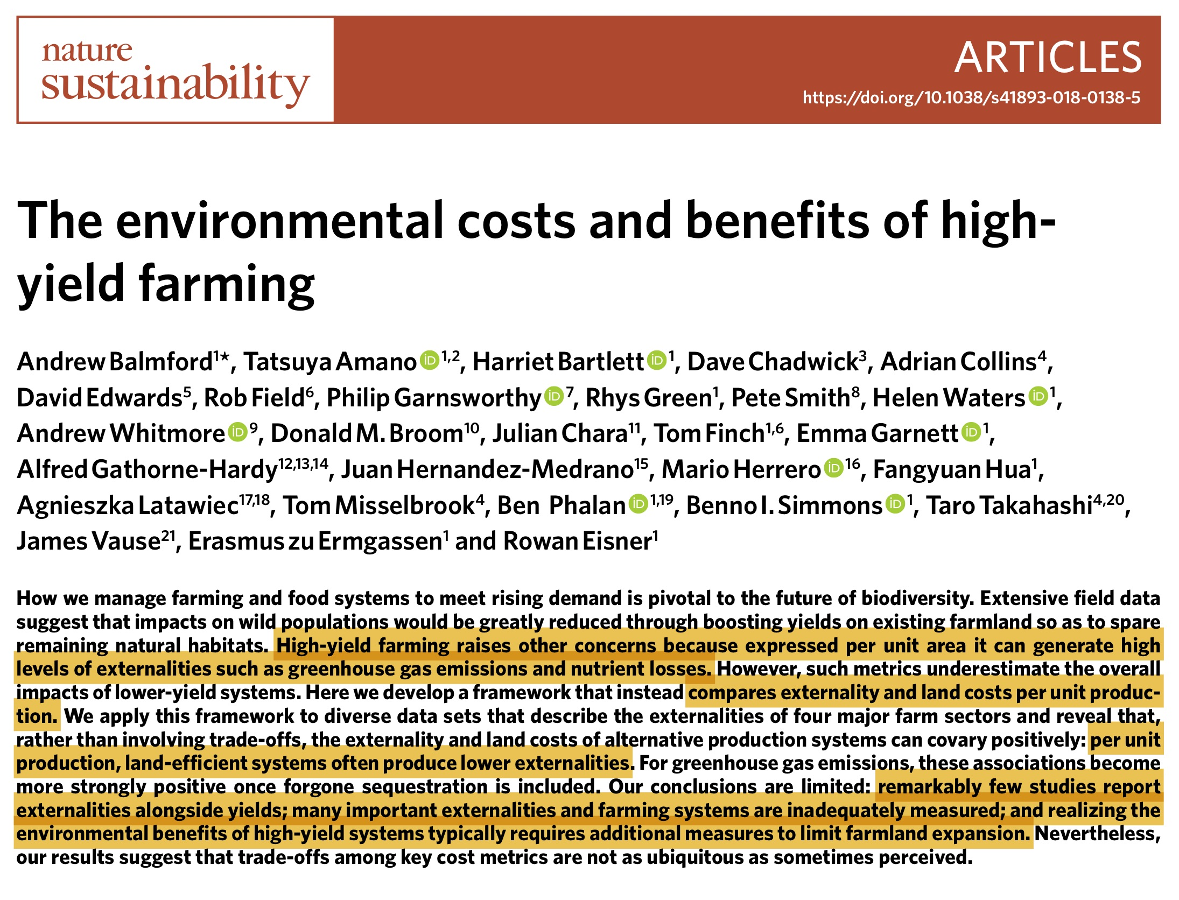
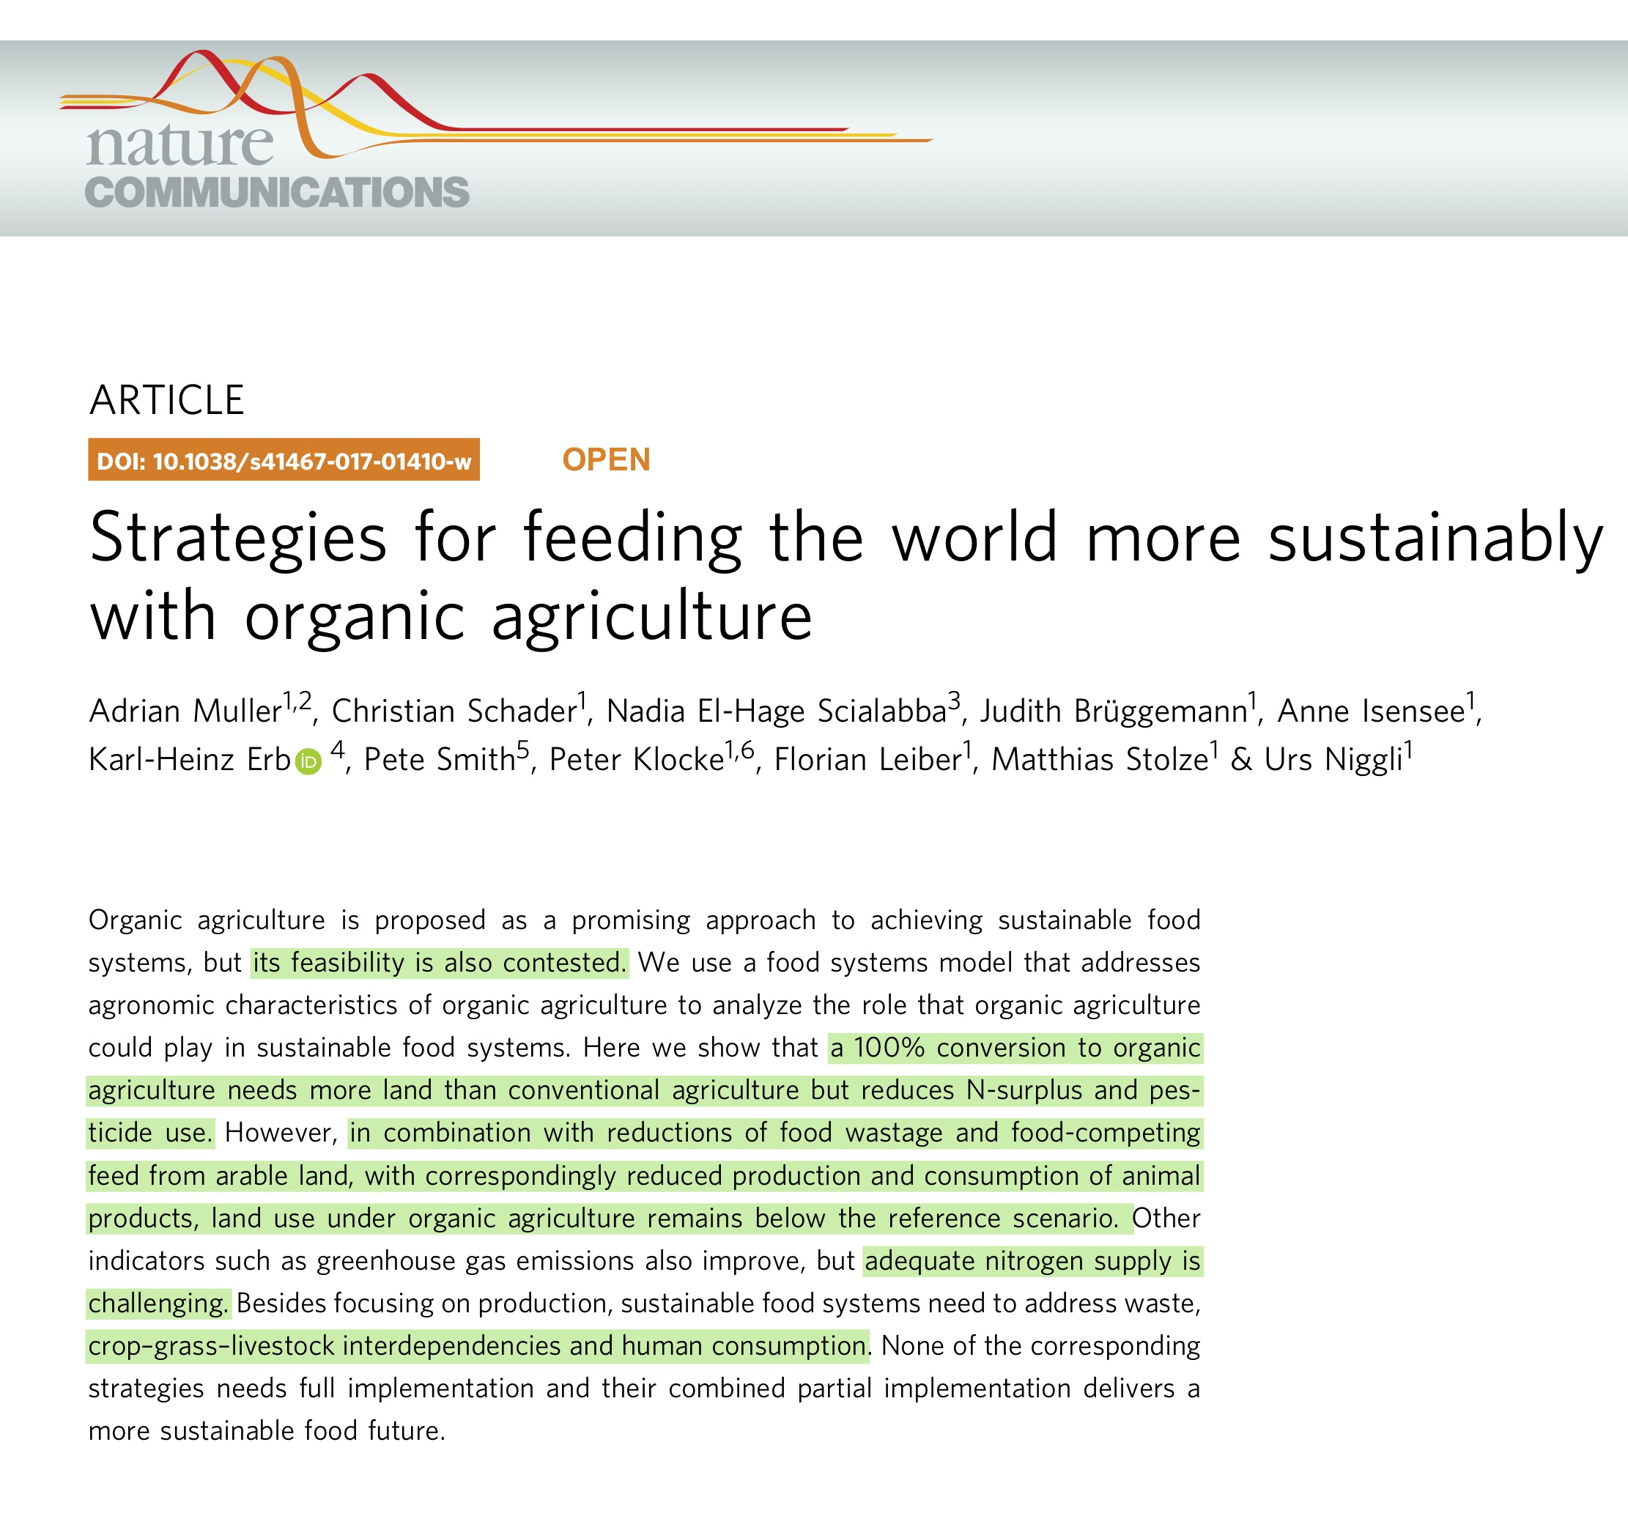

Slide 5
Introduction (3)
A three steps approach
Clarifying the demande vis-à-vis the agricultural (and more broadly: land) sector…
The climate focused approach and its potential consequences
Potentials & limits of alternative approaches that takes more clearly into account biodiversity issues

Slide 6
1. The demand vis-à-vis the agricultural sector

Slide 7
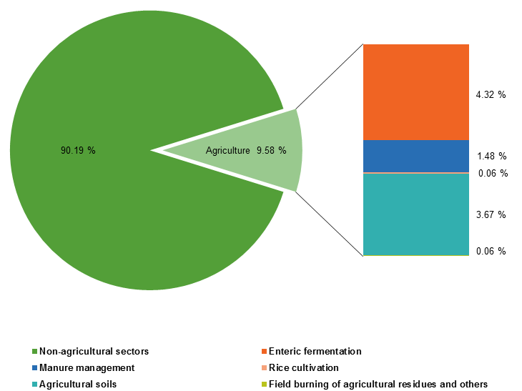
Emission reduction

Slide 8
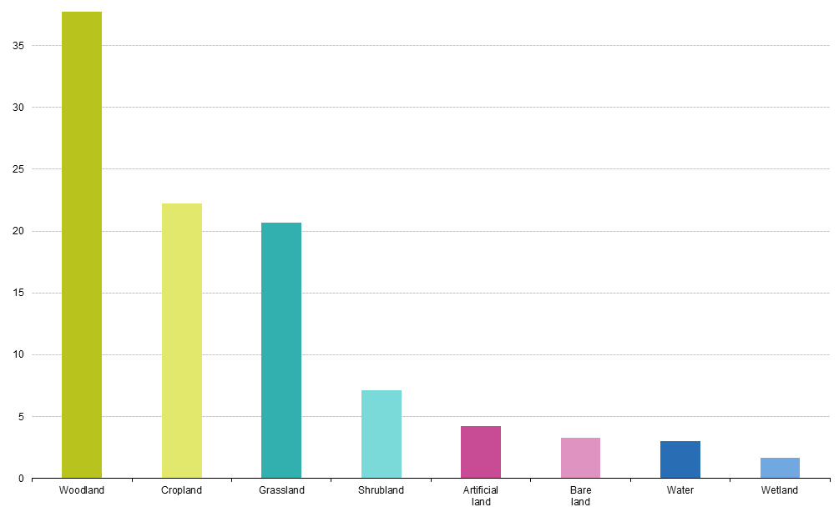
Carbon sequestration
Notes:
Grassland= près de 20% du land use
Forest: plus de 35% du land use

Slide 9
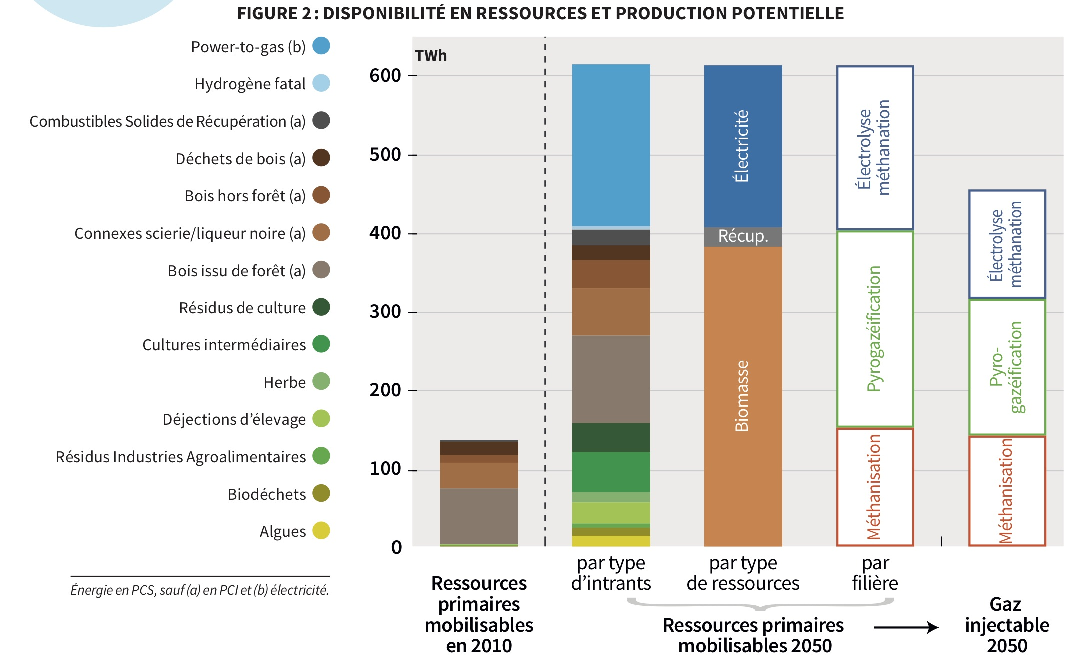
Bimoass for energy and the industry
Biofuel
Biogas
Notes:
Grassland= près de 20% du land use
Forest: plus de 35% du land use

Slide 10
2. A climate-focused approach and its possible consequences

Slide 11
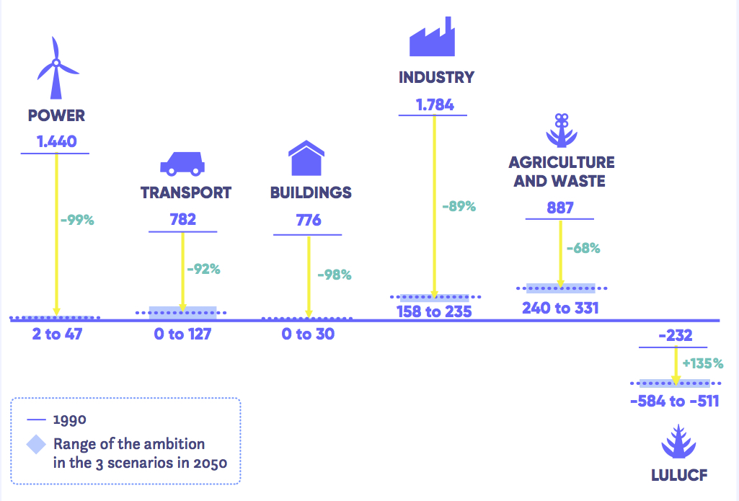
The ECF scenario
Important changes in diets / food consumption
Intensifying food production
To free up some land and use it for:
Sequestration through aforestation
Substitution through energy crops

Slide 12
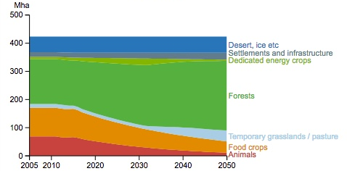
Potential consequences
Intensification and its (potential) impacts:
pesticide and biodiversity and human health;
Synthetic fertlizers and nutrient cycles
Biomass for energy: competition for animal feed and soil organic matter / living soils
Land use changes, grassland and biodiversity

Slide 13
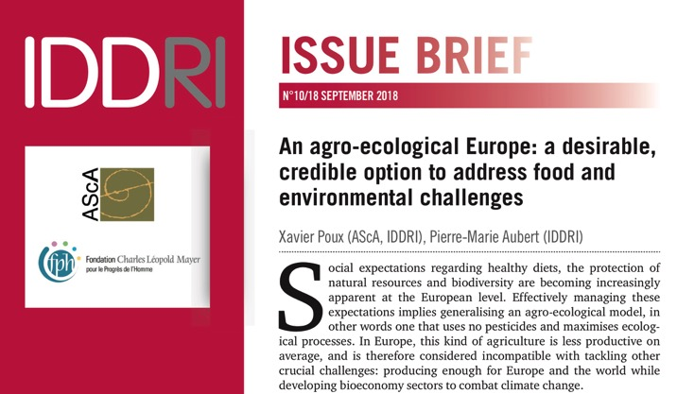
3. Potential and limits of alternative approaches
Insight from the TYFA scenario

Slide 14
The TYFA scenario: the modelling tool
Variables d'entrée :
Conduite des cultures
Modes d'élevage
Régimes alimentaires
Pertes et gaspillages
Usages non alimentaires
Variables résultats
Production
Usage des terres
Émission GES
Biodiversité

Slide 15
The tested hypothesis

Slide 16
The tested hypothesis

Slide 17
The tested hypothesis

Slide 18
The tested hypothesis

Slide 19
The tested hypothesis

Slide 20
The tested hypothesis

Slide 21

Structure and main results of the scenario
3
2
1

Slide 22
Potential for an improved climate impact
Technological improvements for increased efficiency
Changes in animal feed
Livestock reduction and synthetic nitrogen inputs
Carbon sequestration: quantifying the potential of permanent grasslands and agroecological infrastructures agroforestery
Carbon substitution: methanisation / biodigesters? Linked to livestock reduction

Slide 23
Conclusion
A scenario comparable in its potential of emission reduction to numerous others currently discussed at the EU level…
All in all: reaching carbon neutrality under such a scenario would be challenging
But this has to be put in perspective with health and other environmental benefits
Adaptation potential
Biodiversity and natural resources conservation
Some key hypothesis on diets
The need to continue the debate and clarify

Slide 24
Pierre-Marie Aubert (IDDRI) – pierremarie.aubert@iddri.org

Slide 25
