Slide 1
Area-based Management Tools & Marine Protected Areas
Klaudija Cremers, Research Fellow, IDDRI
Webinar: High seas treaty: analysis & implementation
15 March, 2023

Slide 2
Process under the BBNJ treaty
Develop proposal
Submit proposal to the Secretariat
Preliminary review by STB
Proposal
Public consultations
Review & resubmit to Secretariat
Outcome conveyed to proponent
Consultation
Proposal reviewed based on submissions
STB sends recommendations to the CoP
CoP Decision
Decision-making
Consensus or ¾ majority

Slide 3
Process under the BBNJ treaty
Proposals must include:
Geographic or spatial description of the area
Criteria used to identify the area
Human activities in the area, and their possible impact
Description of state of the marine environment and biodiversity
Description of conservation and sustainable use objectives
Draft management plan: proposed measures, monitoring, research and review
Duration, if any
Information on consultation activities
Information on existing ABMTs, including MPAs
Relevant scientific input and, where available, traditional knowledge

Slide 4
Process under the BBNJ treaty
After submission to the Secretariat:
The Secretariat makes the proposal publicly available
The Scientific and Technical Body (STB) assesses the proposal
Consultations
The Conference of the Parties (CoP) will decide whether to adopt the proposal, ideally by consensus, but with the possibility of a ¾ majority vote.
Entry into force 120 days after CoP meeting
Opt-out procedure
Requires justification
“Not undermining”:
If existing organisations have adopted measures, the CoP may provide further recognition or support for such efforts and take decisions on measures compatible with those adopted by existing organisations.
If existing organisations have not adopted measures, the CoP can make recommendations.

Slide 5
Process under the BBNJ treaty
Monitoring and review
Parties shall report to the CoP on the implementation (reports will be publicly available)
Relevant existing organisations shall be invited to provide information on the measures they have adopted
STB shall monitor and periodically review ABMTs to assess their effectiveness and provide advice
Following STB review, the CoP shall update ABMTs, as necessary
Emergency measures
“When a natural phenomenon or human-caused disaster has caused, or is likely to cause, serious or irreversible harm to marine biological diversity”
Implementation
Non-parties “shall not be discharged from the obligation to cooperate”

Slide 6
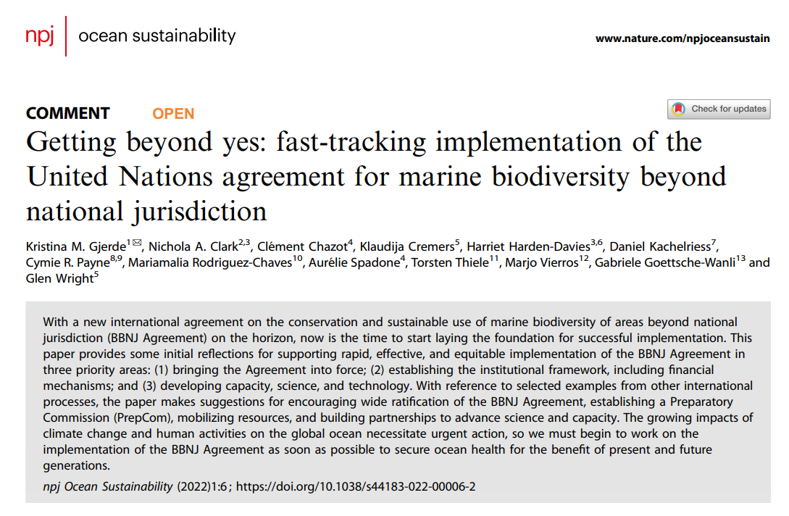
Implementation challenges
Cooperation and coordination with existing global, regional and sectoral bodies “not undermine”
Opt-out in voting
Capacity needs assessment
CBTMT
Clearing-house mechanism
Flag State responsibility
Monitoring, control and surveillance as part of management plan
Enforcement regime with authority and capacity to take action
Sanctions: inform national legal and administrative systems
https://www.nature.com/articles/s44183-022-00006-2

Slide 7
Klaudija Cremers
klaudija.cremers@iddri.org
@CremersK

