Slide 1
What are the outcomes of COP24?
Henri Waisman, IDDRI
Lola Vallejo, IDDRI
Daniel Buira, AILAC advisor
18/12/2018

Slide 2

What happened at COP24? Presidency Ambition Rulebook Finance

Slide 3

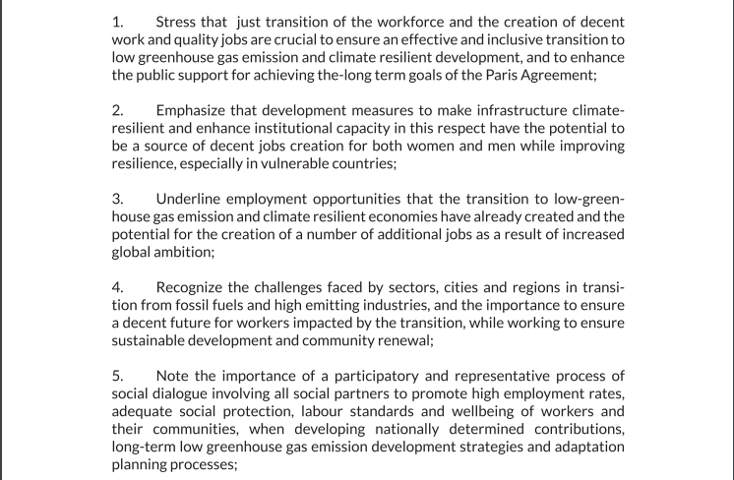
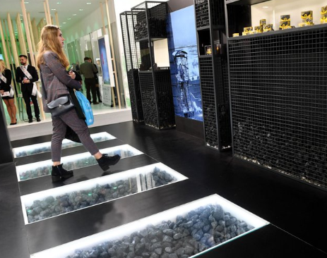

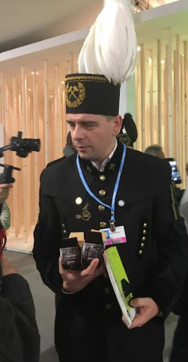
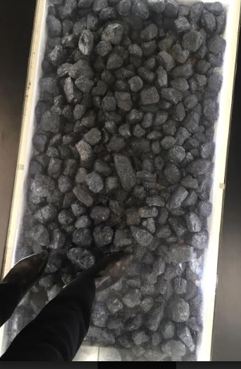

COP24 in Katowice
Notes:
Significant role of the Polish host.
Cultural importance of coal for the Silesia region.
Highlights tension between PL president (There is no plan today to fully give up on coal) and COP24 President
Explain why most emphasis put on agreeing Rulebook + showing progress on Finance, and less on progress made wrt Talanoa/ambition
Put front and centre the question of “Just Transition” → Silesia declaration made valuable points… but signed by only a quarter of delegations
This all shows how important a presidency is to give the “tone” of a COP…and glad that Chile/CR are organizing COP25 instead of Brazil

Slide 4



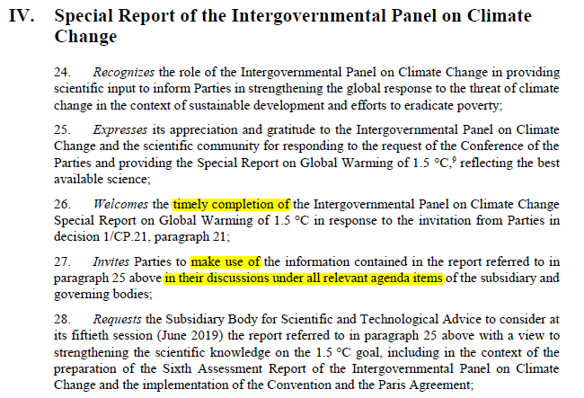
Ambition
IPCC SR 1.5°C
Notes:
Many back and forth… but excellent communication efforts from climate scientists from the IPCC
Dispiriting that the focus has been on « 12 years left to Armageddon » instead of 3 key simple messages underpinning « yes we can still limit GW to 1.5 »

Slide 5

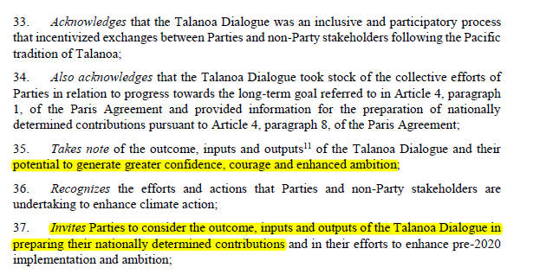
Ambition
Talanoa
Fiji- Poland Talanoa call for action (13 Dec)
We must fulfil the goals of the Paris Agreement.
We must achieve a just transformation towards a better world.
We must unlock the full potential of technology.
We must demonstrate bold leadership.
We must act together.
Notes:
Talanoa
A « spirit » rather than an actual process…
A pretty general declaration
And weak language in the decision
High Ambition Coalition declaration. But only Fiji

Slide 6
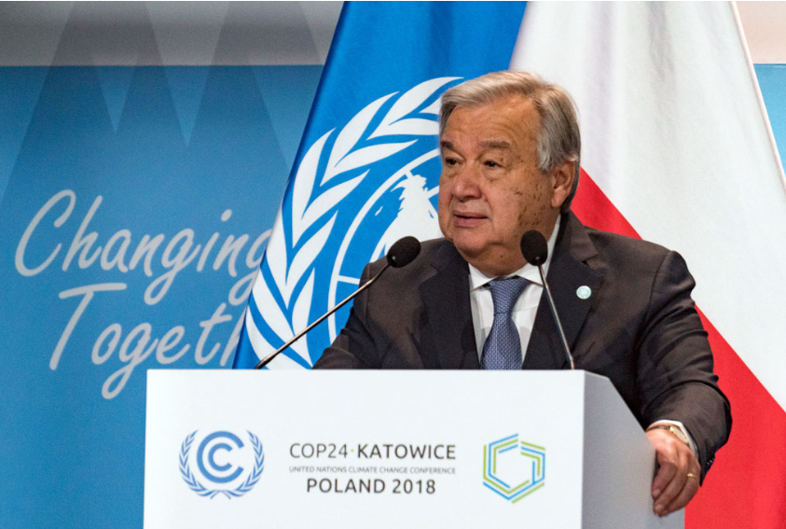
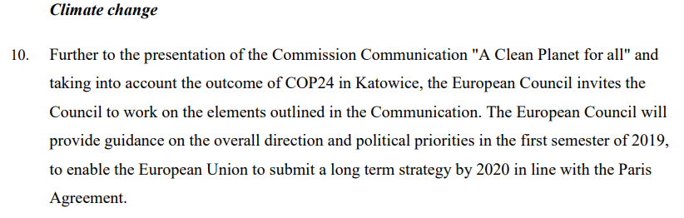

UNSG: the new face of ambition?
EU Council, 12-14 Dec conclusions
Notes:
Very high personal involvment of UNSG, convening Special Summit next year
Devil in the details… text implies merely participating is enough to demonstrate ambition
EU Council worryingly doesn’t plan to launch any conversation on NDC- only refer to the Commission’s LTS

Slide 7
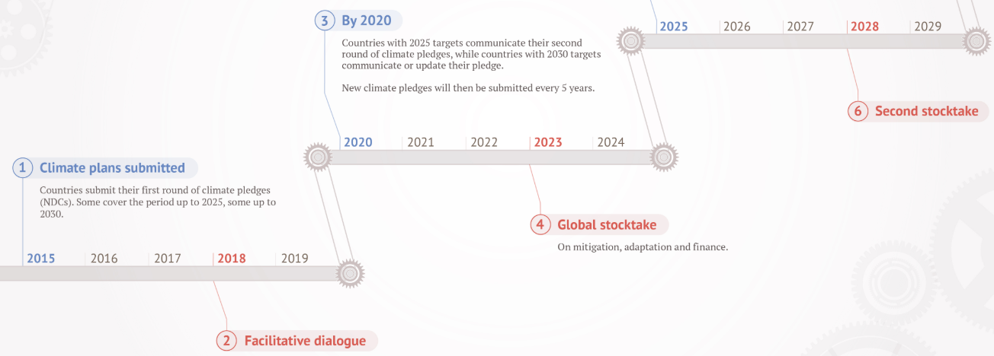
Why a Rulebook?

Slide 8
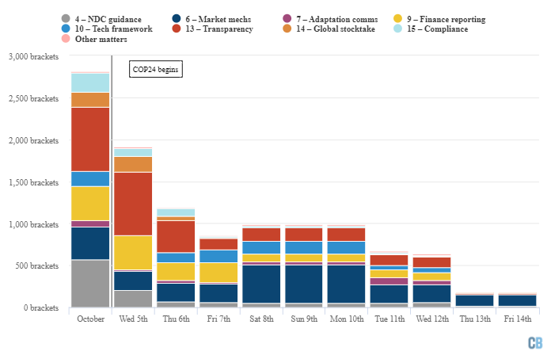
Progress on Rulebook
A mammoth task, and Herculean progress
Source: Carbon Brief

Slide 9
How good is the Rulebook?
ACCOUNTING: All countries “shall” use the latest emissions accounting guidance from the IPCC
COMMON TIMEFRAMES: Parties shall apply common time frames to their nationally determined contributions to be implemented from 2031 onward
FINANCE: Follows closely Paris Agreement text.
Countries shall biennially communicate as available projected levels of public finance to be provided (Art. 9.5)
Countries allowed to report the full value of loans as climate finance…
Art. 6 DEFFERED: Basic accounting rules to prevent “double counting” of emissions reductions could not be agreed.
FLEXIBILITY: Common system but flexibility for scope, frequency and level of detail of reporting, and in the scope of the review. Flexibility is self-determined but need to precise for which provision, clarify capacity constraints, and provide self-determined estimated time frames for improvements. … Link to capacity building.
INPUT FOR GST: Different deadlines for transitioning to the new system for developed countries (BR) 31/12/2022; and developing countries (BUR) 31/12/2024.

Slide 10
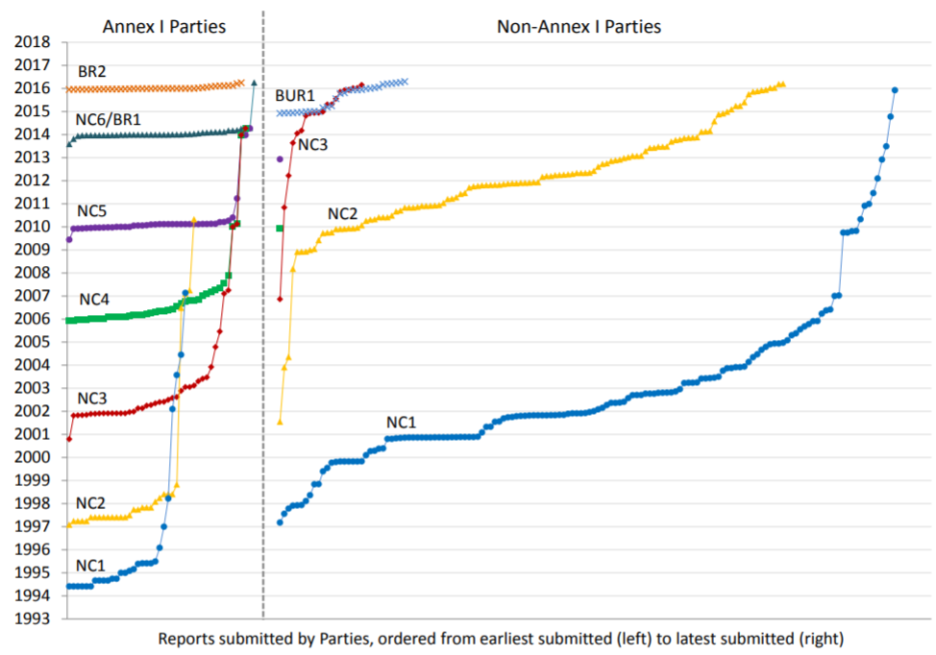
Reality check: where we’re starting from
Source: Briner&Moarif, 2016

Slide 11
Finance
Recognition that Finance plays a key role in enhancing ambition
Several announcements
Regular multilateral space for discussing progress on mobilisation of finance through the extension of the biennial high-level ministerial dialogue on climate finance
Enhance information on the finance provided through more granular reporting on sectors targeted, types of financial instrument used, and how contributors are ramping up their efforts over time
Provision of finance: new steps in right direction… all eyes on Macron + Holness
 | Pre-COP contrib. | Post COP pledges
Adaptation Fund | US$ 28.2m | US$ 129m
LDC Fund | US$ 1.33bn | US$ 28.2m
Green Climate Fund | US$10.3bn | Germany and Norway pledged to double their GCF contributions (€1.5bn and $516m respectively)

