Slide 1
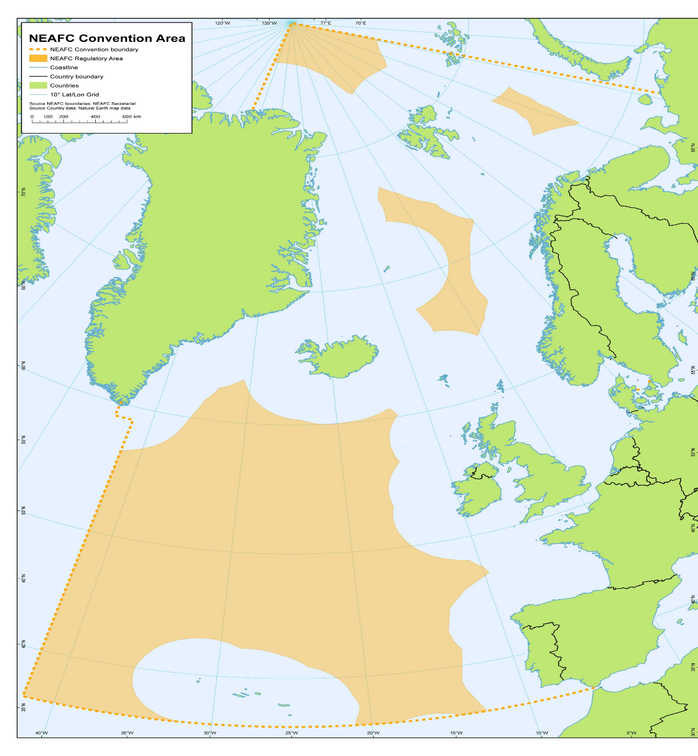
Integrating the GBF into intergovernmental marine-related organisations.
The North-East Atlantic.
Dr. Darius Campbell
Secretary of NEAFC

Slide 2
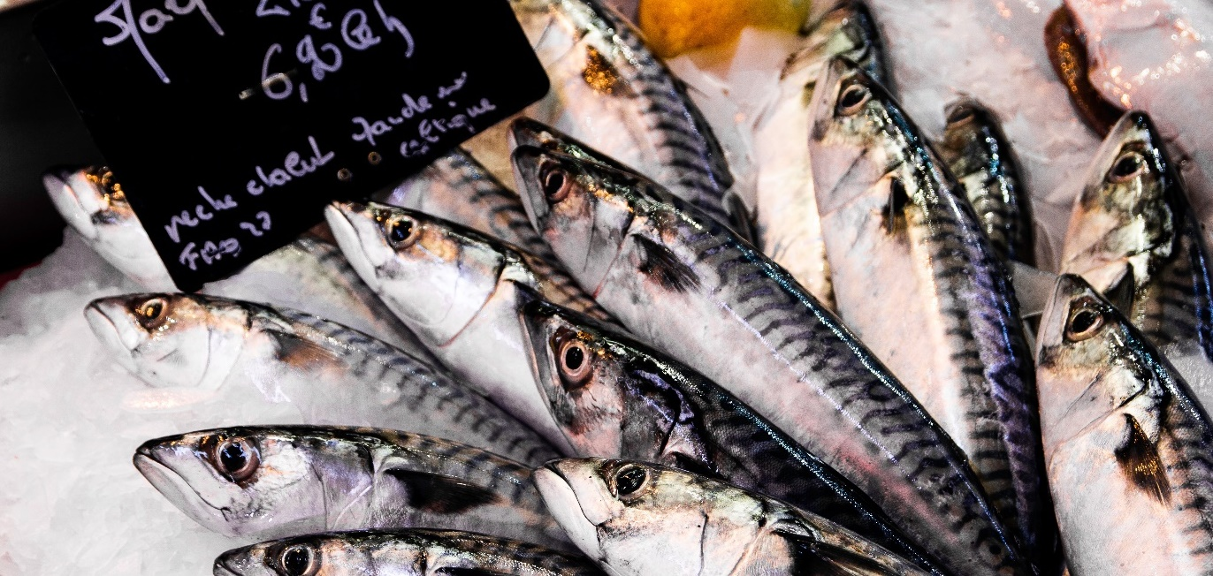
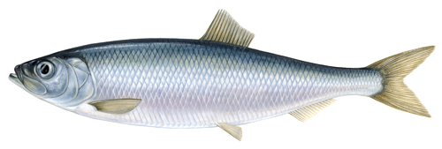
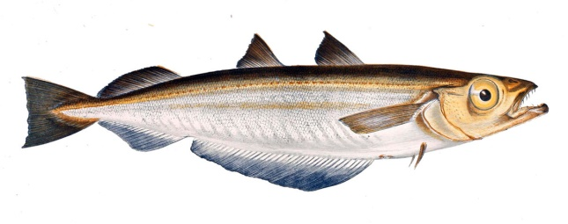
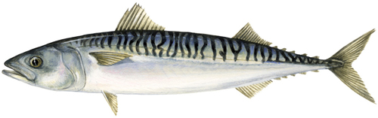
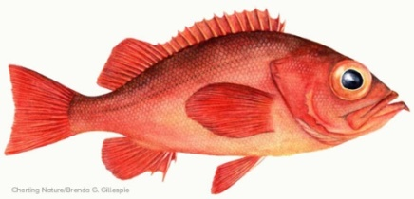
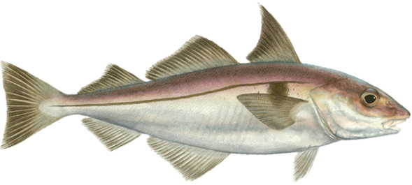
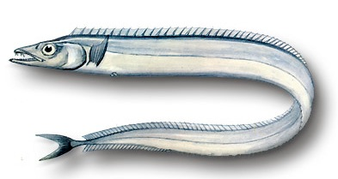
Convention Objectives

Slide 3

We are all busy with all our stuff!

Slide 4
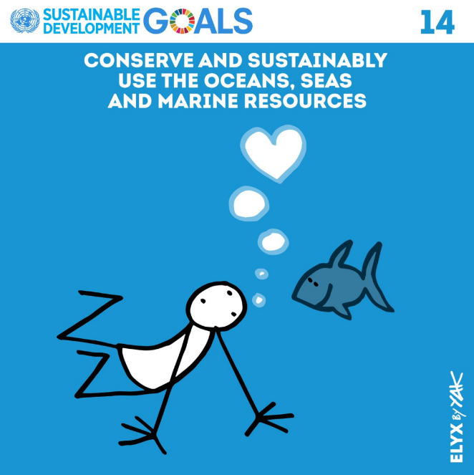

Common drivers
UNCLOS
UN Fish Stocks Agreement
UN Agenda 2030 and Sustainable Development Goal 14
UNCLOS BBNJ Implementation Agreement
CBD Global Biodiversity Framework

Slide 5


Sponsored by RO Korea, Japan and European Commission
15 RSOs out of 18 (20 rep)
15 RFBs out of 51
(17 rep)
18 EU/national gov/institutions
(53 rep)
10 UN orgs
(17 rep)
120
8 Int’l orgs
(13 rep)

Slide 6
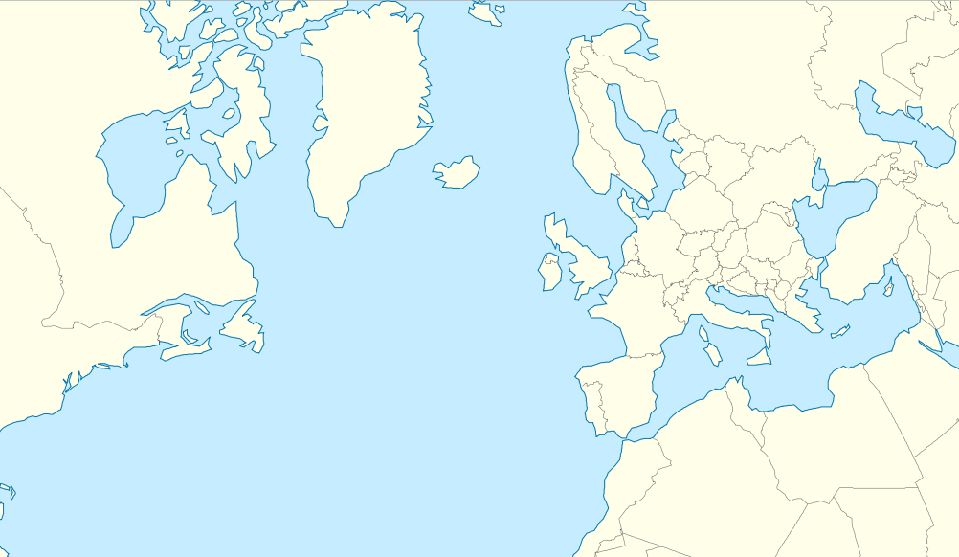



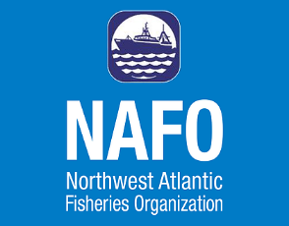




Regional discussion

Slide 7
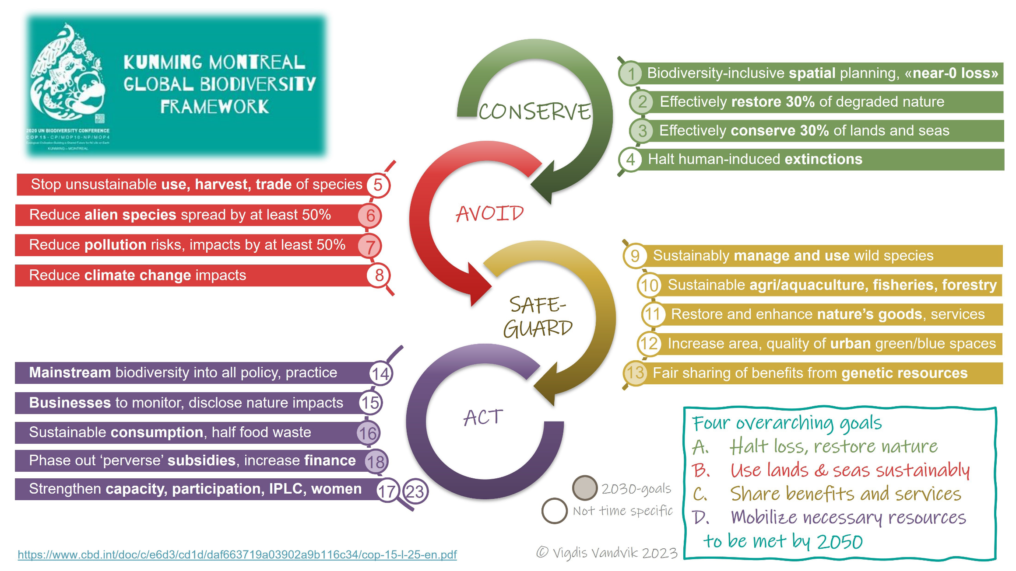
GBF Framework and targets

Slide 8
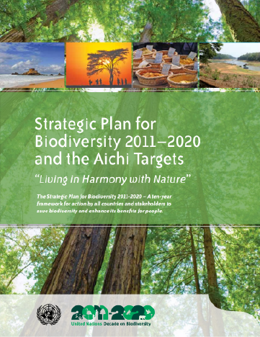

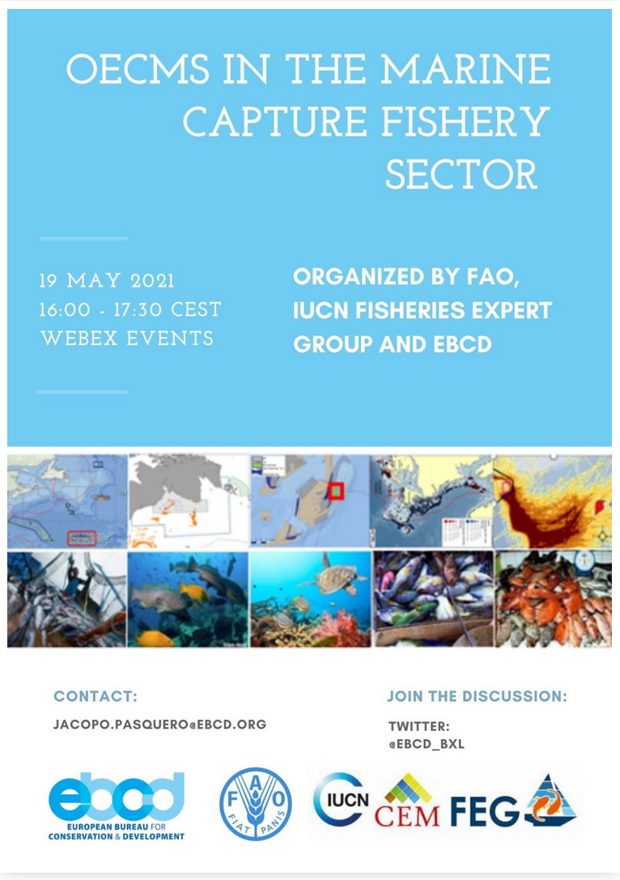
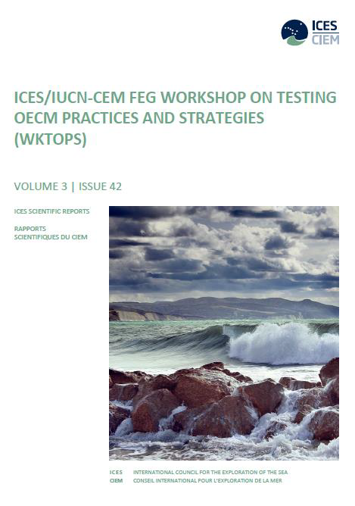
Other Effective area-based Conservation Measures (OECMS)
Photo Linda Snook / Wikimedia Commons
Notes:
The Convention on Biological Diversity (the CBD) has since 2018 recognised that measures other than protected areas can offer complementary area-based conservation.
These Other Effective area-based Conservation Measures (OECMs) are provided by sectors such fisheries.
In the sea they can provide similar conservation benefits as those aimed at by the more familiar Marine Protected Areas (MPAs).
CBD agreed set of criteria so that an OECM designation can demonstrate that it actually leads to biodiversity benefits over the longer term.

Slide 9
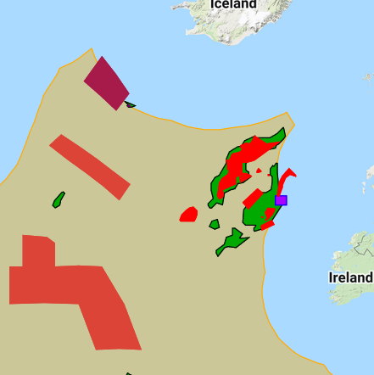
Other Effective area-based [Conservation?] Measures
Irminger Sea redfish closure 2022-2024
Blue ling closure
Rockall haddock box
Gill net ban in less than 200m
VME Recommendation

Slide 10
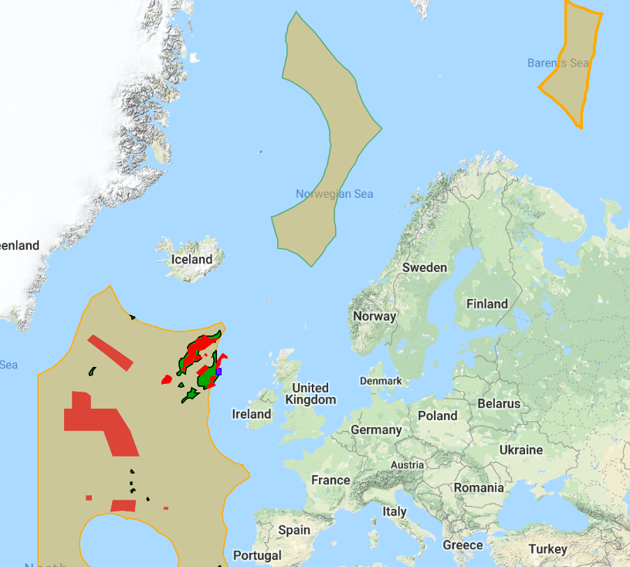
A measure focused on conservation of living marine resources
Restricted bottom fishing areas
Restricted bottom fishing areas
Existing bottom
fisheries areas
Existing bottom
fisheries areas
VME closures
Continued fishing in (green) existing bottom-fisheries areas
VME Bottom fishing closures (red)
Restricted bottom fishing areas - only to open after assessment (buff).
VME closures

Slide 11
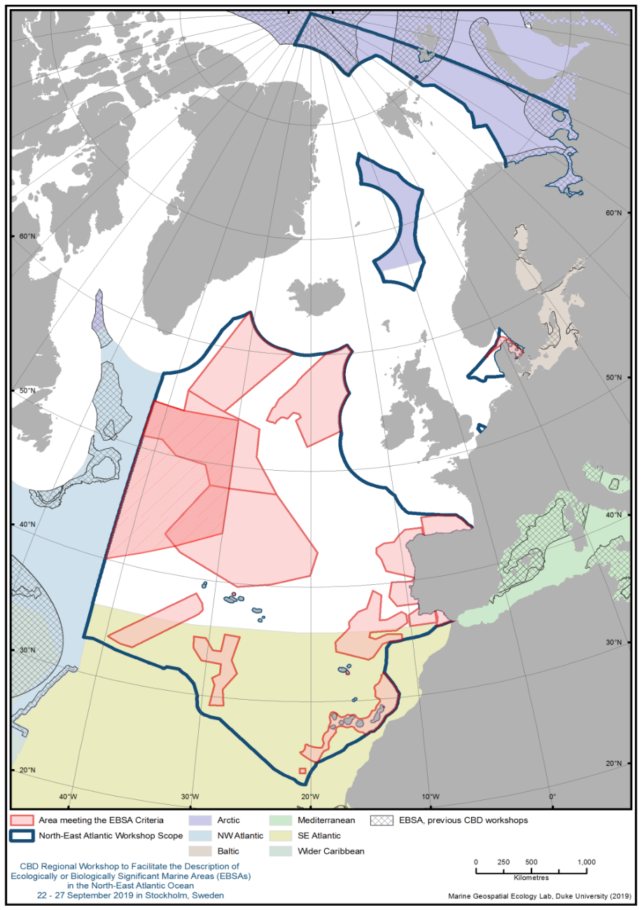
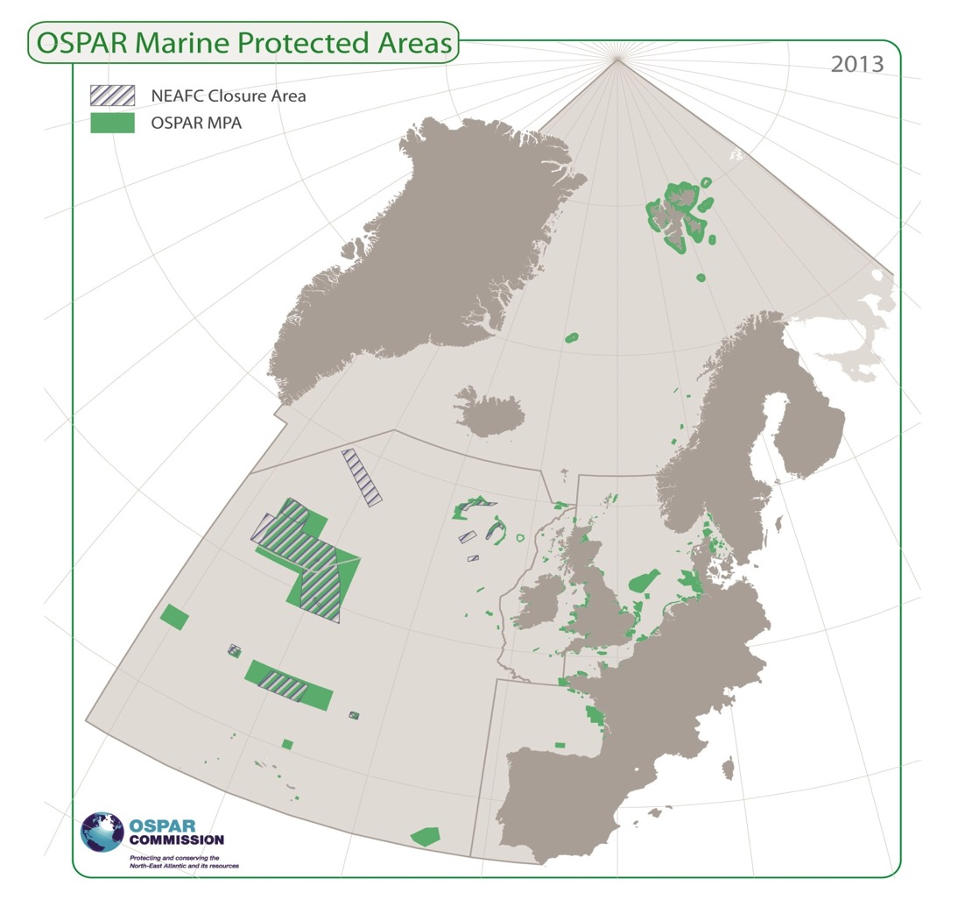
Overlap of measures and biodiversity in 3D
Notes:
The science questions arise on the links between, say the seabed ecosystems and the ecosystems of the pelagic waters above.
For organisations such as NEAFC, this question is linked to decisions on trading off sustainable use, with its economic and social benefits, against environmental benefits.
So, for instance, what sort of activity can I do on the seabed, and how much, without significantly impacting the ecosystems above.
To decide this, we need not just the theoretical descriptions of the links between the ecosystems. We also need sufficient quality and specificity to make management decisions.

Slide 12
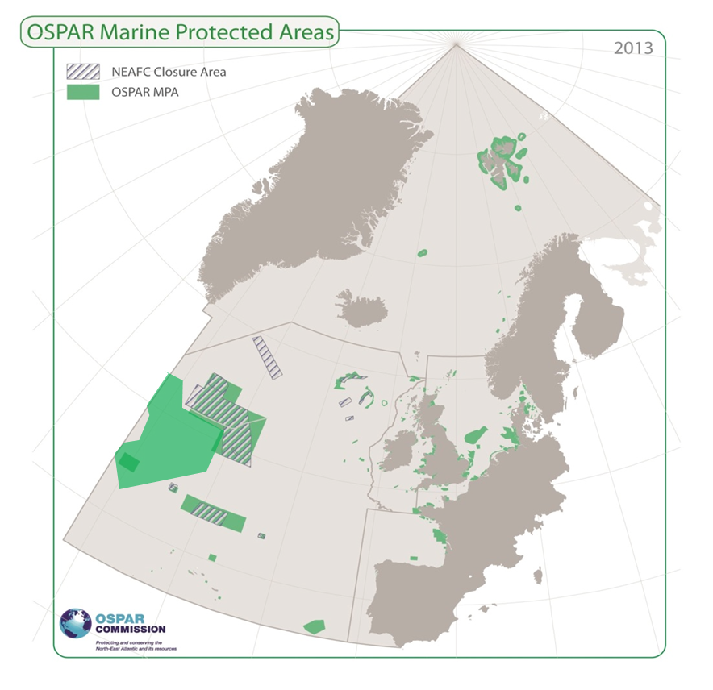
NEAFC and OSPAR meet under the Collective Arrangement
Monitoring and assessment
Overlap of area based designations
Bycatch
Ecosystem Approach

Slide 13
Best independent wholistic scientific advice

Slide 14
Sustainable high quality food protein

Slide 15


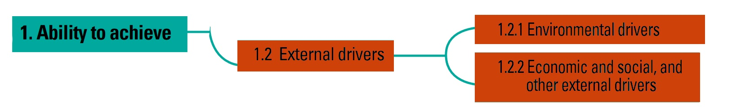
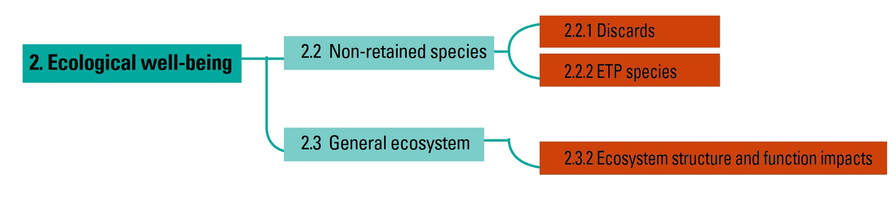
ICES: trial application of the FAO EAF implementation monitoring tool to NEAFC
Some implicitly incorporated
Not incorporated
Requests currently running
Requests currently running
Set objectives

Slide 16

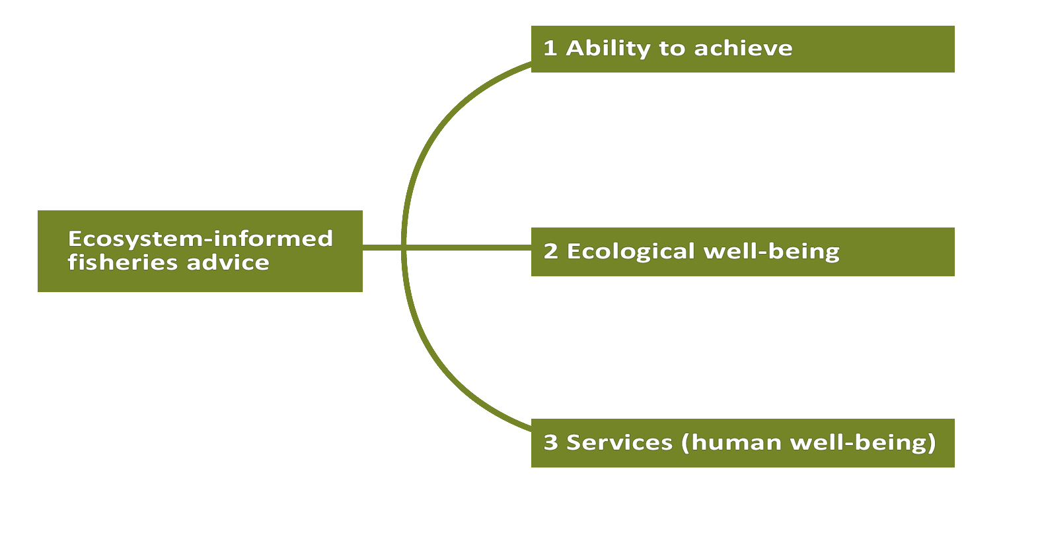



ICES: ecosystem-informed fisheries advice

Slide 17
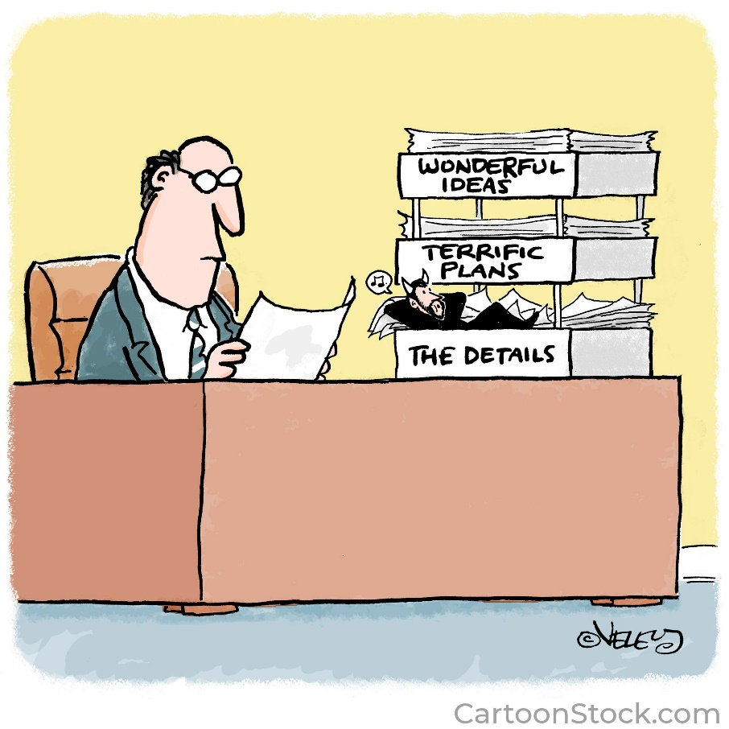
Implementing Ecosystem Approach in reality
Objectives with regard to ecosystem structure and function
Bycatch - Sharks and Deep Sea Sharks, Rays Chimaeras
Bird bycatch
Monitoring biodiversity response to measures
Specific advice to managers

Slide 18
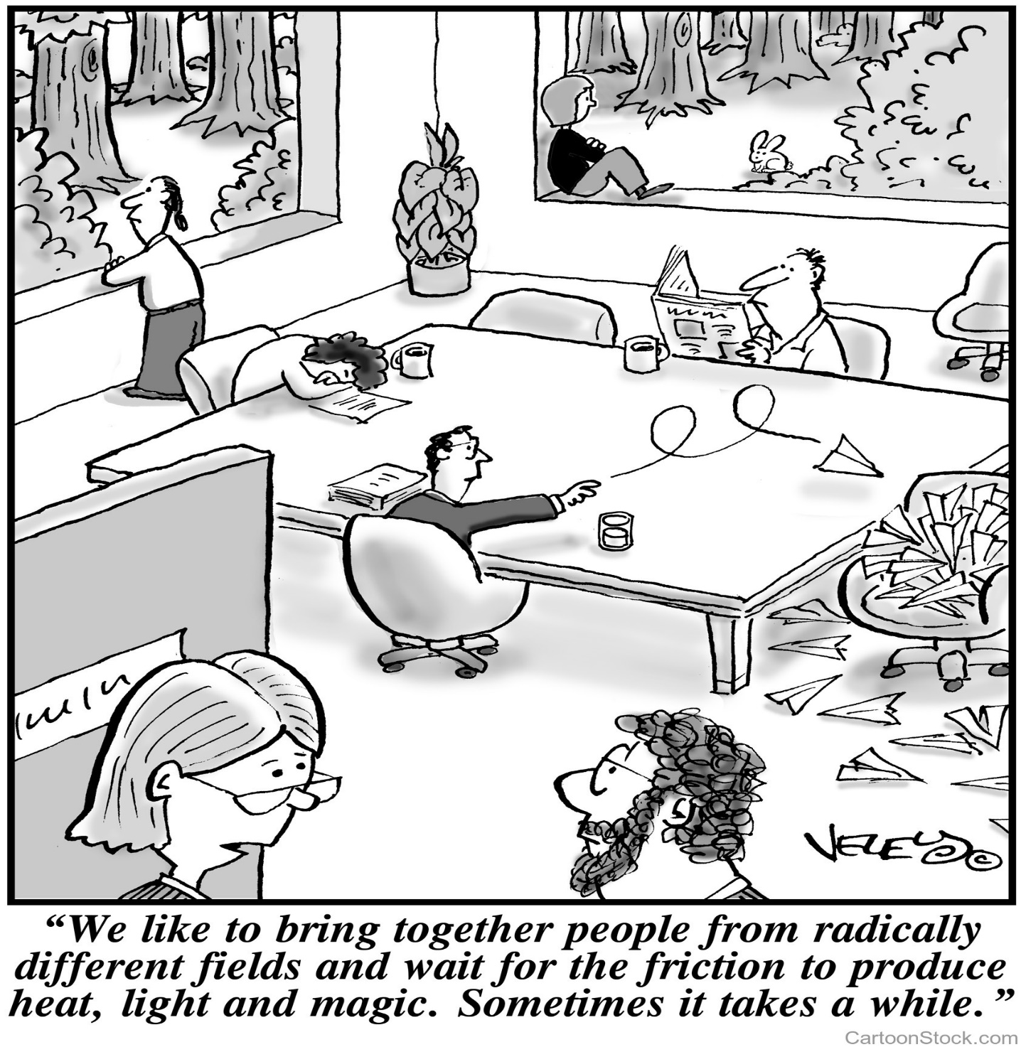
Next Steps
Engage
Engage
Engage

