Slide 1

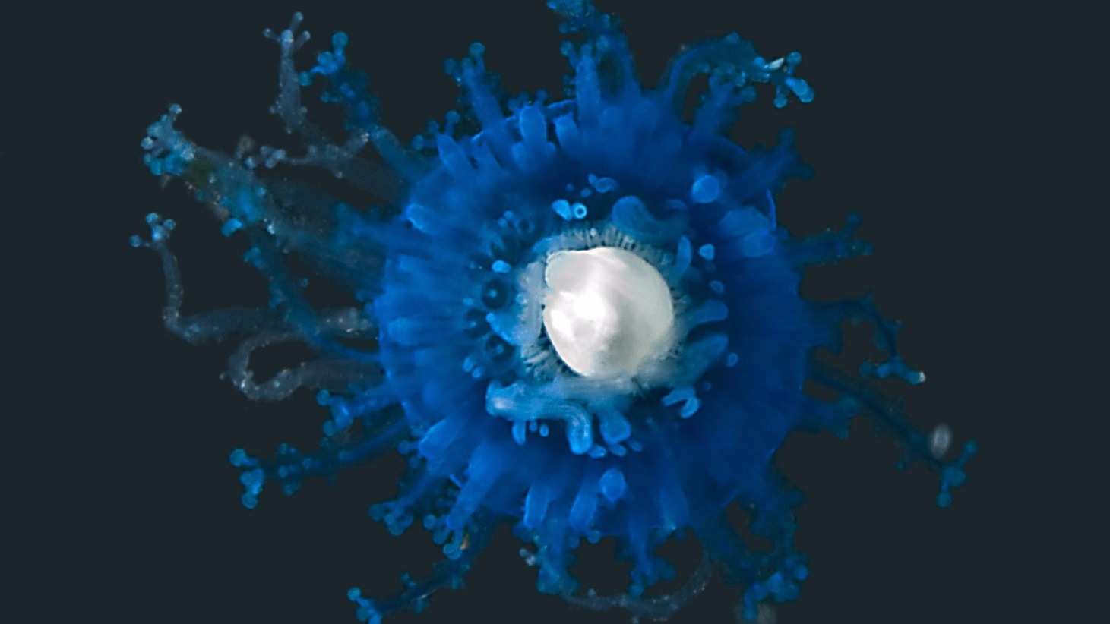
World Heritage in the High Seas : An Idea Whose Time Has Come
© Sönke Johnsen

Slide 2
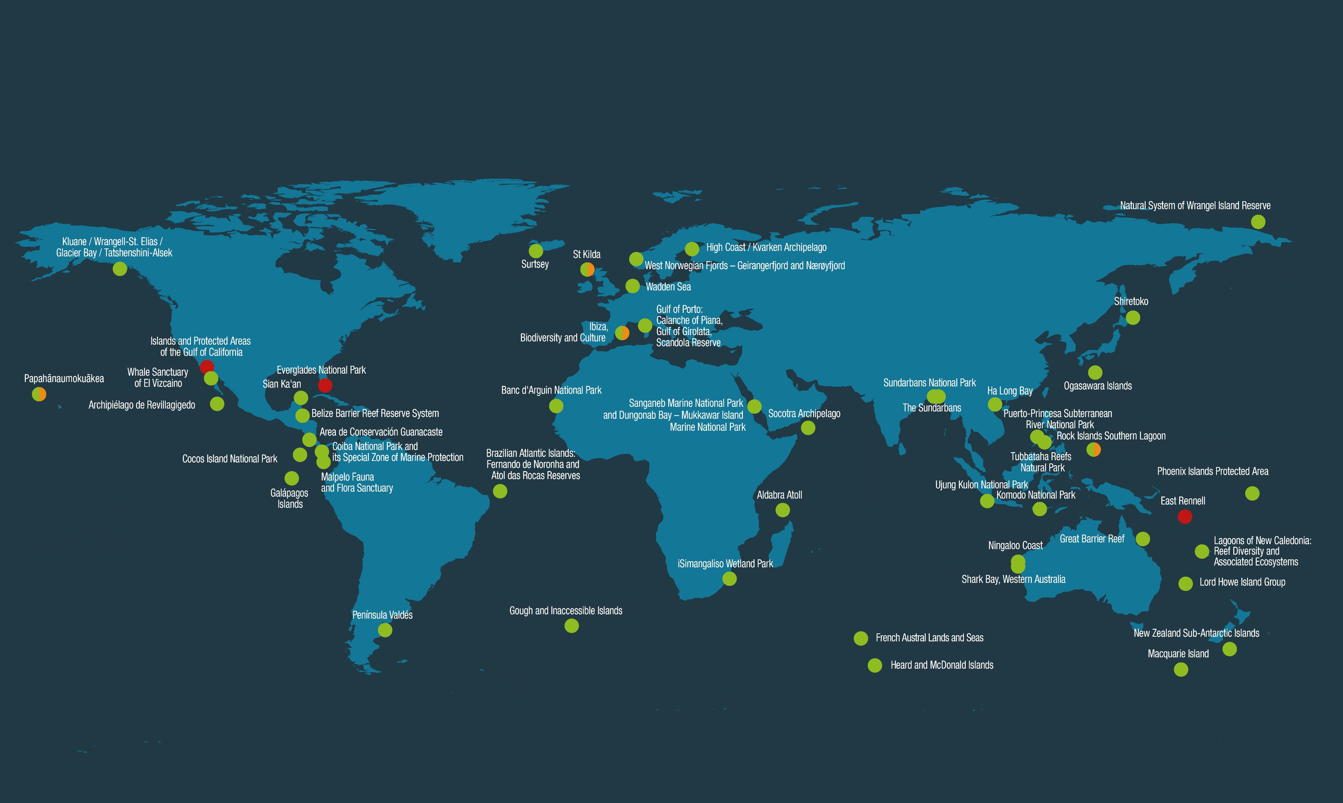
50 flagship marine protected areas of Outstanding Universal Value inscribed on the World Heritage List

Slide 3
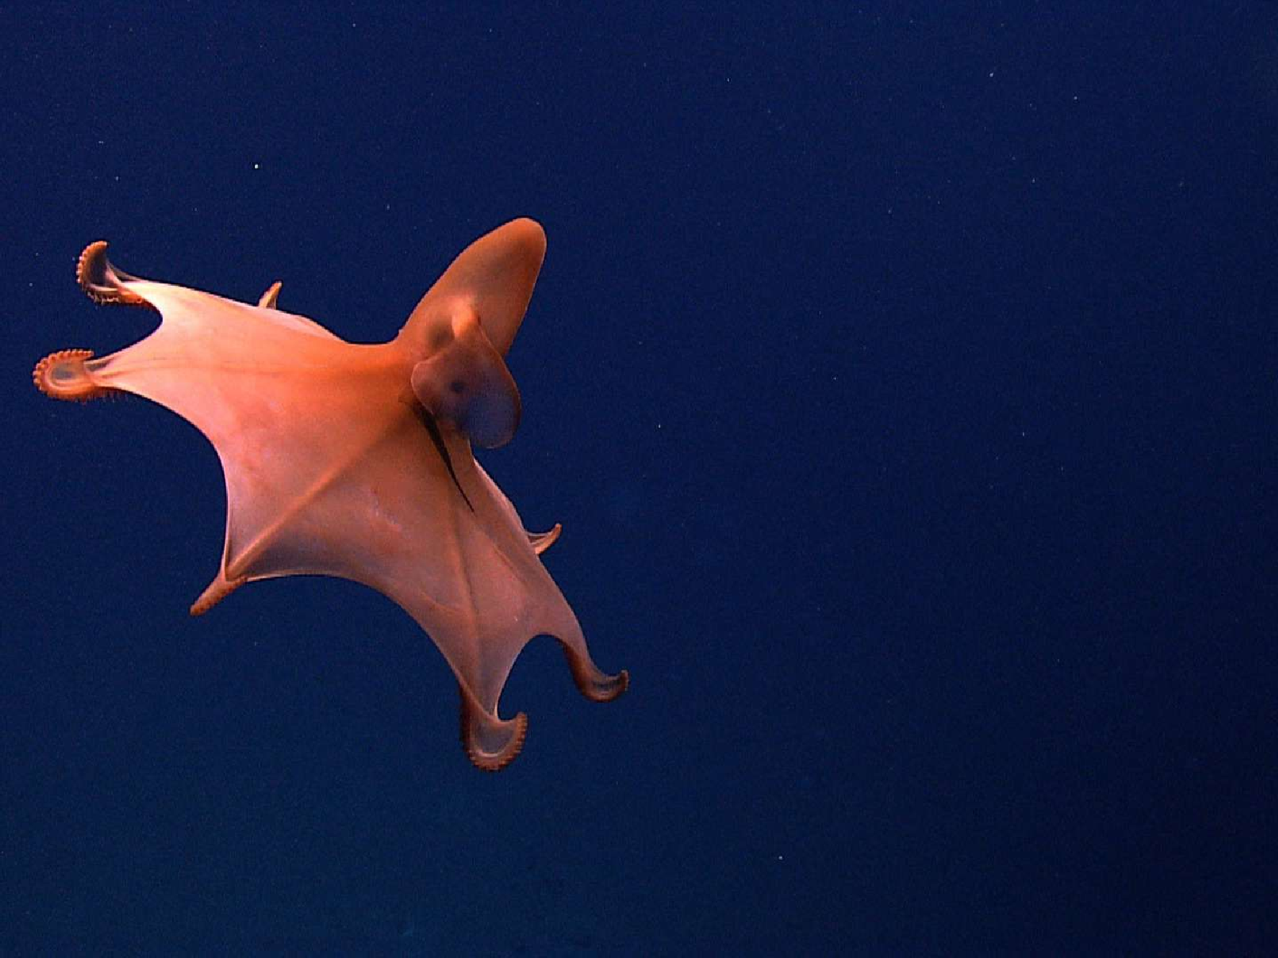
World Heritage
Criteria (natural):
Phenomenon/area of exceptional natural beauty;
Outstanding major stages of Earths history
Iconic ecological/biological processes
Unique natural habitats and biodiversity

Slide 4
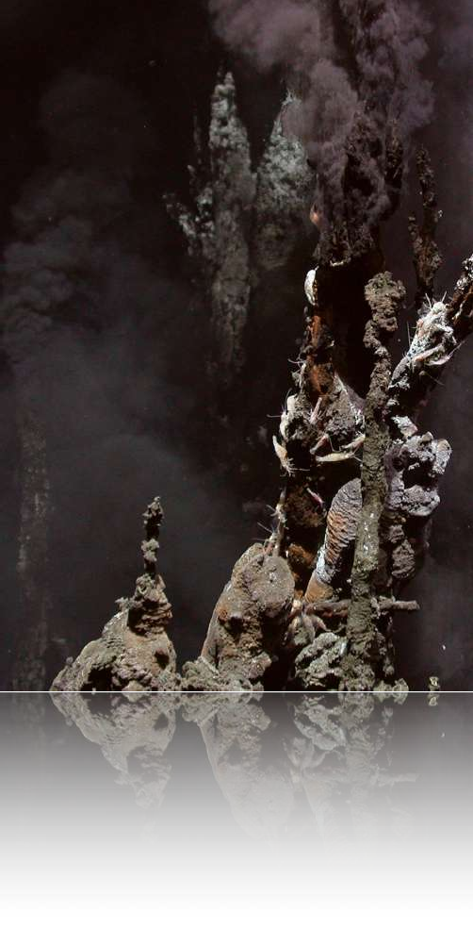
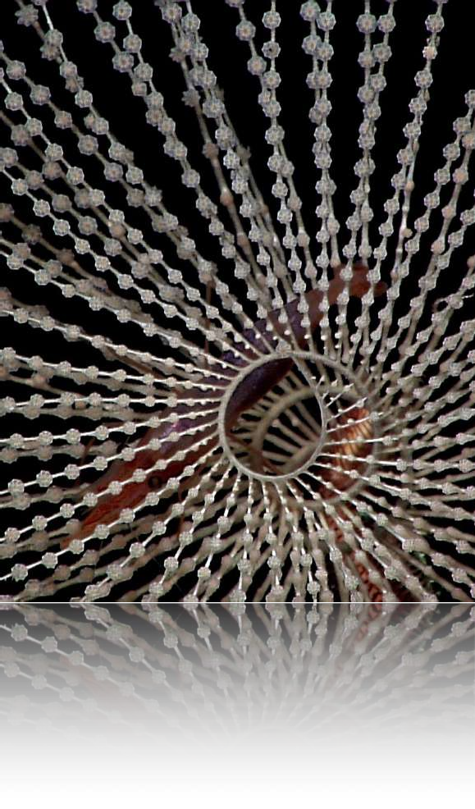
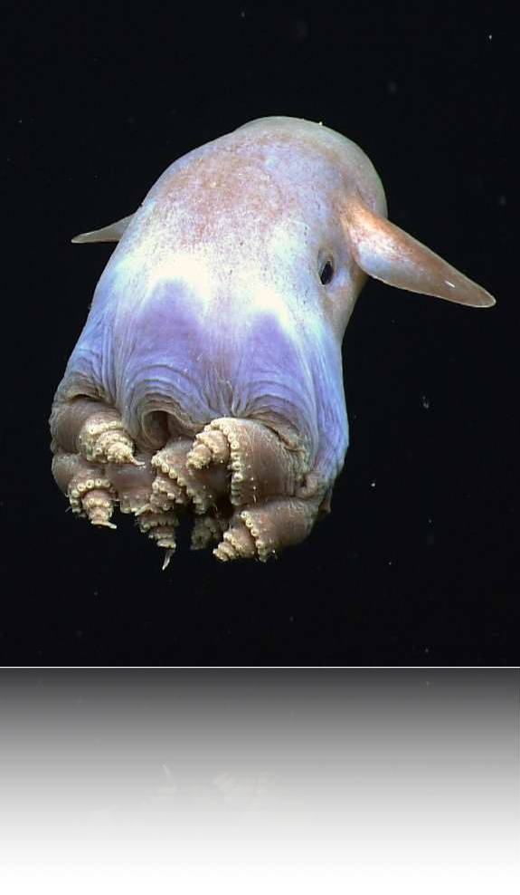
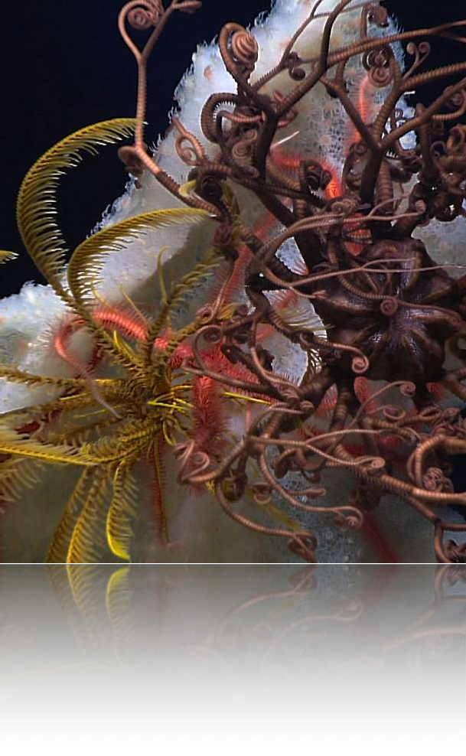
Sunken fossilized islands…
Giant volcanoes forming vast seamounts… A floating golden rainforest…
60 metre high white spires of rock…

Slide 5
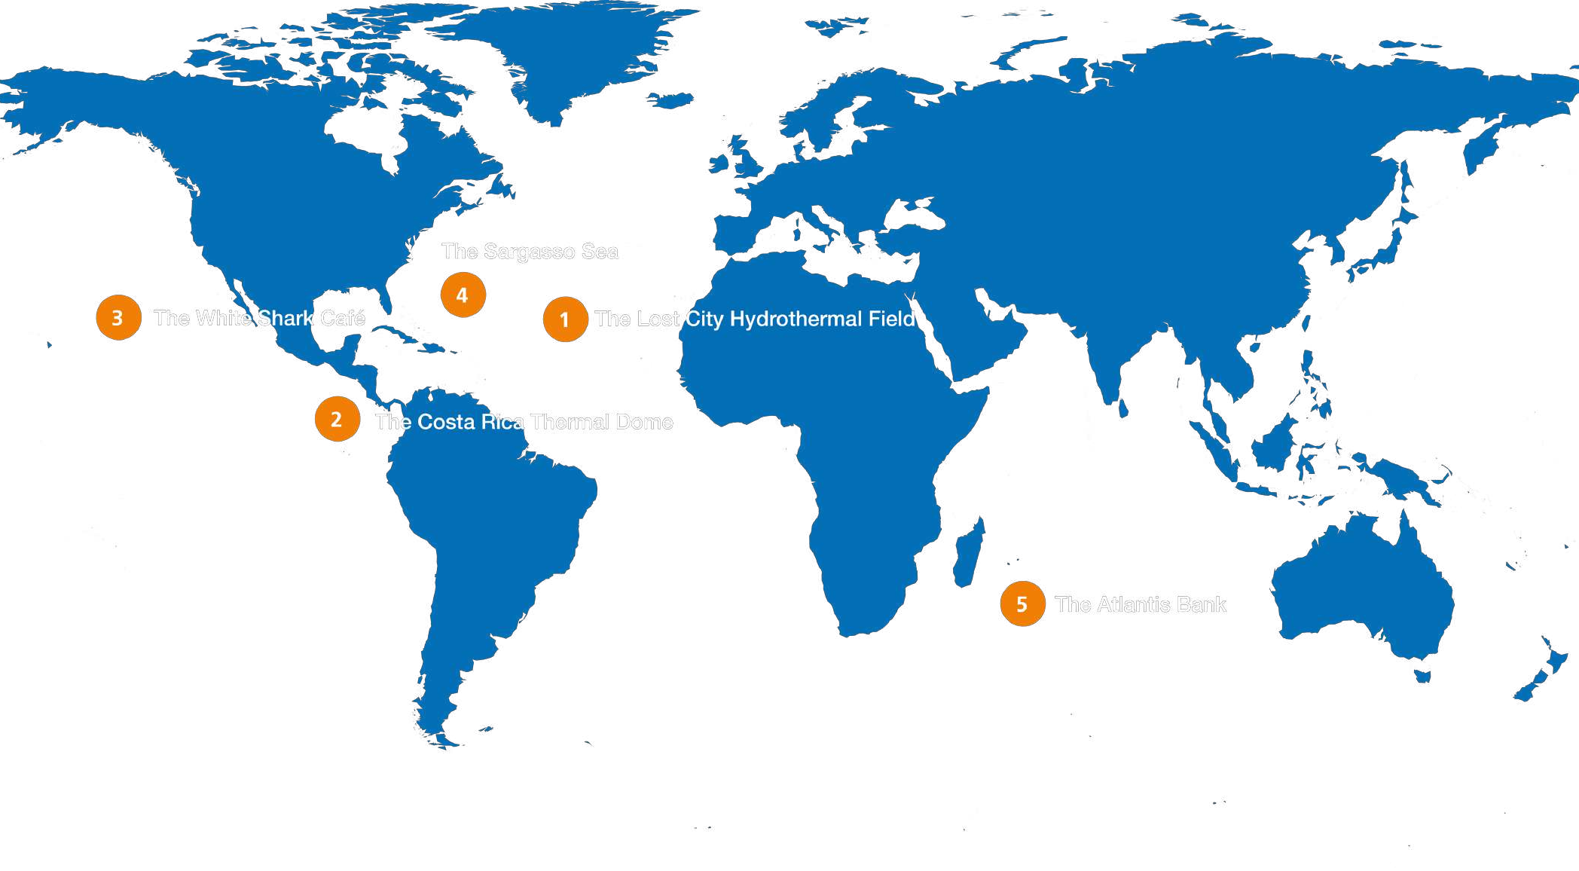

Slide 6

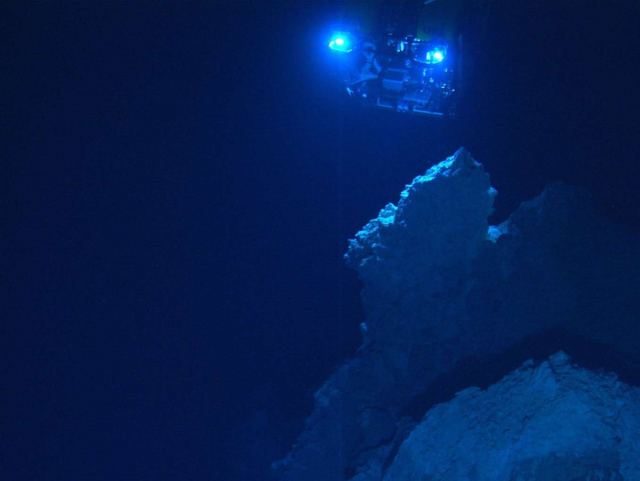
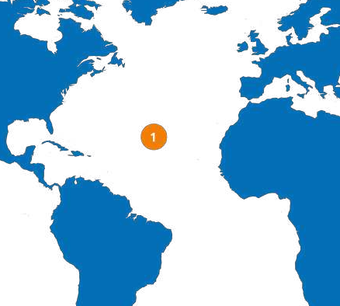
The Lost City Hydrothermal Field
Discovered in 2000 and unlike any other ecosystem yet known on Earth.
Sits at 800m depth with serpentinite
cliffs weep hot fluids producing delicate finger- like outgrows and chimneys which has been going for
120,000 years.

Slide 7
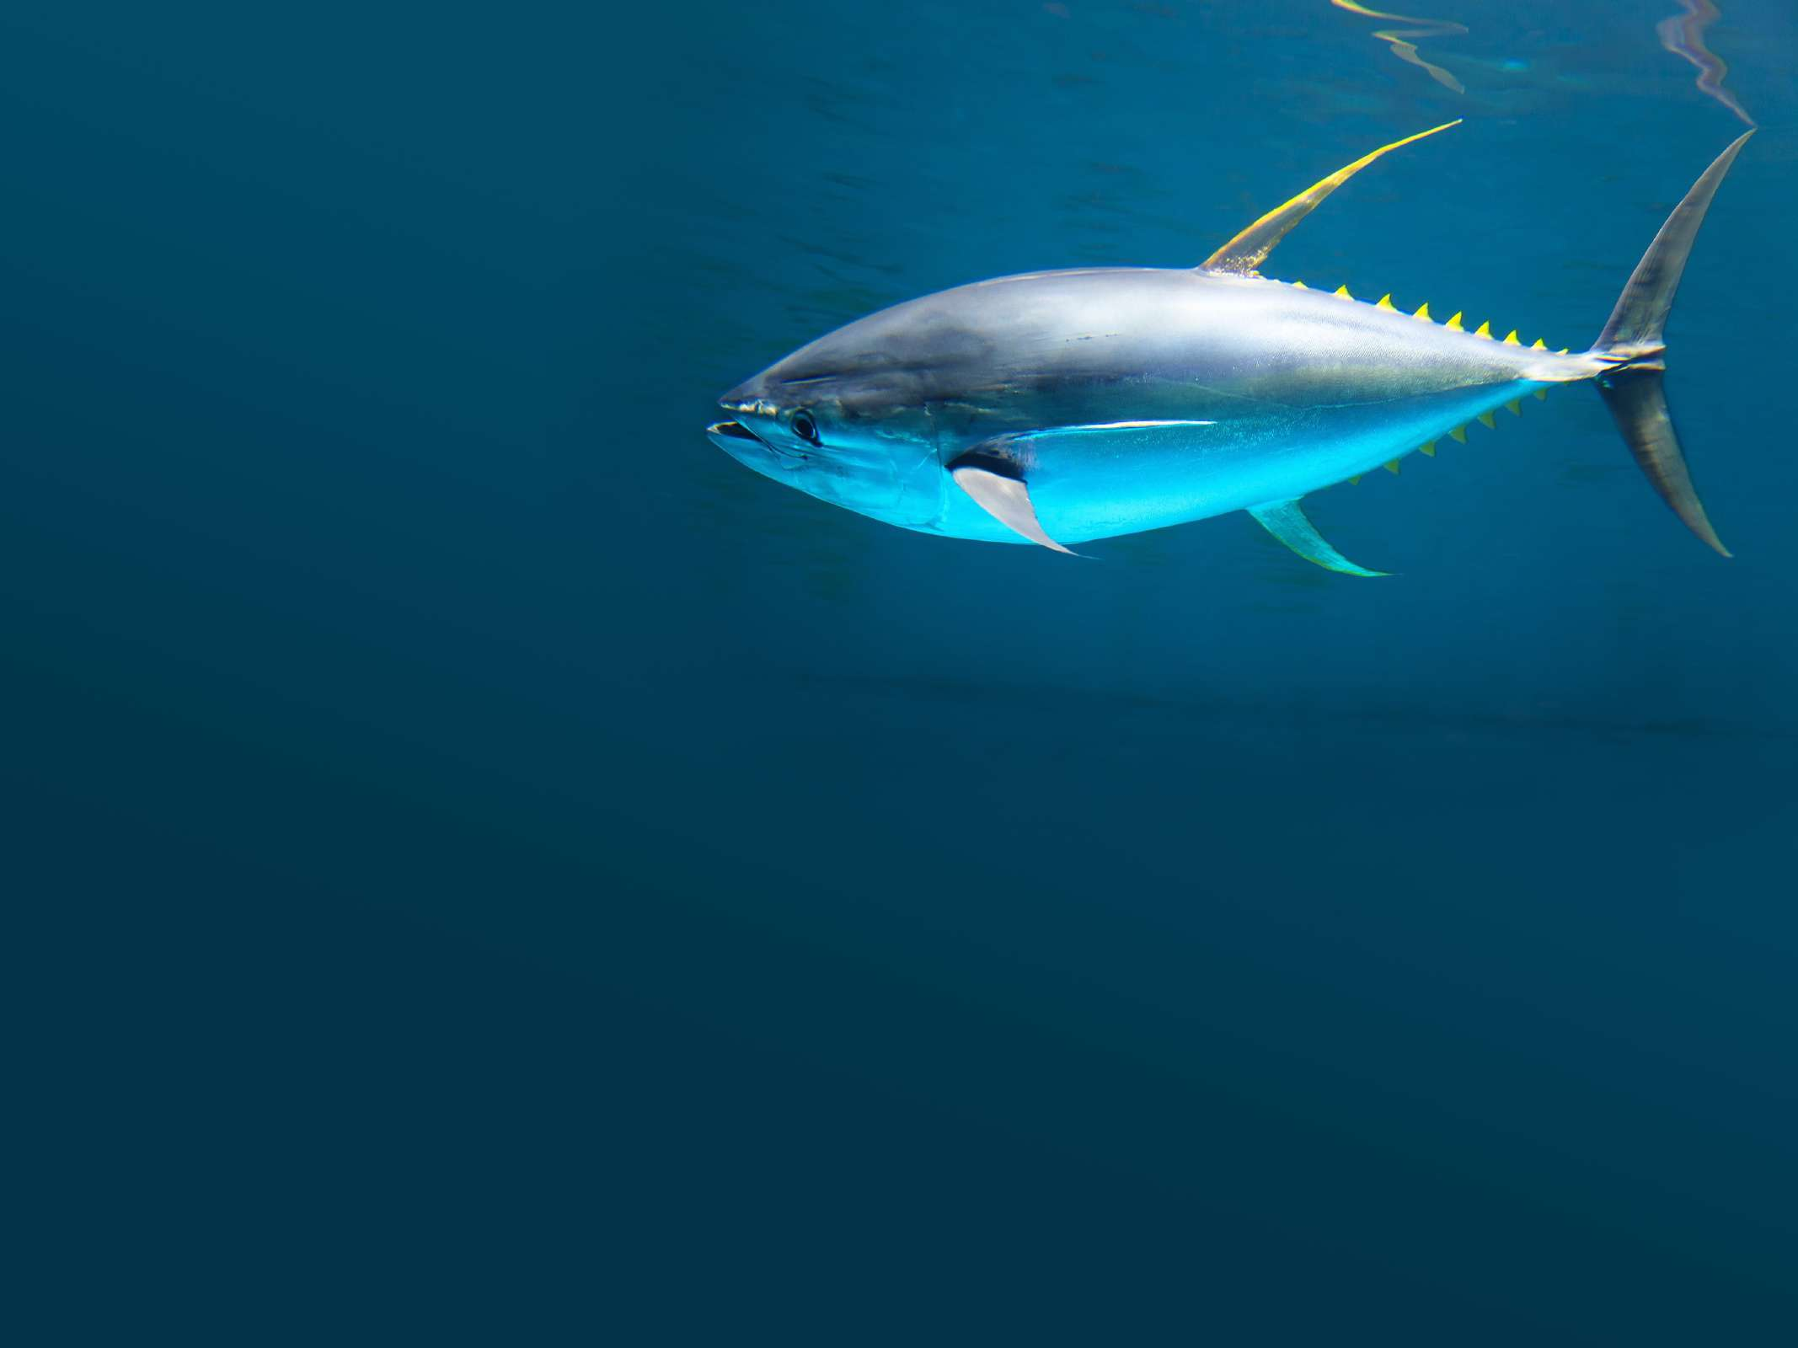
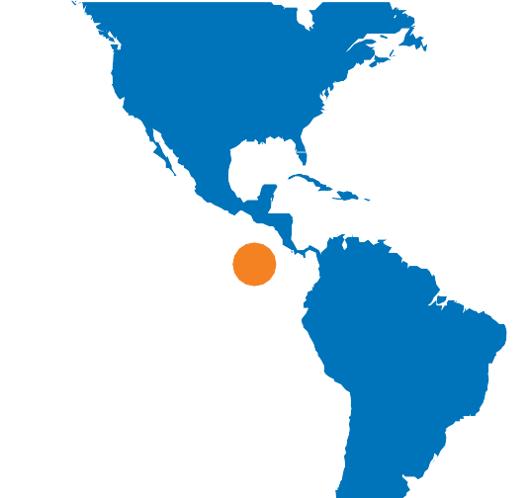
Costa Rica Thermal Dome
2
First observed in 1948, the 500km wide oceanic oasis is created through an interaction between wind and currents which promotes blooms of surface plankton that nurture a globally exceptional environment for
highly migratory marine predators.

Slide 8
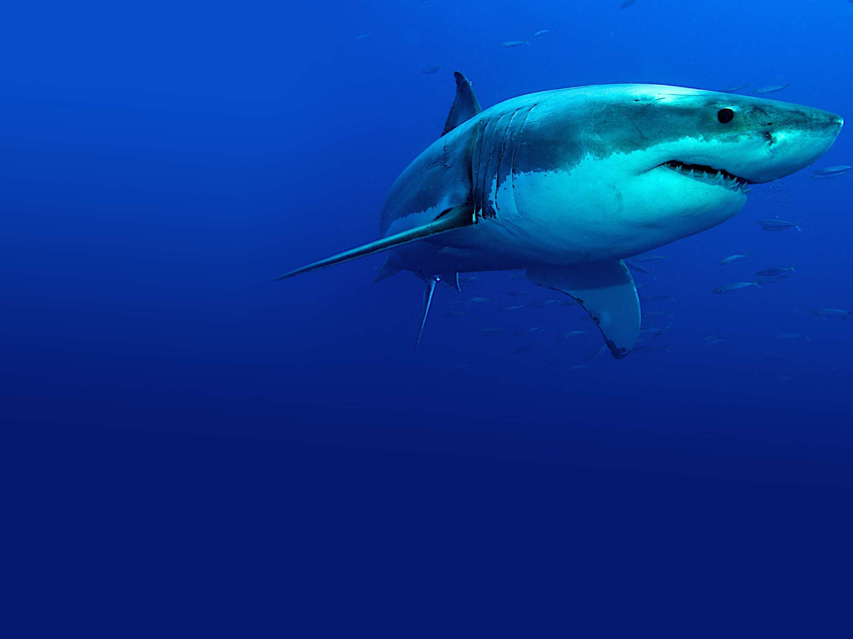
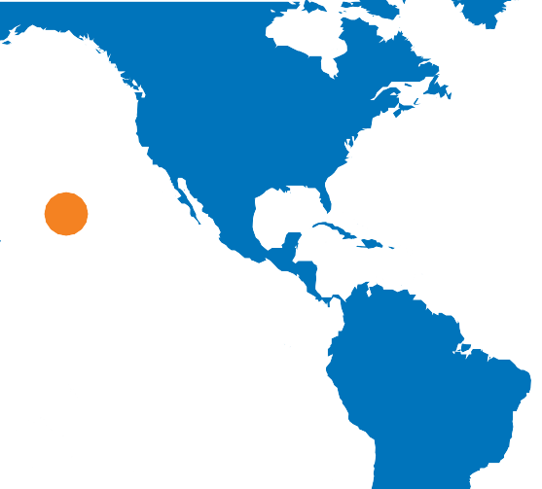
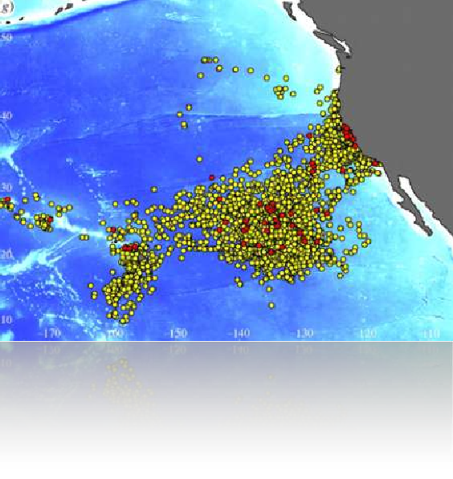
White Shark Café
3
Halfway between North America and Hawaii,
white sharks
congregate to this spot, likely to feed and mate.
No other place like it is known on Earth.

Slide 9
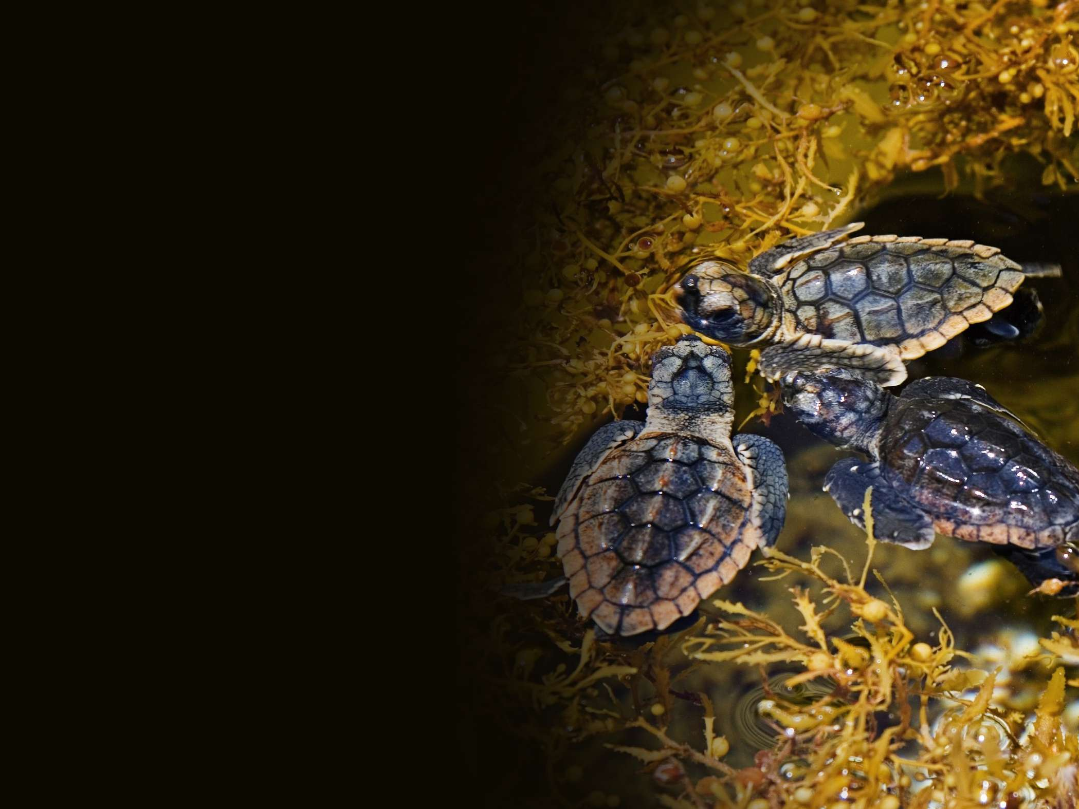
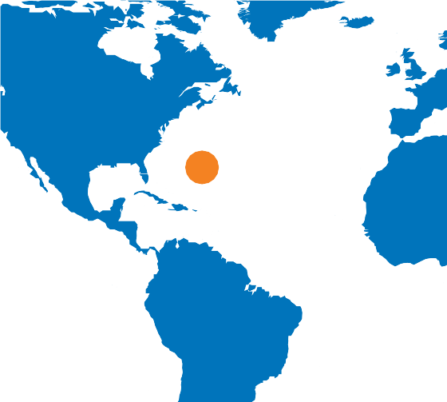
Sargasso Sea
4
First viewed by Columbus on his first voyage in 1495
and has been a place of myth and legend ever since. Commonly called the
Golden Rainforest
of the Ocean, it is home to an
iconic pelagic ecosystem built around the floating Sargassum seaweeds, the worlds’ only holopelagic algae.

Slide 10
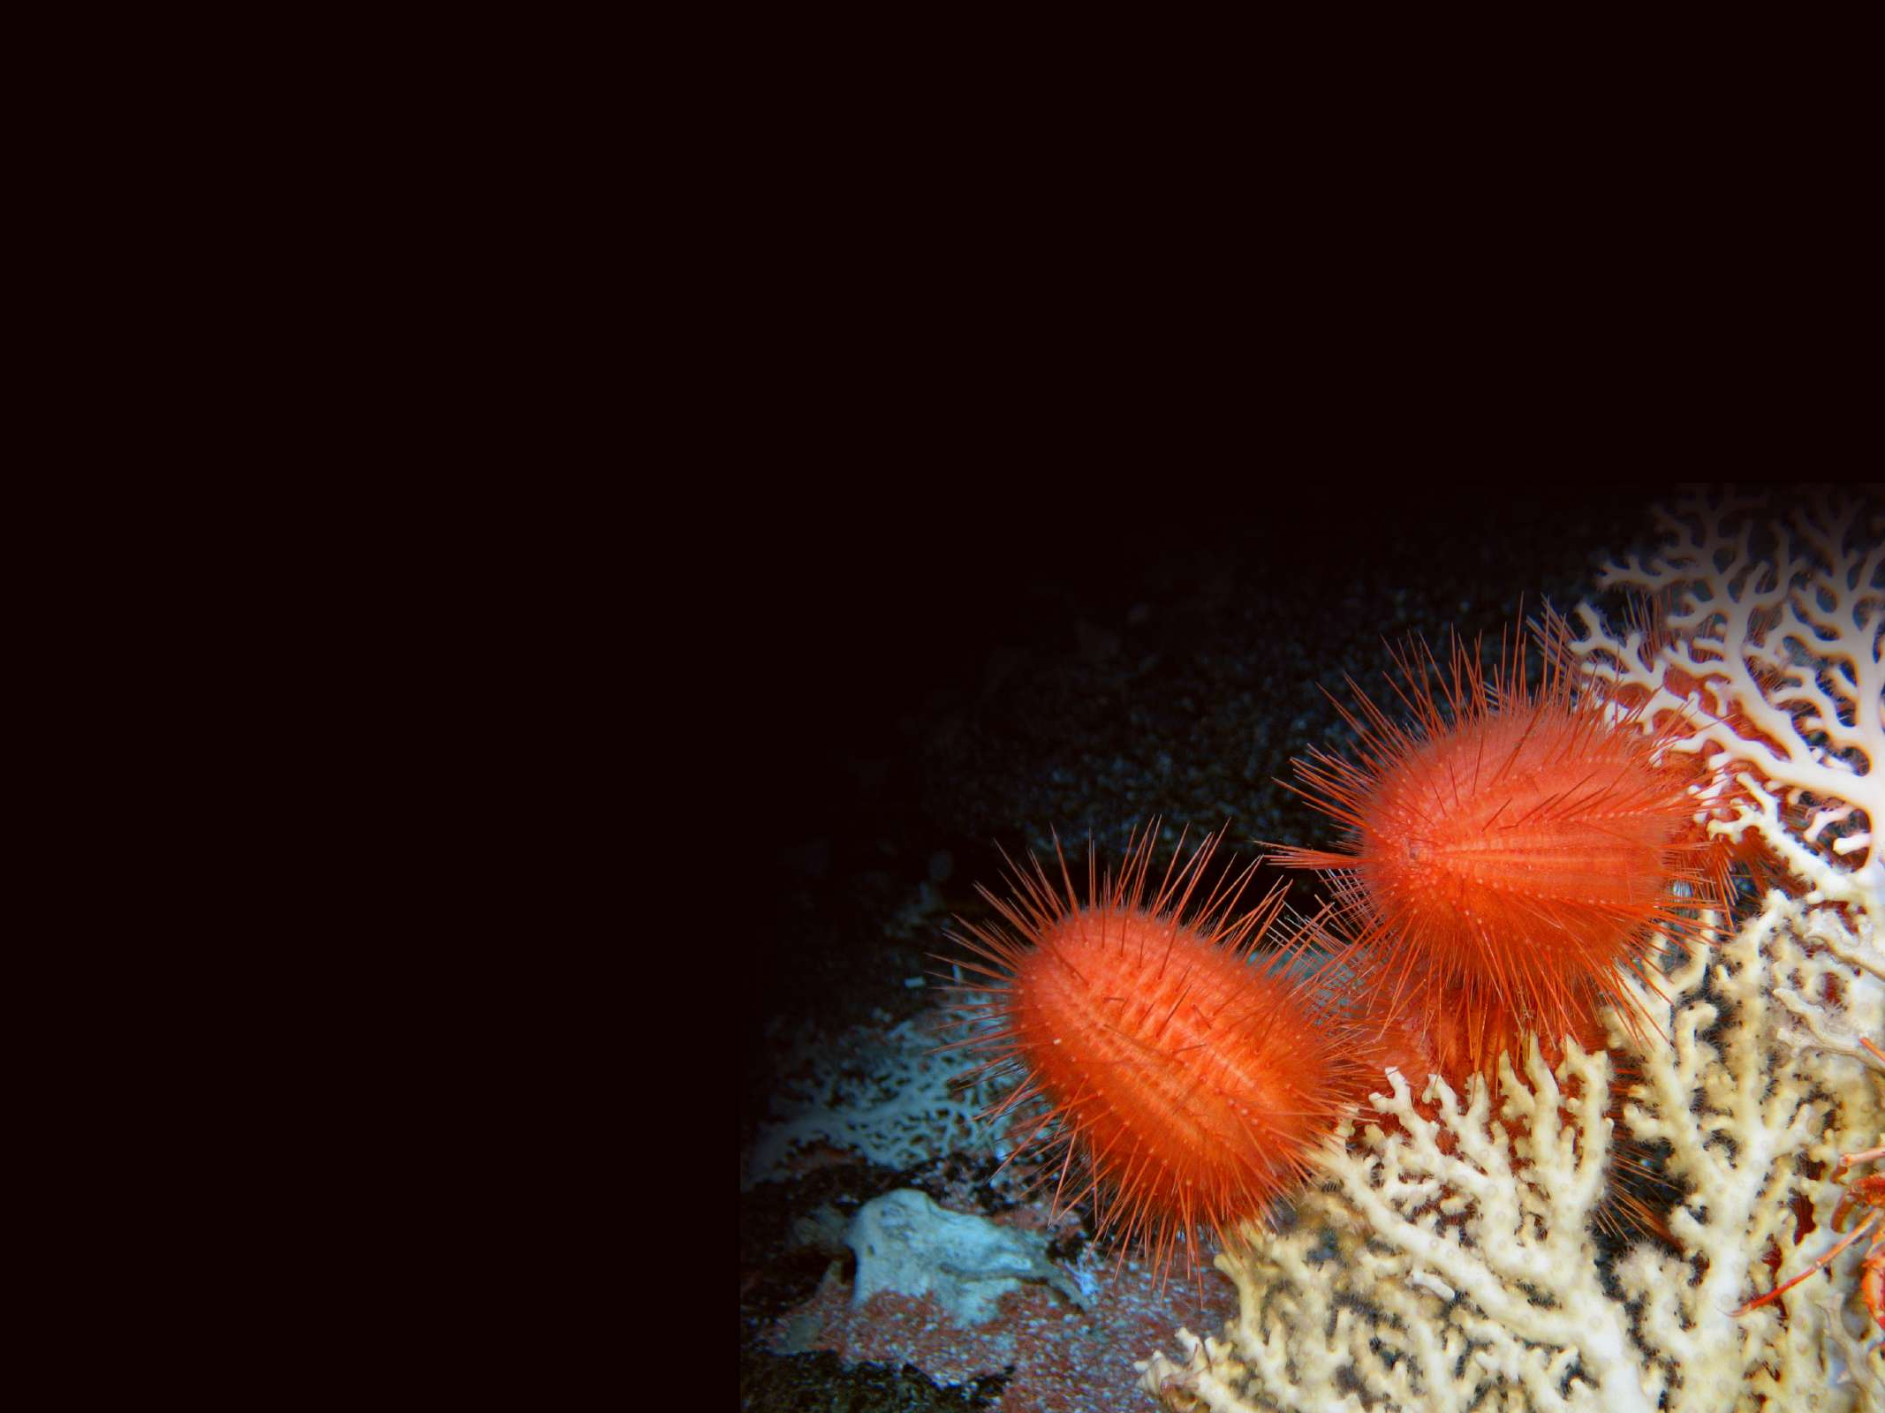
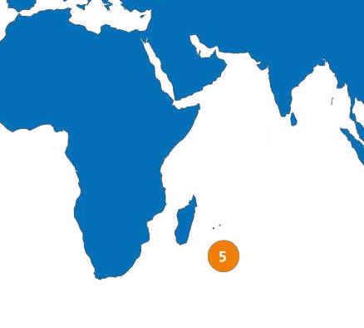
Atlantis Bank
Uniquely remarkable tectonic featured created by uplift
Southwest Indian Ridge
that harbours highly diverse and stunning
coral gardens and
complex sea-cliff deep sea communities
like armchair sized sponges, predatory sea spiders and many unknown species yet to be named by science.

Slide 11
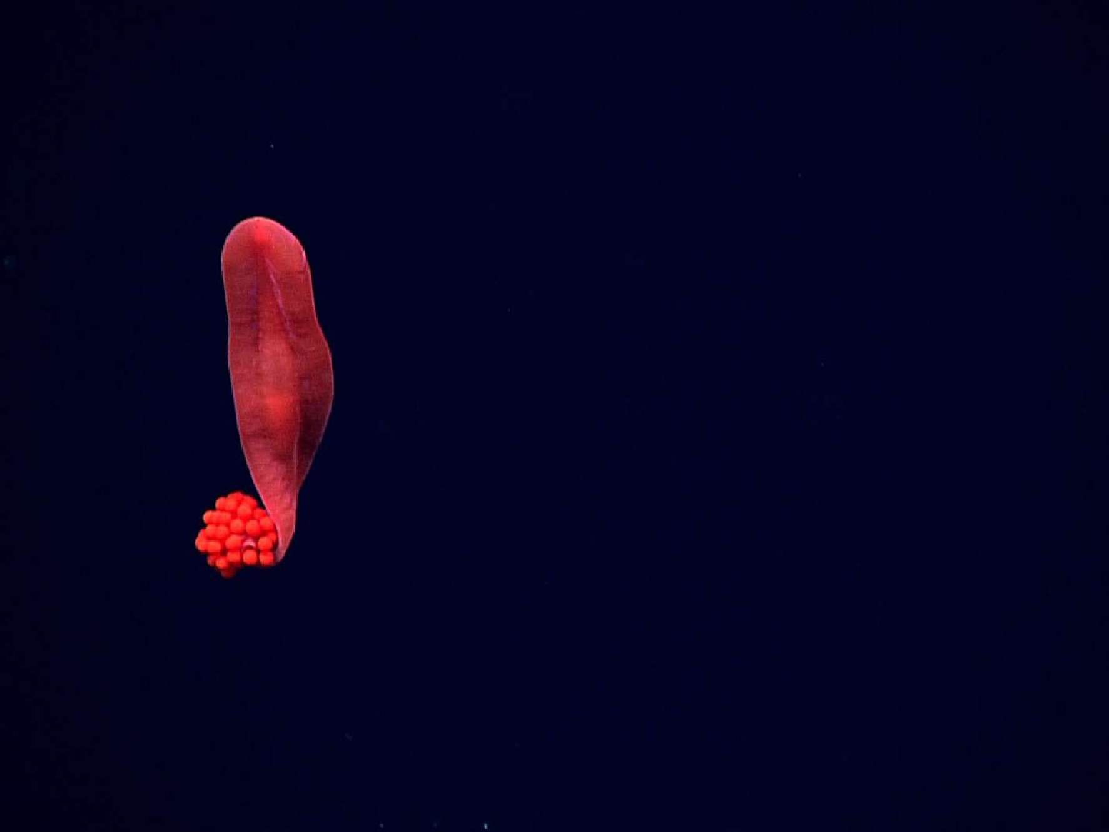
How could the World Heritage Convention protect these unique deep sea treasures?

Slide 12
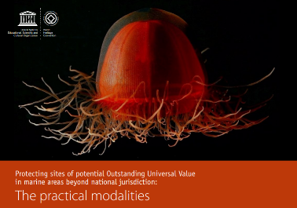
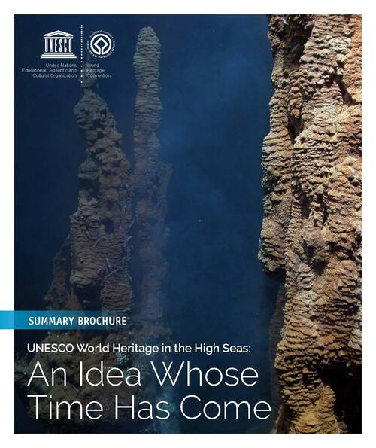
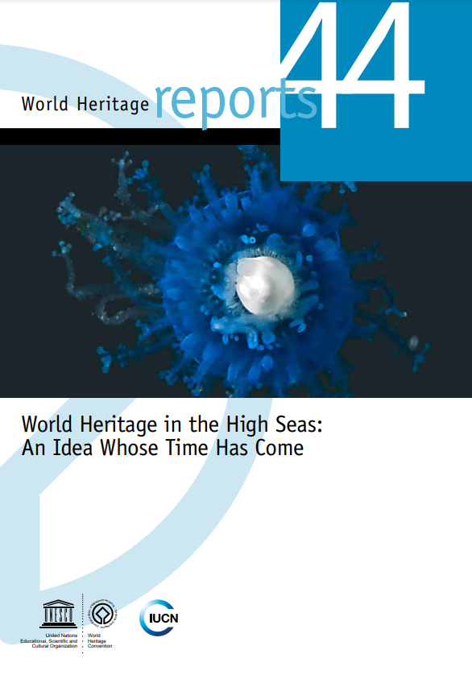
2020
Summary Brochure
Available in English, French and Spanish
2016
UNESCO-IUCN Report
Available in English, French and Spanish
2018
Legal Meeting Proceedings
Available in English and French

Slide 13
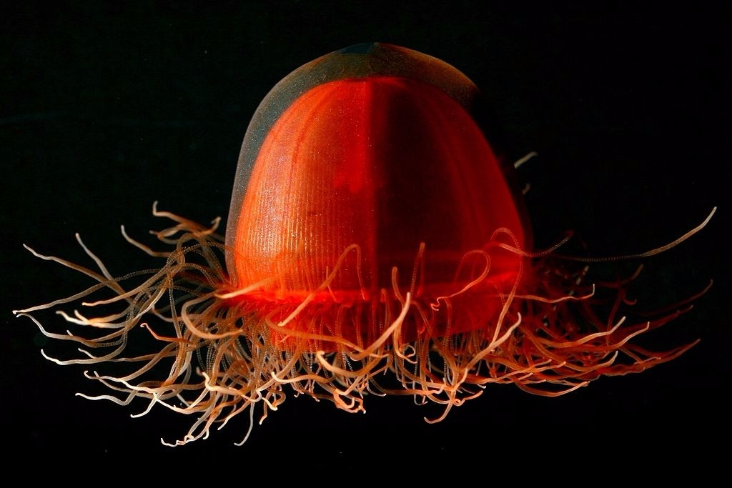
Thank you.
For information:
whc.unesco.org/en/highseas/
Contact: Dr Fanny Douvere Head, Marine Programme,
UNESCO World Heritage Centre
f.douvere@unesco.org
© Kevin Raskoff / NOAA / Wikipedia

