Slide 1

Post-2020 Global Biodiversity Framework: what’s next for the Ocean?
Integrating the GBF into the Barcelona Convention
Online workshop, Thursday 6 April 2023
Gabino Gonzalez Deogracia, Deputy Coordinator
UNEP/MAP - Barcelona Convention Secretariat
gabino.gonzalezdeogracia@un.org

Slide 2
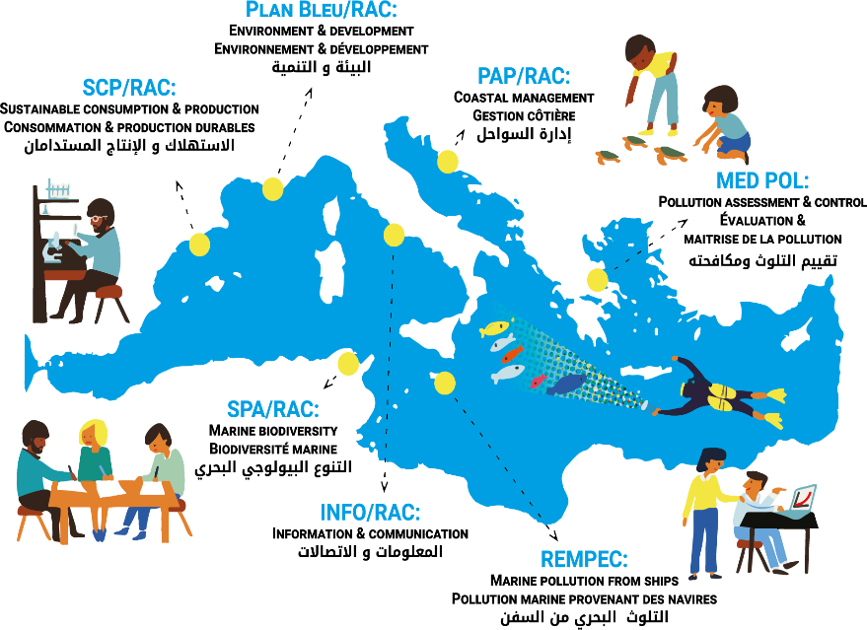
The UNEP/MAP system - Barcelona Convention
Mediterranean Action Plan (UNEP/MAP): established in 1975
Convention for the Protection of the Marine Environment and the Coastal Region of the Mediterranean (BC): adopted in Barcelona, 1976; amended in 1995.
7 Protocols inc. 1995 Protocol Specially Protected Areas and Biological Diversity in the Mediterranean
UNEP/MAP Coordinating Unit – Barcelona Convention Secretariat, based in Athens (Greece).
MAP Components : 6 Regional Activity Centres (RACs) and the MED POL Programme.
Specially Protected Areas Regional Activity Centre (SPA/RAC) based in Tunis (Tunisia).
SCP/RAC: MedWaves
Notes:
Mediterranean Action Plan (UNEP/MAP): established in 1975 as an institutional framework for cooperation to address the common challenges of the Mediterranean marine environment.
Convention for the Protection of the Marine Environment and the Coastal Region of the Mediterranean (BC): adopted in Barcelona, 1976; amended in 1995.
7 Protocols dealing with specific topics:
« Dumping » Protocol - Prevention of Pollution in the Mediterranean Sea by Dumping from Ships and Aircraft
« Prevention and emergency » Protocol Cooperation in Preventing Pollution from Ships and, in Cases of Emergency
« Land-based sources » Protocol - Protection of the Mediterranean Sea against Pollution from Land-Based Sources and Activities
« SPAs & Biodiversity » ProtocolSpecially Protected Areas and Biological Diversity in the Mediterranean
« Offshore » Protocol -Protection against Pollution Resulting from Exploration and Exploitation of the Continental Shelf and the Seabed and its Subsoil
« Hazardous waste » Protocol Prevention of Pollution by Transboundary Movements of Hazardous Wastes and their Disposal
« ICZM » Protocol Integrated Coastal Zone Management in the Mediterranean

Slide 3
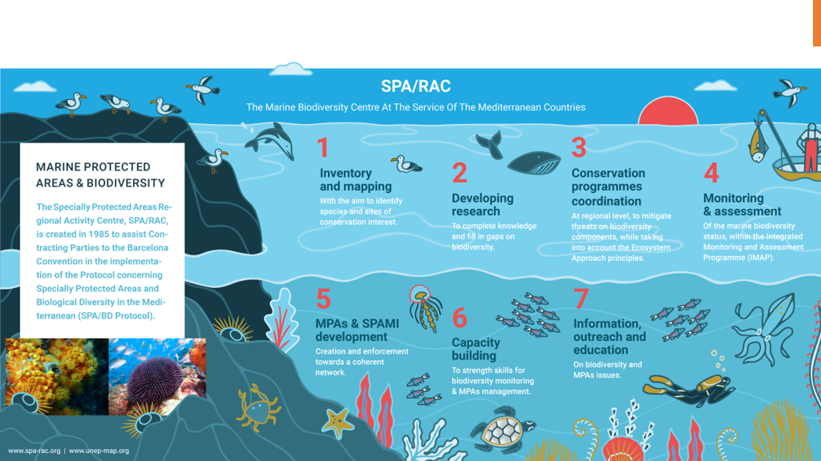
SPA/RAC: The Mediterranean biodiversity Center of the UNEP/MAP

Slide 4
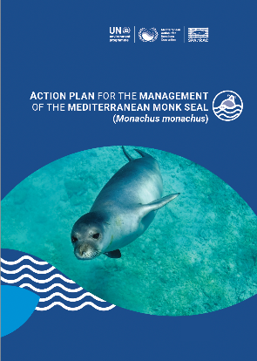
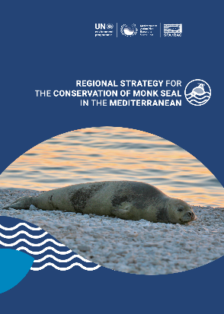
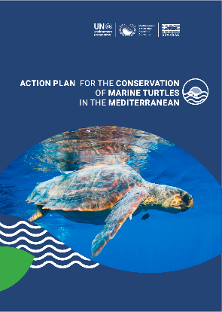
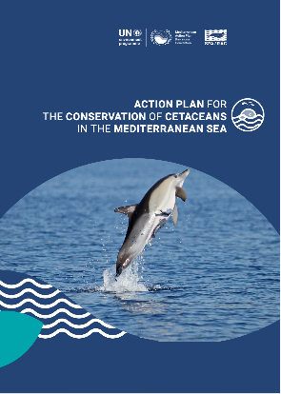
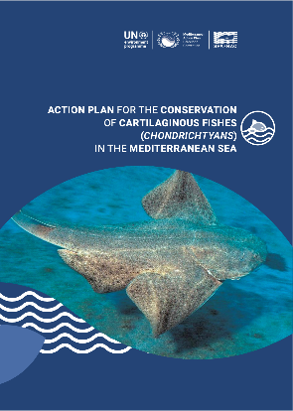
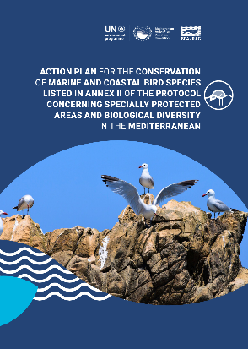
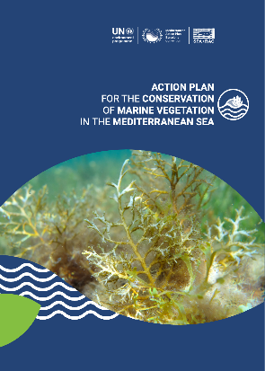
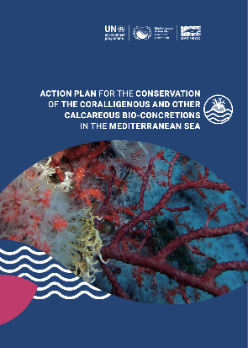
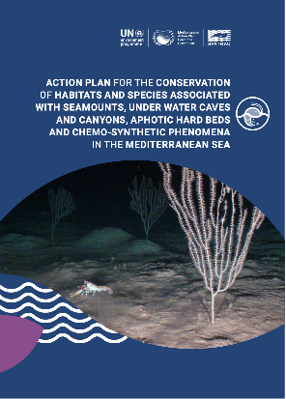
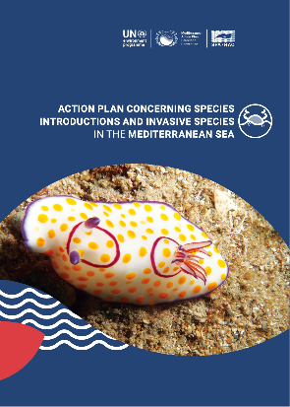
Regional Action Plans for the conservation of Species and Habitats
under the SPA/BD Protocol
Notes:
5 Action Plans & 1 Strategy for the conservation of species (Mediterranean Monk Seal, Marine Turtles, Cetaceans, Cartilaginous Fishes, and Marine & Coastal Birds)
3 Action Plans for the conservation of habitats (Marine Vegetation, Coralligenous, and Dark Habitats)
1 Action Plan on Species Introductions and Invasive Species

Slide 5
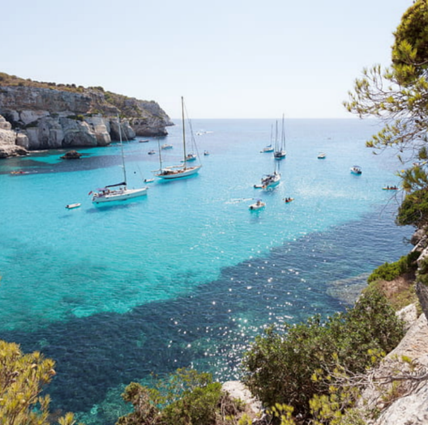
The Mediterranean: a semi-enclosed sea under pressure
7% of the world's population (512 million inhabitants in 2018) of which 1/3 are in coastal areas
1st world destination for tourism, 30% of tourists in the world
1/3 of global maritime traffic
78% of fish stocks are overexploited
Significant land-based pollution including plastic
Exploitation of hydrocarbons at sea is booming
Drastic impacts of climate change
1100 non-indigenous marine species, of which at least 10% are invasive
Notes:
As a semi-enclosed sea, the Mediterranean is more susceptible to human impacts than more open waters.
A recent study has shown that the Mediterranean is among the world biomes that show the strongest negative responses to land use and climate change pressures.
The marine environment and MPAs are particularly sensitive to external threats (Pollution, Unsustainable fishing, Invasive Alien Species, Coastal and marine habitat degradation, Collision with ships, Climate Change). The biggest drivers of anthropomorphic threats to the region stem from the tourism, shipping and fishing industries.
The Mediterranean:
0.3% of the Ocean Volume → 18% of the world's known species
246 threatened marine species live there
A significant regression of biodiversity is already observed with the following impacts
loss of ecosystem services, including socio-economic services
loss of natural protection against erosion, drought and flooding and of the purifying power of water
loss of exploitable resources, especially for food
loss of carbon sequestration potential
This is caused in particular by :
The regression of the emblematic Posidonia oceanica seagrass beds by 30% over the last 50 years
The disappearance of 78% of wetland habitats since 1970

Slide 6


UNEP/MAP-SPA/RAC efforts towards expanding the regional MPA system
and improving its management
56 areas
(MPAs/SPAMIs
and futur MPAs)
in
18 COUNTRIES
CROATIA
Boka
Prvić
Goli Otok
Sv. Grgur
Unije,
Susak
Srakane
ITALY
Egadi
Tavolara-Punta
Coda Cavallo
Torre del Cerrano
Torre Guaceto
SLOVENIA
Strunjan
MONTENEGRO
Boka Kotorska Platamuni
Ratac
France
Côte Bleue
Spain
Medes
ALBANIA
Karaburun-Sazan
Porto Palermo
TURKEY
Foça
MALTA
Għar Lapsi - Filfla
Dwejra
Ponta ta' San Dimitri - Il-Qaliet
Ponta tal-Ħotba-Tal-Fessej
Rdum Majjiesa - Għar Lapsi
SYRIA
Om Al Toyour
ALGERIA
El Kala
Habibas
Paloma
Rachgoun
Réghaia
TUNISIA
Cap Negro-Cap Serrat Kerkennah
Kneiss
Kuriat
Zembra
& Zembretta
MOROCCO
Al Hoceima
Cap des Trois
Fourches
Jbel Moussa
CYPRUS
Cape Greko
LEBANON
Batroun
Byblos
Enfeh
Jounieh
Medfoun
Nakoura
Palm Islands
Raoucheh
Ras Chekaa
Saida
Tyre Coast
ISRAEL
Rosh Hanikra
LIBYA
Ain Al Ghazala
El Kouf
Farwa
Gulf of Sirte
EGYPT
Sallum
6
Notes:
SPA/RAC is supporting the Mediterranean countries in:
Undertaking baseline studies (socio-economic, ecological, stakeholders) for future MPA establishment;
Establishing and managing MPAs (elaborating management plans, business plans, communication strategies; undertaking pilot management/monitoring actions, capacity-building programmes, exchanges, SPAMI/MPA Twinning Programmes, etc.)
These efforts have been intensified during the last 20 years, with the entry into force of the SPA/BD Protocol (Dec. 1999):
56 sites (MPAs/SPAMIs and future MPAs) in 18 Mediterranean countries
This was possible thanks to the generous support of external donors: EU, MAVA, FFEM, GEF, Italy, AECID, …

Slide 7
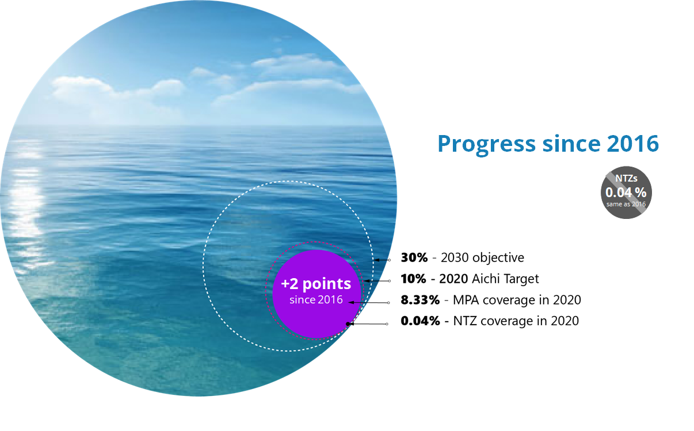
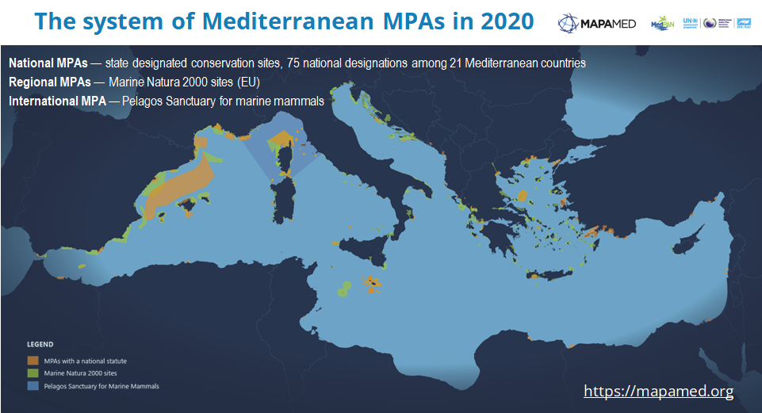
Notes:
1,087 officially MPAs covering 209,303 km² // 8.3 % of the Med

Slide 8
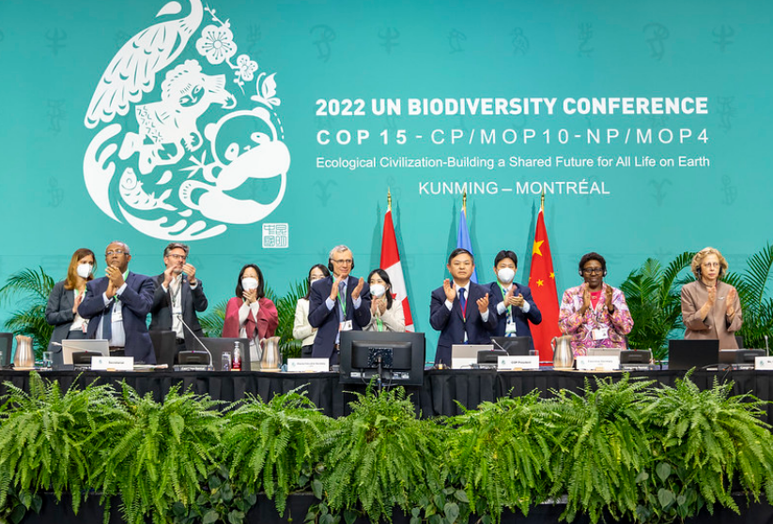
Global targets for 2030: the Kunming-Montreal Global Biodiversity Framework
Notes:
Considerations for the implementation of the GBF:
Cooperation and synergies: Enhanced collaboration, cooperation and synergies between the CBD and its Protocols, other biodiversity-related conventions, other relevant multilateral agreements and international organizations and processes, in line with their respective mandates, including at the global, regional, subregional and national levels, would contribute to and promote the implementation of the Framework in a more efficient and effective manner;

Slide 9

Post-2020 Strategic Action Programme for the Conservation of Biological Diversity and Sustainable Management of Natural Resources in the Mediterranean Region
Vision: “By 2050, marine and coastal biodiversity is valued, conserved, restored and wisely used, maintaining ecosystem services, sustaining a healthy Mediterranean Sea and coast, and delivering benefits essential for all people”
Goal 1. Reduce the threats to biodiversity
Address specific pressures on biodiversity
An effective network of marine protected areas and OECMs
Ecosystem health and restoration, and nature-based solutions
Goal 2. Ensure that biodiversity is preserved and maintained or enhanced in order to meet people’s needs
4. Improve knowledge on marine and coastal biodiversity
5. Sustainable fisheries in harmony with biodiversity conservation
6. Mainstreaming and integration of biodiversity within other administrative and socio-economic sectors
Goal 3. Enable the necessary transformative change, putting in place tools and solutions for implementation and mainstreaming
7. Monitoring and reporting
8. Capacity building and networking
9. Outreach and awareness
10. Mobilizing sufficient resources
Notes:
The Post-2020 Strategic Action Programme for the Conservation of Biological Diversity and Sustainable Management of Natural Resources in the Mediterranean Region (Post-2020 SAPBIO) is a 15 years life cycle strategic action programme that enables a collective regional implementation of the Barcelona Convention’s SPA/BD Protocol. It identifies needs, priorities, synergies for the conservation and sustainable use of marine and coastal biodiversity in the Mediterranean. The action proposals build on a participative bottom-up process and are harmonized with the main biodiversity frameworks (at regional and global levels, mainly GBF).

Slide 10
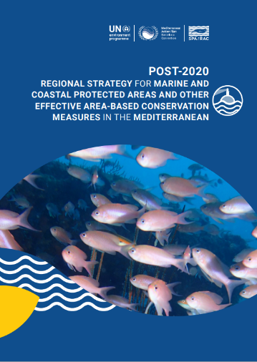
The Post-2020 Regional Strategy for MCPAs and OECMs
Adopted by the Barcelona Convention COP 22 (Antalya, Türkiye, 7-10 Dec. 2021)
Reaching the global target in terms of area-based conservation implies numerous and ambitious quantitative and qualitative improvements to be made at different levels :
2 main targets:
1) By 2030, at least 30 % cent of the Mediterranean Sea is protected and conserved through well connected, ecologically representative, and effective systems of marine and coastal protected areas (MCPAs) and other effective area-based conservation measures (OECMs), ensuring adequate geographical balance, with the focus on areas particularly important for biodiversity
2) By 2030, the number and coverage of MCPAs with enhanced protection levels is increased, contributing to the recovery of marine ecosystems
MCPA management effectiveness
Government and stakeholders action
OECM recognition
MCPA network expansion
Governance

Slide 11
OUTPUTS
OUTCOMES
TARGETS
PILLAR
GOVERNANCE
01
Legal and institutional frameworks allow for participatory management
Governance arrangements are inclusive and equitable
National, regional, transboundary, and cross sectoral operations are strengthened
Adaptive planning and frameworks are strengthened
Inclusive and effective governance of MCPAs and OECMs
BY 2030
At least
30%
PILLAR
MCPA COVERAGE
02
Areas important for biodiversity and ecosystems services are identified
MCPA distribution across the Mediterranean is balanced
MCPA coverage in areas beyond national jurisdiction is increased
The number and coverage of MCPAs with enhanced protection levels is increased
Increased coverage
of effective MCPA systems
of the Mediterranean Sea is protected and conserved through well-connected, ecologically representative and effective systems of marine and coastal protected areas an other area-based conservation measures, ensuring adequate geographic balance, with the focus on areas particularly important for biodiversity
PILLAR
OECMs
03
OECMs identified, recognised and reported
Awareness on OECMs enhanced & guidance to apply OECM criteria provided
OECMs are identified, recognised and reported to regional & global databases
OECM effectiveness is enhanced, including the prioritisation of marine spatial planning
New OECMs are established and recognised OECMs expanded
THE MCPA & OECM STRATEGY AT A GLANCE
PILLAR
MCPA Management Effectiveness
04
All MCPAs have management plans adopted, effectively implemented and periodically reviewed
Sufficient and sustainable resources for MCPA establishment and management are mobilised
Individual and institutional capacity for MCPA management is enhanced
Surveillance and enforcement in MCPAs are strengthened and user compliance promoted
Monitoring of conservation outcomes and evaluation of management effectiveness are strengthened
MCPAs managed effectively
A
The number and coverage of marine and coastal protected areas with enhanced protection levels is increased, contributing to the recovery of marine ecosystems.
PILLAR
Government and Stakeholders Action and Support
05
Awareness, understanding and appreciated of the values of, and threats to, MCPAs and OECMs across all the stakeholders are increased
Political support for the establishment and management of MCPAs and biodiversity conservation is increased
The contribution of MCPAs and OECMs to sustainable development goals, the blue economy, climate change mitigation and adaptation, and the wider society, are recognised and accounted for
Action and support for MCPAs mobilised
Notes:
Under each of the 5 strategic pillar a clear strategic outcome, with 20 Outputs supported by 126 Proposed Actions at both Contracting Party, and Regional and International Organization levels, has been identified. Recognizing that countries are at different stages with regard to the establishment and management of their MCPAs, the proposed actions under each output therefore are meant to be indicative and not prescriptive.
An Evaluation and monitoring framework is being prepared for the Post-2020 Regional Strategy (2022-2023), with the technical support of the Ad hoc Group of Experts for Marine Protected Areas in the Mediterranean (AGEM).​

Slide 12
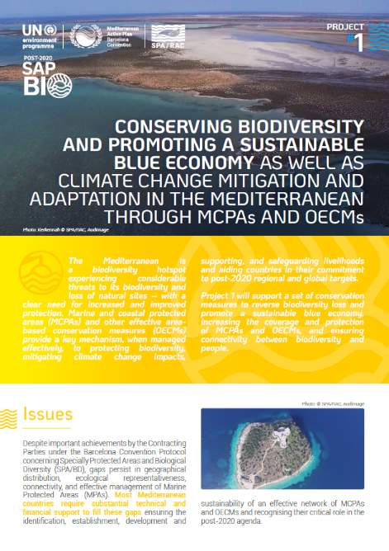
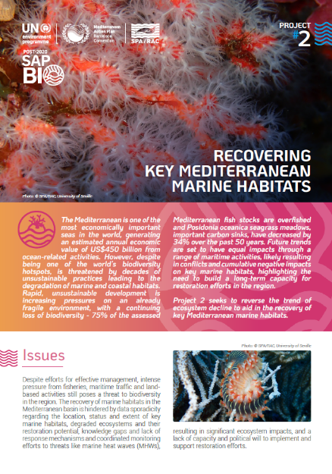
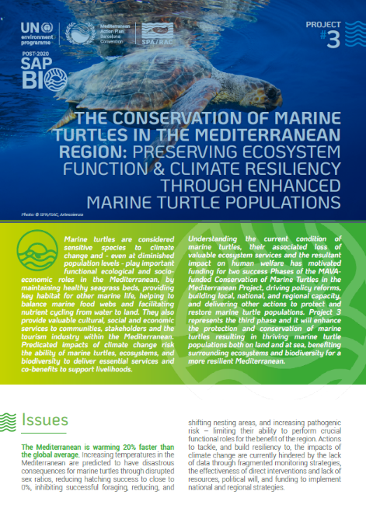
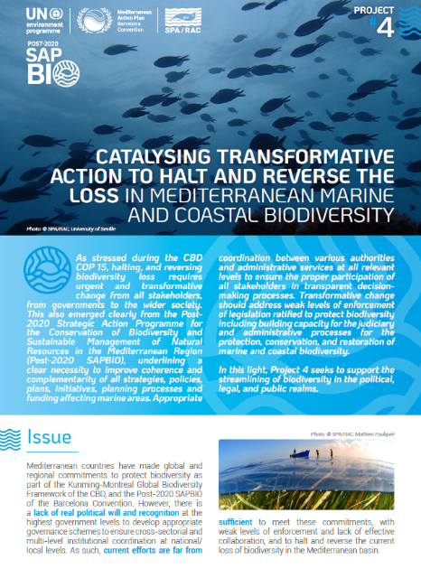
Resource Mobilization Strategy to support the implementation of the Post-202O SAPBIO including the Post-2020 Regional Strategy for MCPA and OECM
During the conference, a portfolio of 4 projects was presented to the donors:
Notes:
Framework of the Resource Mobilisation Strategy:
The RMS is the first step in the implementation of the Post 2020 SAPBIO including the Post2020 regional Strategy for the MCPAs and OECMs
In the same way, like the Post-2020 SAPBIO, it is aimed to be considered as a frame for coherence among regional and national actions seeking, to the extent possible, complementarity and avoiding overlapping of biodiversity conservation programmes and marine resource sustainable management.
It is built as a space of collective and synergic action of all the relevant (regional and national) marine conservation actors in the Mediterranean.
Objective of the Resource Mobilisation Strategy:
Ensure financial support that has a switch value to allow a sequence of actions for a realistic operational implementation of the Post-2020 SAPBIO.
Provide a description of the kind of support, such as capacity building, technical, scientific, legal or institutional assistance, needed by the contracting parties for their efforts in implementing the Post-2020 SAPBIO.

Slide 13
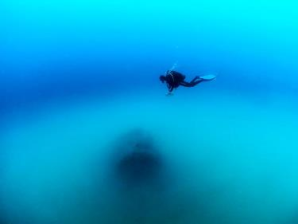
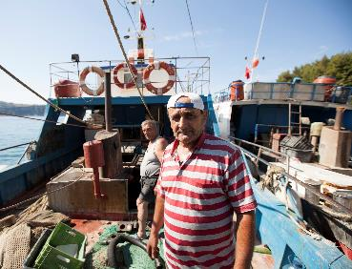
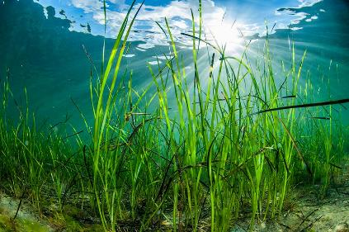

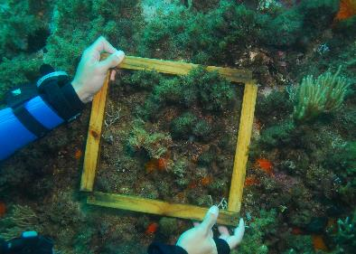
Barcelona Convention 2024-2025 Programme of Work: Main Biodiversity priorities
The main priority for SPA/RAC in 2024-25 PoW is the implementation of the Post-2020 SAPBIO, including mainly:
Improving the ecosystem resilience through a restoration programme.
Upgrading and expanding the Mediterranean network of MPAs and OECMs while improving their effective and sustainable management.
Elaboration of a monitoring and evaluation system for MPAs and OECMs in the Mediterranean.
Upgrading the conservation status of the Mediterranean endangered and threatened species and key habitats, through the implementation of the Regional and national relevant Action Plans.
Support the countries in their national monitoring programmes within the Integrated Monitoring and Assessment (IMAP) UNEP/MAP ecosystem approach process.

Slide 14

Thank you
Gabino Gonzalez Deogracia
UNEP/MAP Deputy Coordinator
gabino.gonzalezdeogracia@un.org

