Slide 1
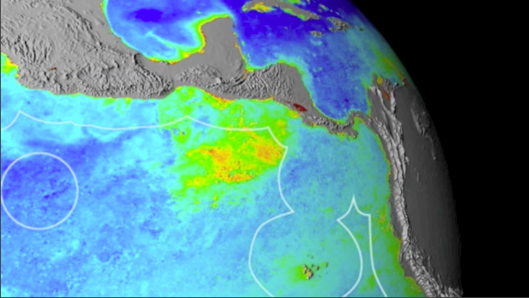



The Costa Rica Thermal Dome:
an upwelling at the Eastern Tropical Pacific

Slide 2
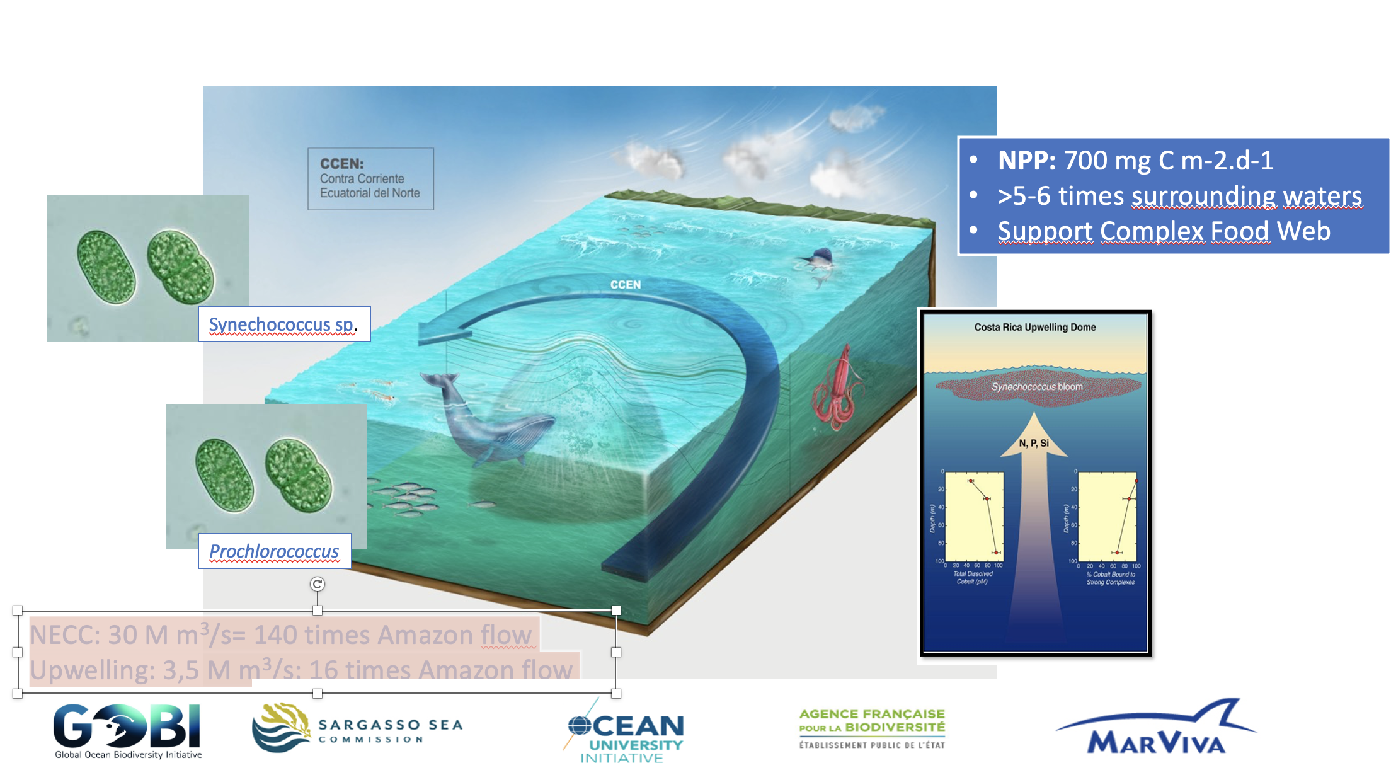

Slide 3
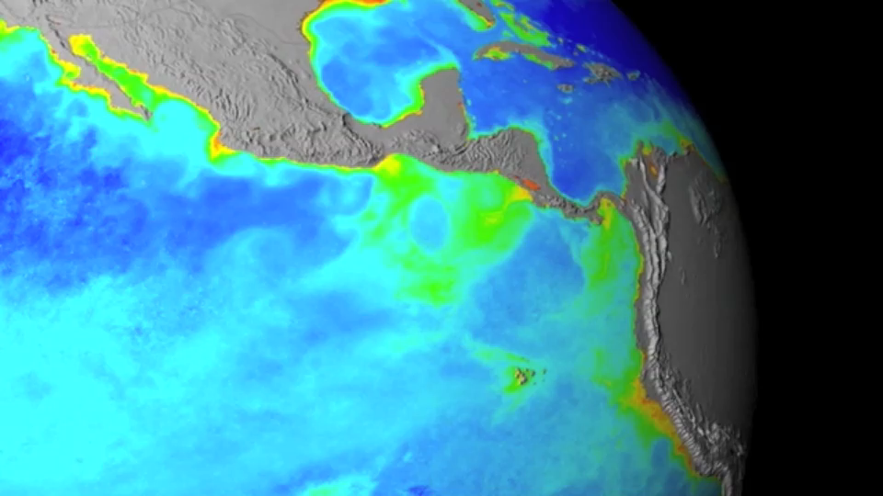


Dynamic Management

Slide 4
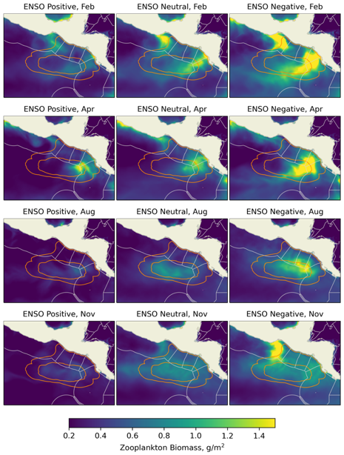
Biomass in different periods
Figure 8 ENSO aware seasonal climatology of mean depth to the 20°C isotherm; seasonal representation based on analyses performed in Fielder et al., 2017.

Slide 5
Multiple Jurisdictions

Slide 6
“Uneven” Policies & Regulations
National
Regional
International
Coordination
“Similarity”

Slide 7
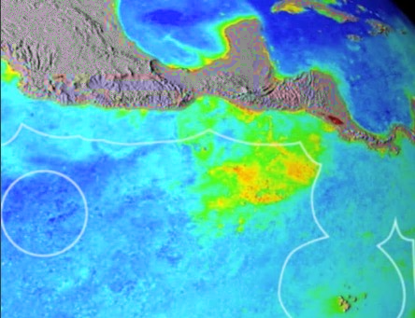



Connectivity: Coastal-Regional (Ecological-Economic Relevance)

Slide 8
International Coordination
Managing multi-jurisdictional sites and migratory species
Site-based measures are not enough

Slide 9
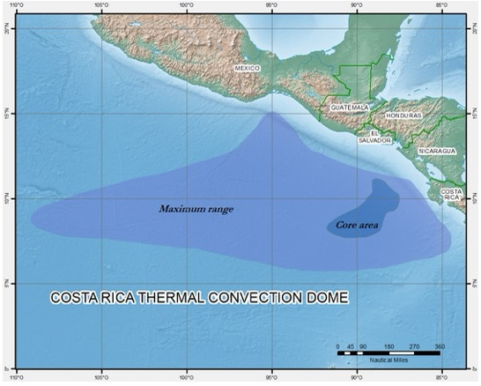
Large Scale
650
2.000 km

Slide 10
Challenges:
Ecosystem Analysis
Management Measures
Control & Surveillance

Slide 11
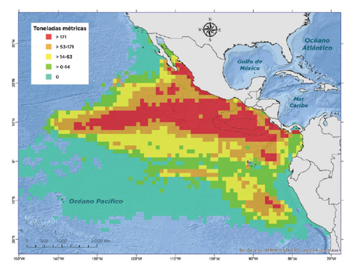
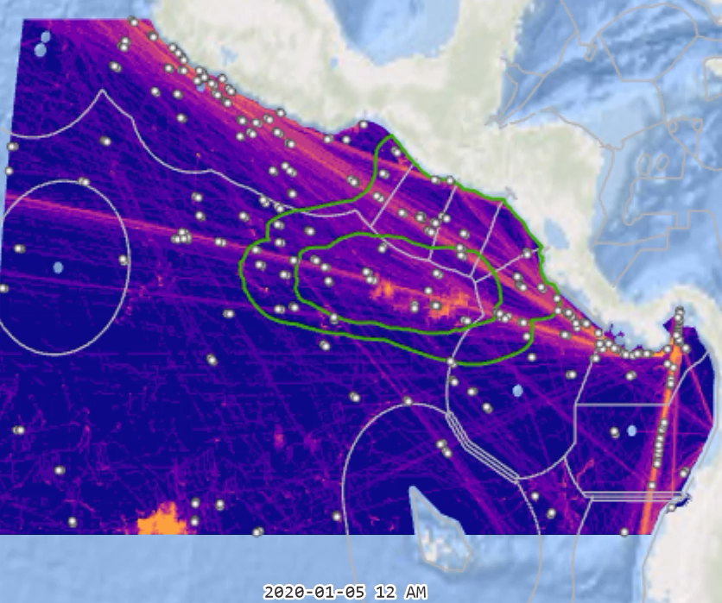

Multiple Sectorial Management
Fishing
Navigation

Slide 12
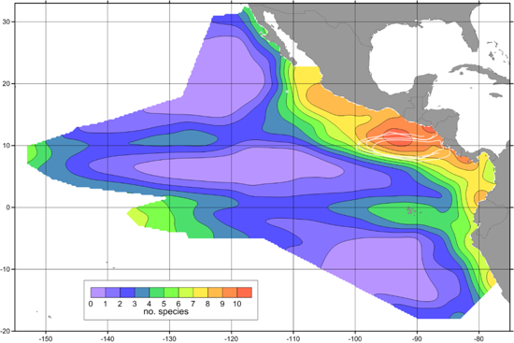
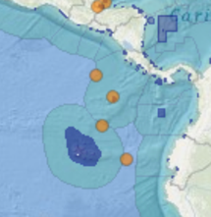
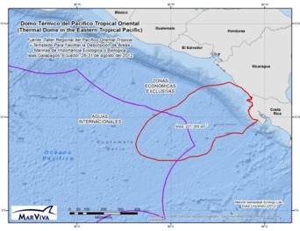
Multiple Sectorial Interest
Conservation. (EBSA, IMMA, ISRA)
Mission Blue: Hope Spots
Adapted from
Fidler et al, 2017
Delfín Listado
0,25x0,25 degrees
15x 15 nm
EBSA
Delfín Común
IMA- 21 cetacean species & subspecies in the ETP
Ballena Azul

Slide 13














Global
Regional
BBNJ (??)

Slide 14
Governance Schemes
Jurisdictional
Rights
Analytical/Implementation
Capabilities
Policy
Differences
Muti-level
institutions
Sectorial Interests

Slide 15

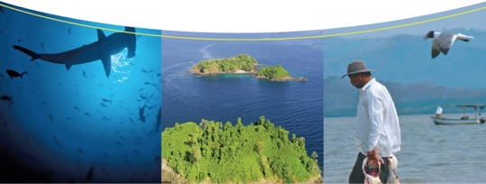
Jorge A. Jimenez. jorge.jimenez@marviva.net

