Slide 1

The Personalization of Climate Litigation: Law & Science
May 11, 2023
Michael Burger
Executive Director
Sabin Center for Climate Change Law

Slide 2
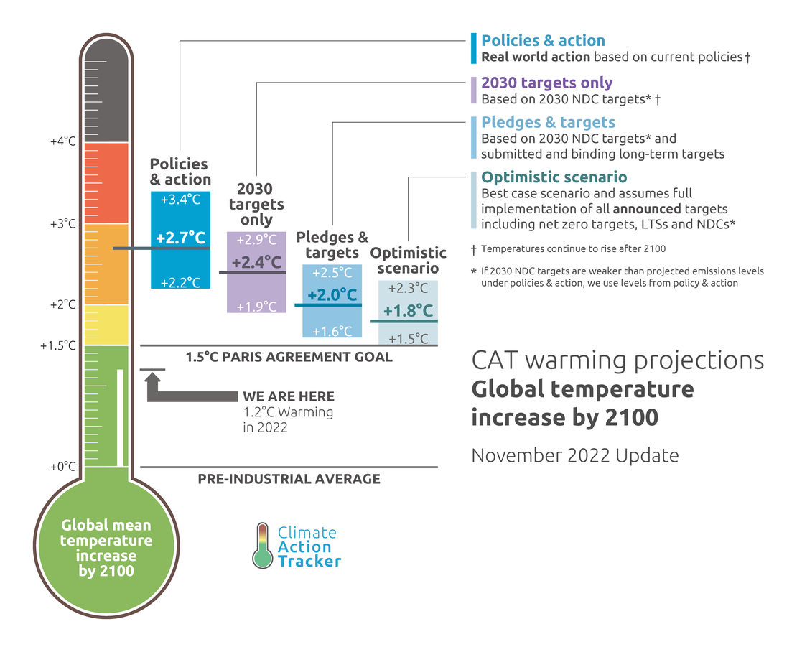

Slide 3
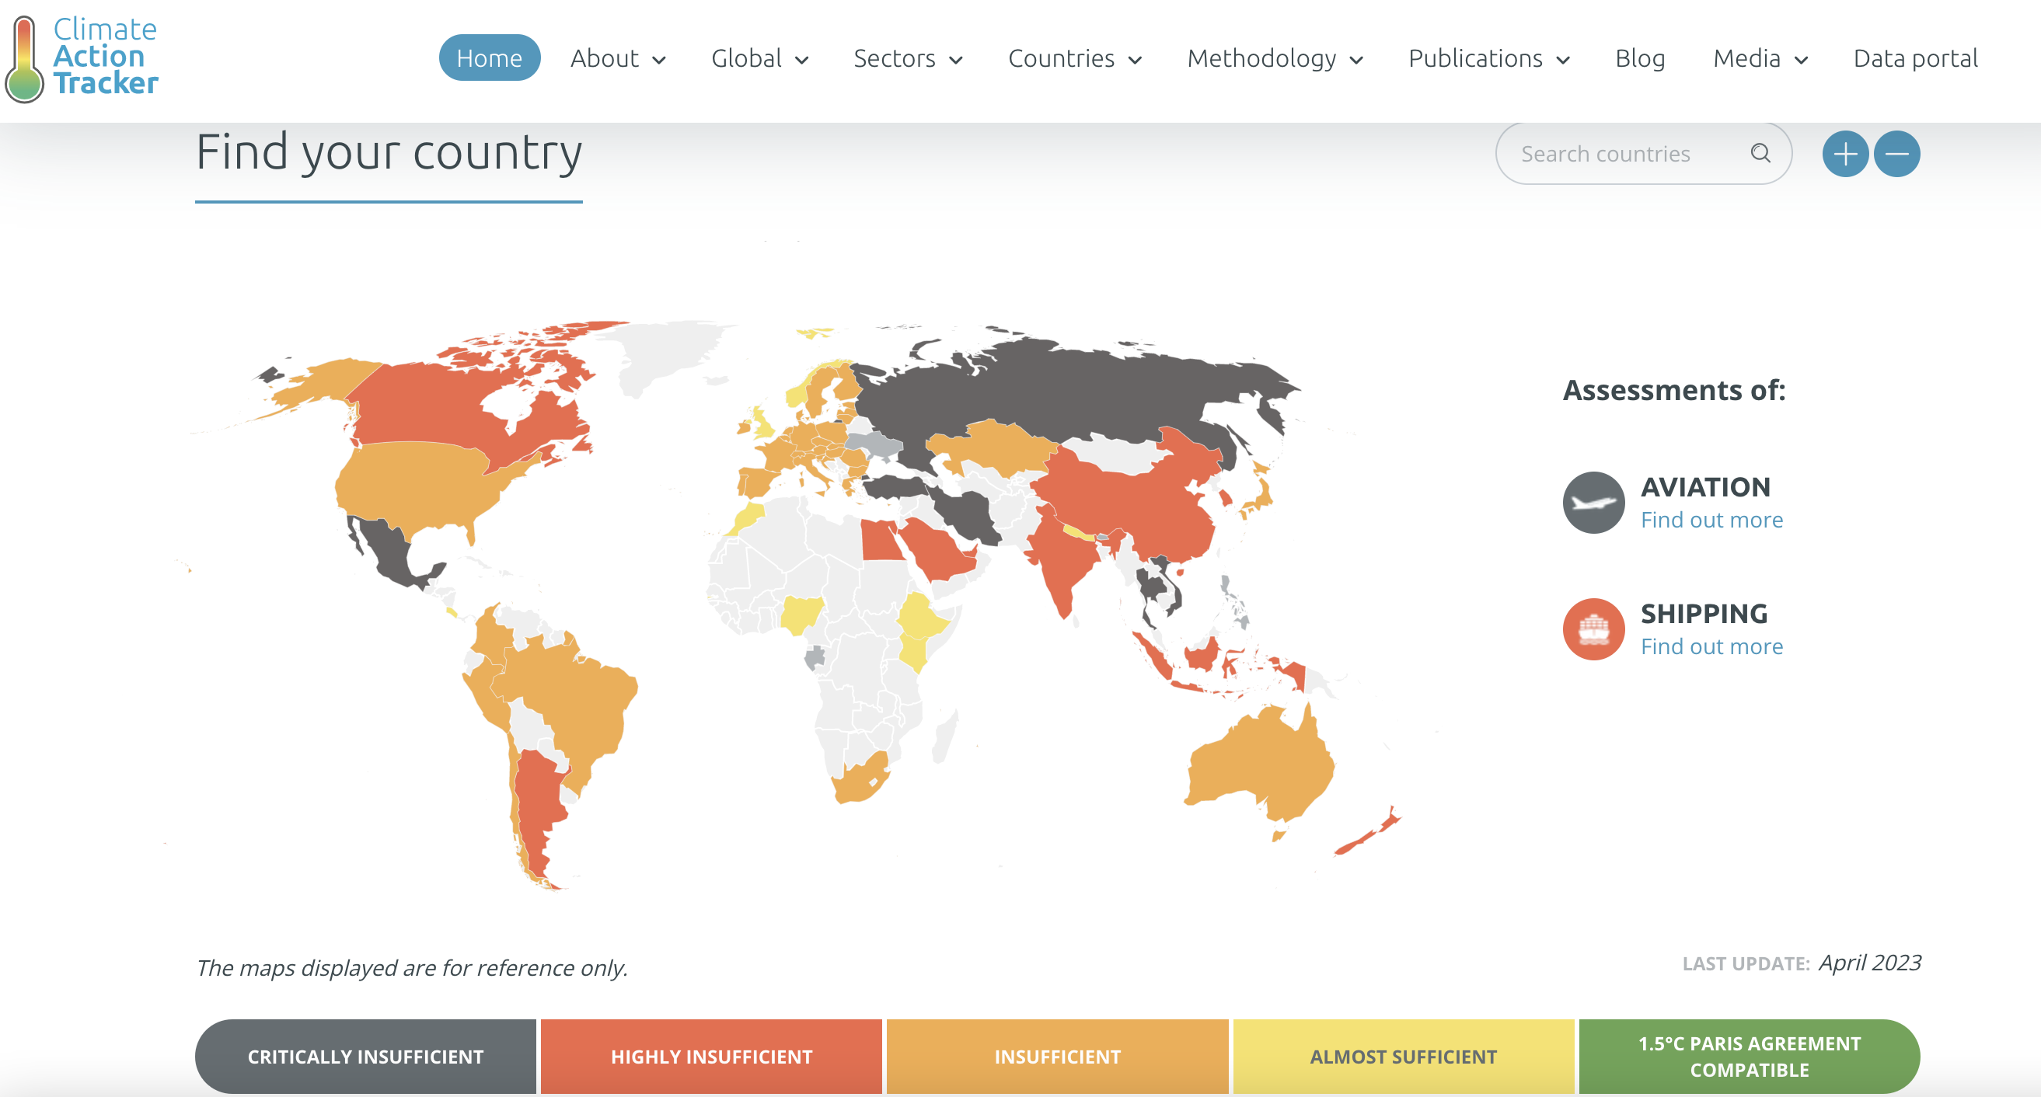

Slide 4
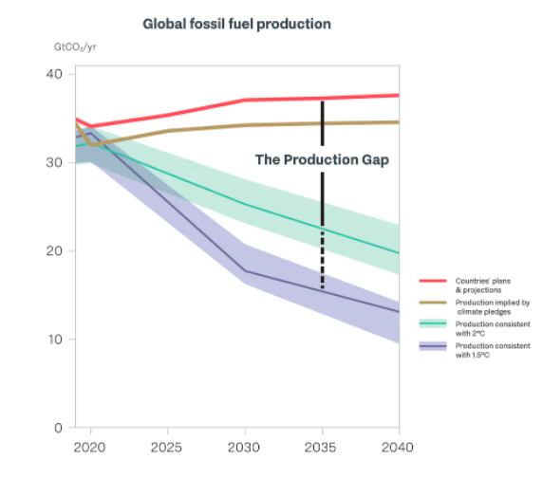
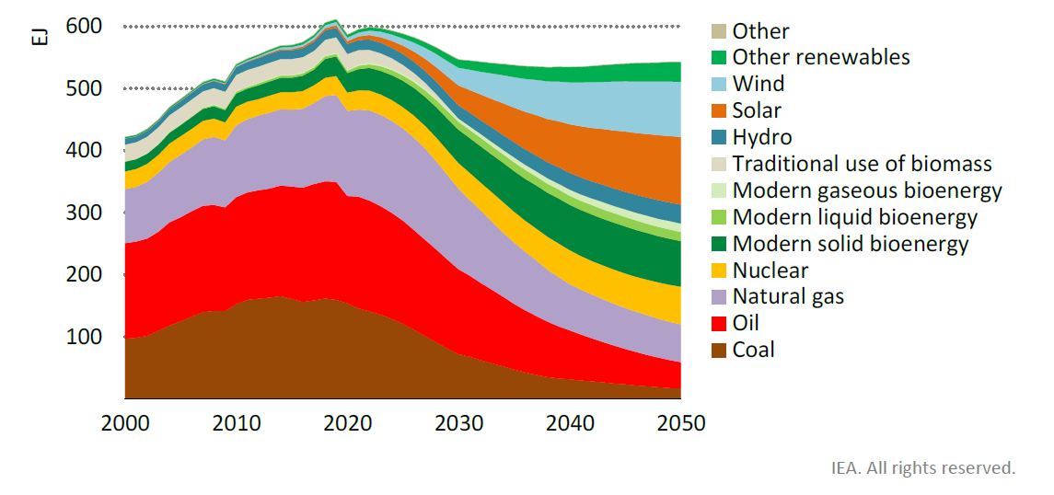

Slide 5
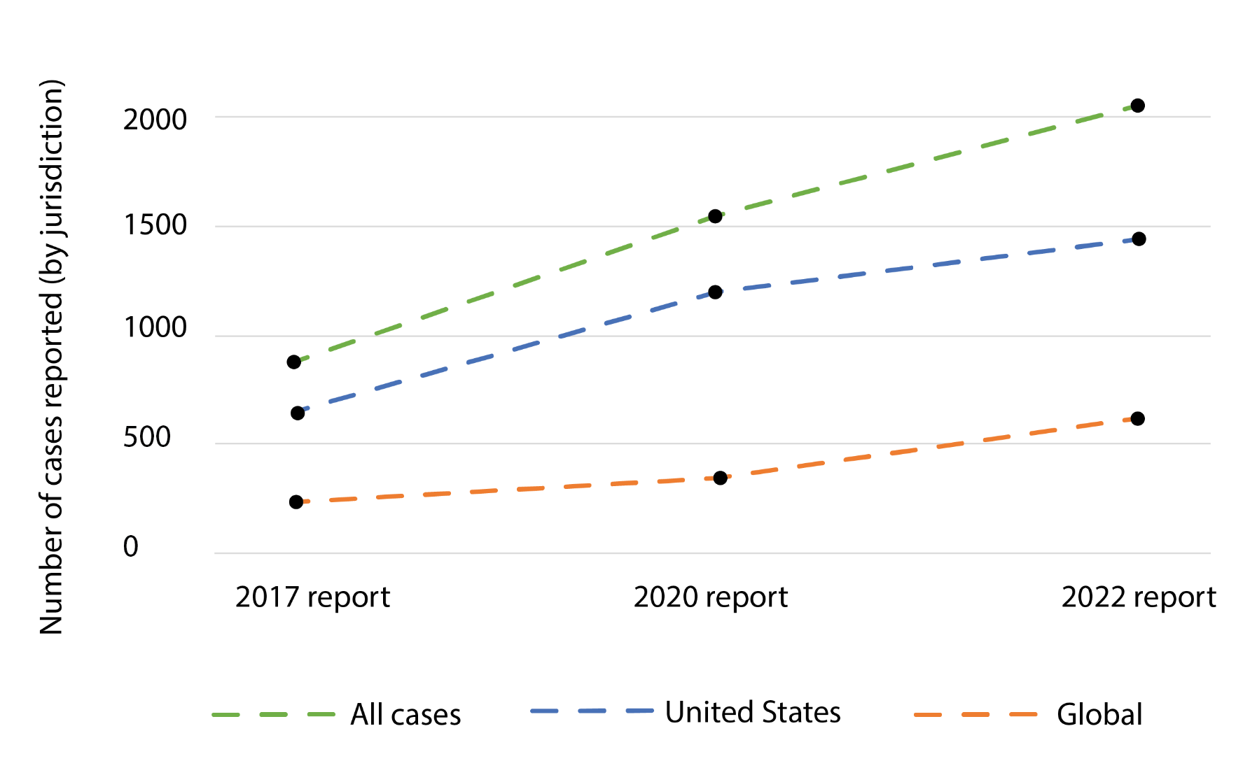
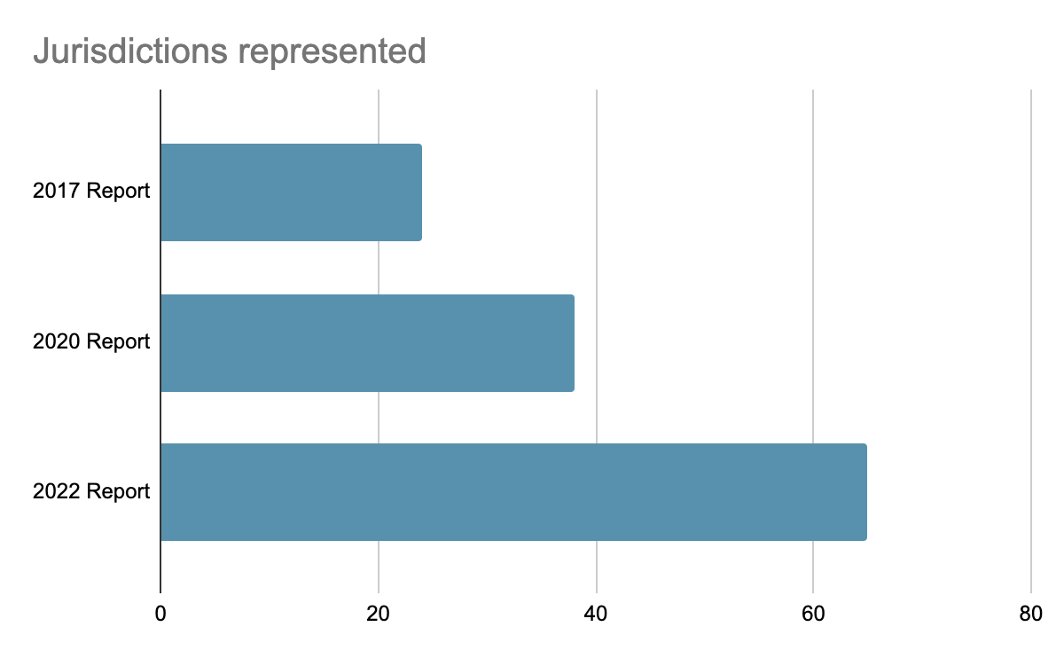
Growth of Climate Litigation
Climate litigation has grown steadily both within the U.S. and globally since 2017.
The number of jurisdictions represented in global climate litigation has grown steadily as well.

Slide 6
Number of cases per jurisdiction*
Jurisdiction | Number of cases
Chile, Netherlands | 7 each
Italy, Pakistan | 6 each
Belgium, Japan, Inter-American System of Human Rights | 5 each
Ireland | 4
Austria, Czech Republic, Ecuador, Guyana, Philippines, Republic of Korea, Switzerland, Stockholm Chamber of Commerce, United Nations Special Procedures (Special Rapporteurs), World Trade Organization Dispute Settlement Body | 3 each
China, Denmark, Kenya, Nigeria, Norway, Sweden, Türkiye, Uganda, Ukraine, International Court of Justice, United Nations Human Rights Committee | 2 each
Estonia, Finland, Luxembourg, Nepal, Papua New Guinea, Peru, Russian Federation, Slovenia, Thailand, East African Court of Justice, European Committee on Social Rights, International Criminal Court, International Tribunal of the Law of the Sea, Permanent Court of Arbitration, United Nations Committee on Rights of the Child, United Nations Secretary General | 1 each
Total | 2180
Jurisdiction | Number of cases
United States of America (~70 per cent) | 1522
Australia | 127
United Kingdom of Great Britain and Northern Ireland | 79
European Union | 62
Germany | 38
Canada | 34
Brazil | 30
New Zealand | 26
France | 22
Mexico | 18
Spain | 17
Indonesia | 12
European Court of Human Rights (ECtHR) | 12
India | 11
UNFCCC | 11
Argentina | 10
Colombia, Poland, South Africa, ICSID | 9 each
*Numbers updated until December 31, 2022.

Slide 7
Issues: Sources of legal obligations
Statutory or Policy Causes of Action
Constitutional and Human Rights
Common Law/Tort Theories

Slide 8
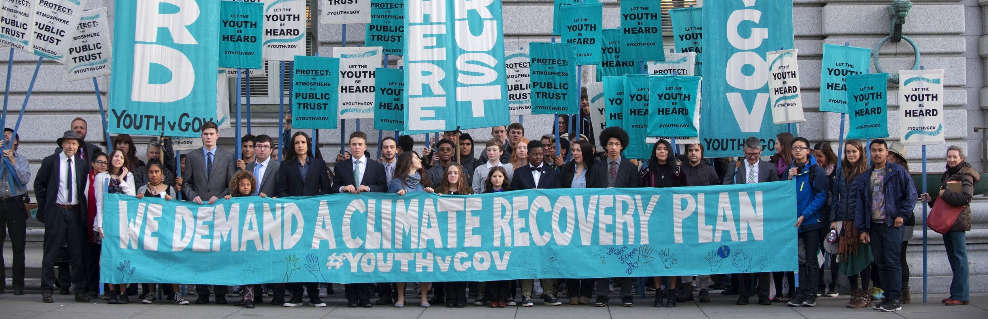
Government Obligations – GHG Emissions
Suing governments for regulatory inaction + contributions to climate change
Citizens and public interest groups are seeking court orders to accelerate GHG reductions and end policies such as fossil fuel subsidies.

Slide 9
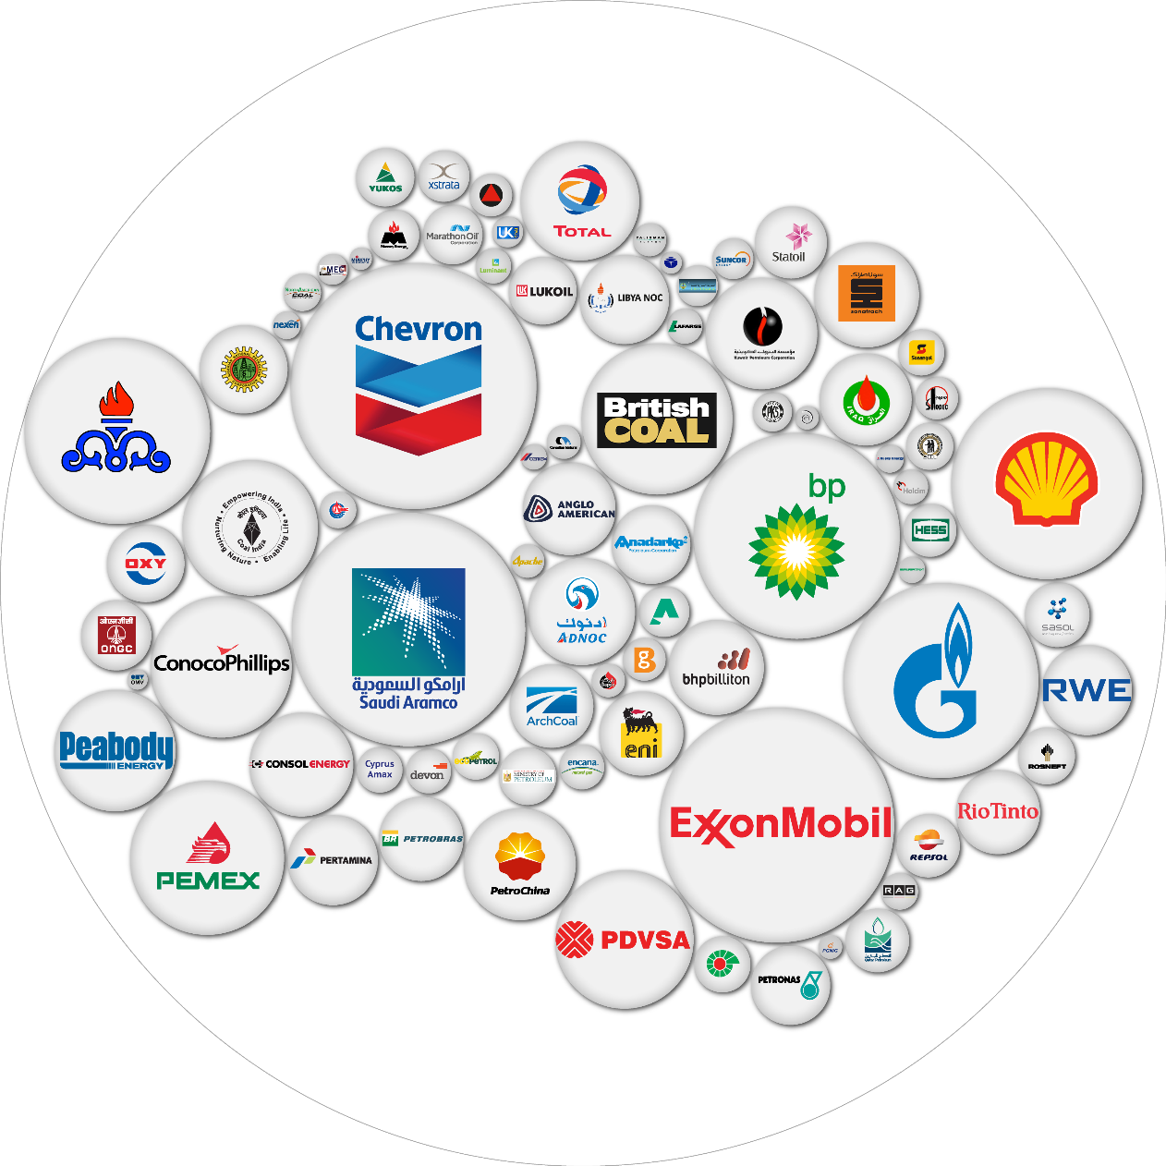
Corporate Accountability
Suing companies for disinformation+ contributions to climate change
Liability for corporate contributions to climate change
  Plaintiffs seeking monetary damages to help cover adaptation costs, as well as changes in corporate conduct
  Some cases pursuing a “public deception” theory, where liability is based on climate disinformation
Corporate greenwashing suits

Slide 10
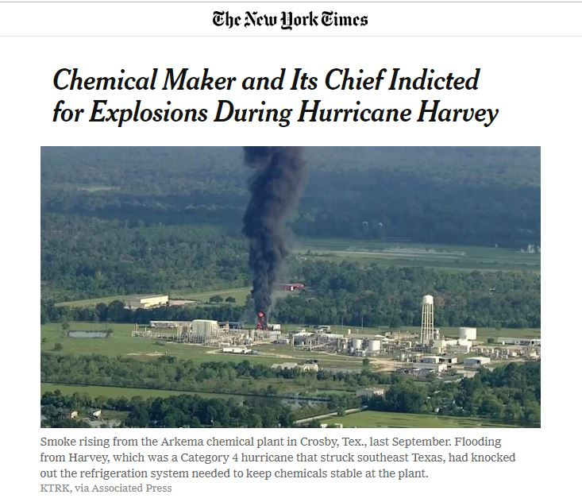
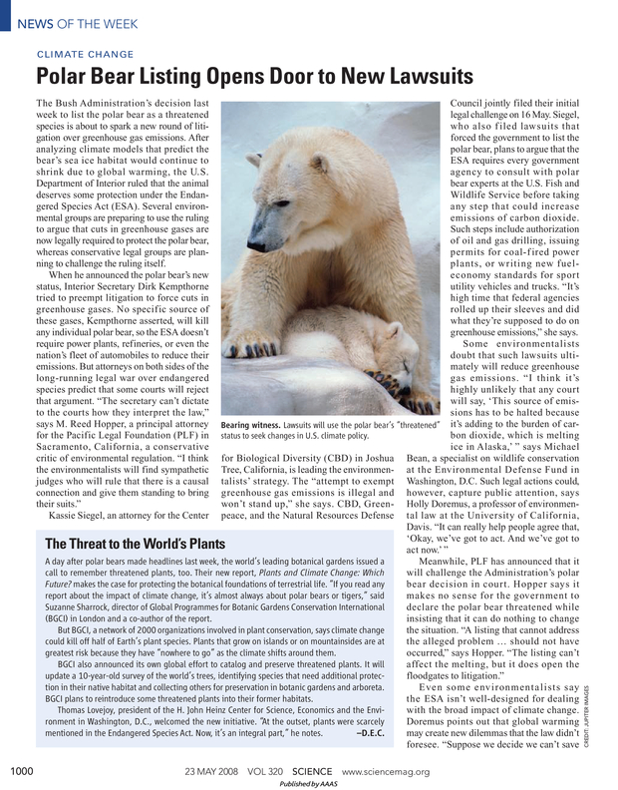
Preparing for Climate Impacts and Risks
Adaptation and disclosure related lawsuits
Failure-to-disclose: Challenging government or corporate failures to analyze and disclose climate change-related considerations in planning documents, environmental impact assessments, financial disclosures, etc.
Failure-to-adapt: Challenging government or corporate failures to prepare for the impacts of climate change on infrastructure, communities, or natural resources.
Defense of adaptation: Defending actions taken in response to climate change against legal challenges

Slide 11
Detection and Attribution Research
An essential tool in climate litigation
Global Climate Change Attribution: How are human activities affecting the global climate system? (IPCC WGI)
Extreme Event Attribution: How are changes in the global climate system affecting the frequency, magnitude, and other characteristics of extreme weather events?
Impact Attribution: How are changes in the global climate system affecting other interconnected natural and human systems? (IPCC WGII)
Source Attribution: To what extent have different sectors, activities, and entities contributed to anthropogenic climate change?
Source: Michael Burger, Jessica Wentz, and Radley Horton, The Law and Science of Climate Change Attribution, 5 Columbia Journal of Environmental Law 57 (2020)

Slide 12
Role of Attribution Research + Climate Science
Causation and Foreseeability
Causation: Establishing a causal link between the defendant’s contributions to climate change and injuries to the public or individual plaintiffs.
Foreseeability: Demonstrating that climate-related impacts are foreseeable and therefore should be considered in decision-making and planning processes.
Defendant’s conduct
Global climate change
Physical impacts
Harm to public / plaintiffs

Slide 13
Juliana v. United States
Alleging U.S. climate + energy policy violated fundamental rights
Plaintiffs supported their case with declarations by the 21 plaintiffs and reports from 18 experts, as well as hundreds of government records.
Some of the experts included:
  James Hansen (climate, impact, and source attribution)
  Kevin Trenberth (extreme event attribution)
  Joseph Stiglitz (source attribution)
  Peter Erickson (source attribution)
  Gus Speth (government responsibility)
Complete list at: http://climatecasechart.com/case/juliana-v-united-states/

Slide 14
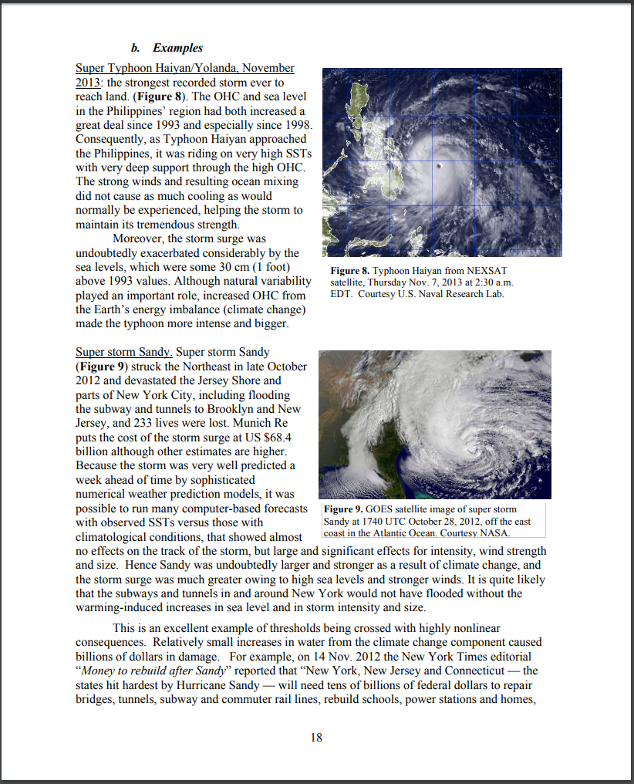
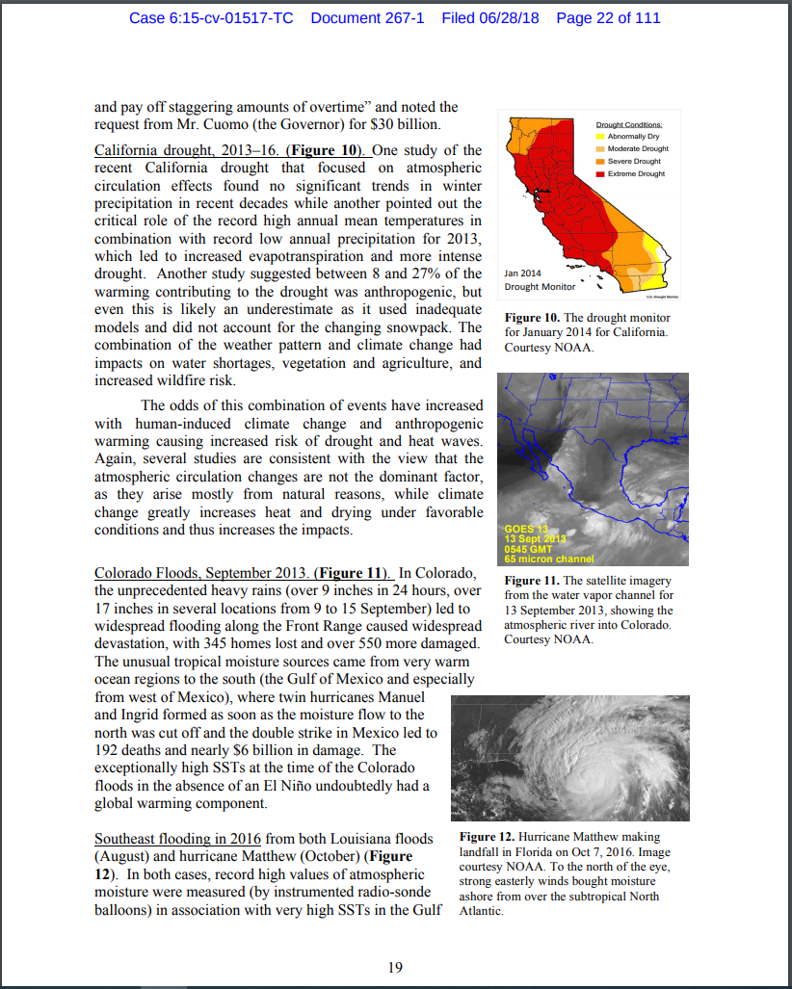
Juliana v. US
Extreme Event Attribution: Expert Report of Dr. Kevin Trenberth
Connection between climate change and extreme events such as hurricanes, floods, droughts, and wildfires
Examples of specific extreme events that have been attributed to anthropogenic climate change

Slide 15
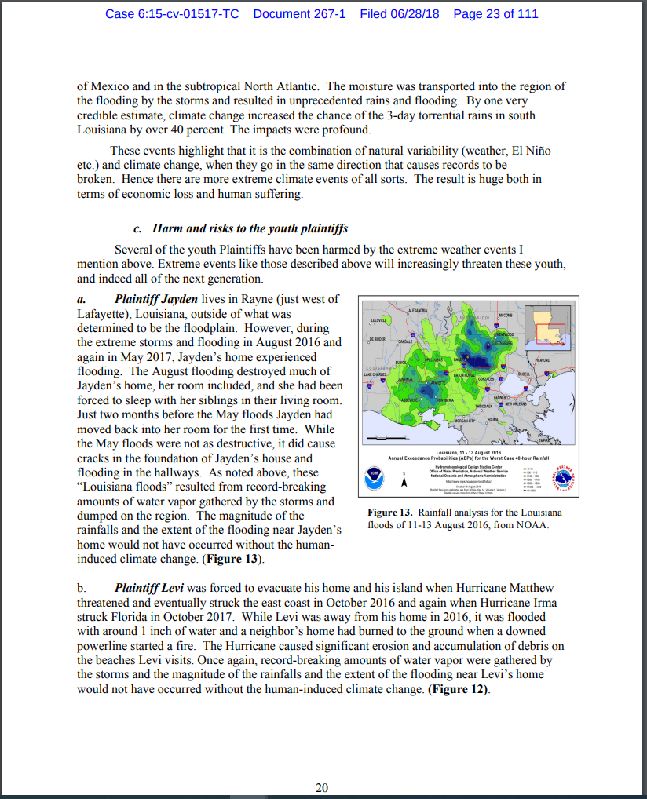
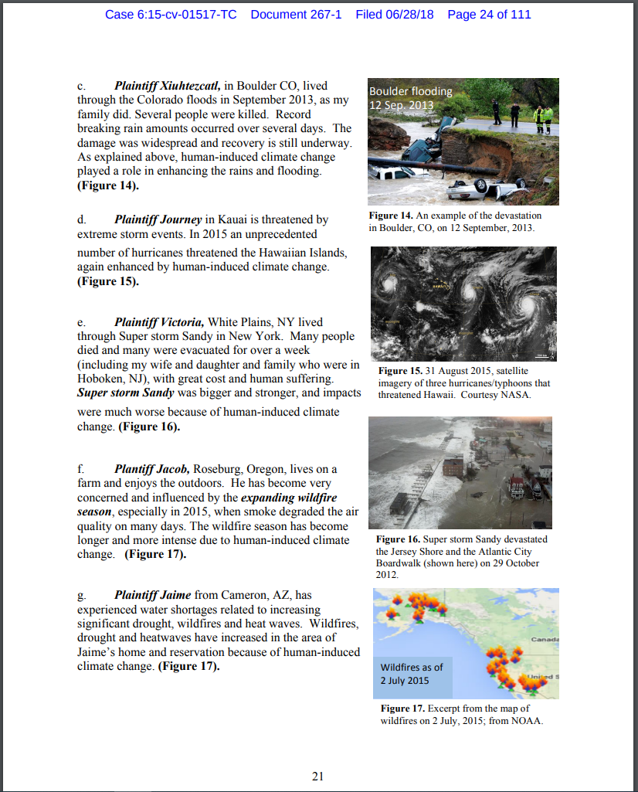
Juliana v. US
Extreme Event Attribution: Expert Report of Dr. Kevin Trenberth
Effect of extreme events on youth plaintiffs
Examples of injuries include:
  Property damage and displacement due to storms and flooding
  Asthma from wildfires
  Displacement due to water scarcity

Slide 16
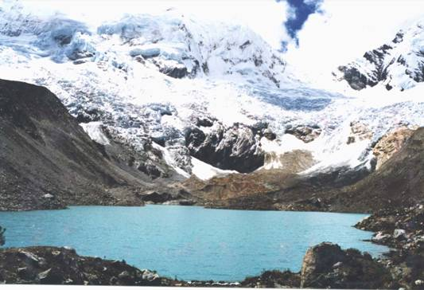
Corporate Obligations
Lliuya v. RWE AG
Peruvian farmer sued the German utility RWE for its contribution to climate change, seeking compensation based on the costs of protecting his town from flood risk arising from glacier retreat.
  Seeking compensation for 0.47% of flood protection costs, based on RWE's cumulative contribution to global GHG emissions from industrial sources
Climate scientists conducted a targeted attribution study, found that anthropogenic climate change was responsible for essentially all of the observed glacier retreat.
  Stuart-Smith et al., Increased outburst flood hazard from Lake Palcacocha due to human-induced glacier retreat, 14 Nature Geoscience 85 (2021)

Slide 17
Responding to Climate Change
Legal Questions About Adaptation
Lawsuits challenging failures to prepare for the impacts of climate change on infrastructure, communities, or natural resources.
Lawsuits challenging failures to analyze and disclose climate change impacts in planning documents (e.g., environmental impact reports, management plans)
Legal defense of adaptation measures
Attribution research is primarily used to demonstrate that climate change impacts are foreseeable and thus the defendant had an obligation to account for those impacts.

Slide 18
Responding to Climate Change
Examples of Adaptation-Oriented Claims
Conservation Law Foundation v. Massachusetts DEP – challenging siting of landfill on coastline vulnerable to sea level rise and other climate impacts
Casa Mira Homeowners Association v. California Coastal Commission – challenging local coastal plan which prohibited long-term shoreline protective devices, claiming that this would limit ability to address sea level rise
Conservation Law Foundation v. Shell – alleging violations of Clean Water Act (CWA) arising from failure to prepare coastal facilities for climate impacts
Cole v. Collier – Texas federal court recognized government obligation to protect inmates from extreme heat events, which will be exacerbated by climate change

Slide 19
From Source Attribution to Impact Attribution
New research helps flesh out the causal chain
Government obligations:
Otto et al., Assigning historic responsibility for extreme weather events, 7 Nature Climate Change 757 (2017)
Jason Hickel, Quantifying national responsibility for climate breakdown: an equality-based attribution approach for carbon dioxide emissions in excess of the planetary boundary, 4 Lancet Planetary Health E399 (2020)
Corporate obligations:
Richard Heede, Tracing anthropogenic carbon dioxide and methane emissions to fossil fuel and cement producers, 1854–2010, 122 Climatic Change 241 (2014) (“Carbon Majors”)
Ben Franta, Early oil industry knowledge of CO2 and global warming, 8 Nature Climate Change 1024 (2018)
Ekwurzel et al., The rise in global atmospheric CO2, surface temperature, and sea level from emissions traced to major carbon producers, 144 Climatic Change 179 (2017)
Licker et al., Tracing Fossil Fuel Companies’ Contribution to Climate Change and Ocean Acidification (UCS 2019).
Stuart-Smith et al., Increased outburst flood hazard from Lake Palcacocha due to human-induced glacier retreat, 14 Nature Geoscience 85 (2021)
Economic Impacts:
Strauss et al., Economic damages from Hurricane Sandy attributable to sea level rise caused by anthropogenic climate change, 12 Nature Communications 2720 (2021)
David J. Frame et al., The economic costs of Hurricane Harvey attributable to climate change, 160 Climatic Change 171 (2020)

Slide 20
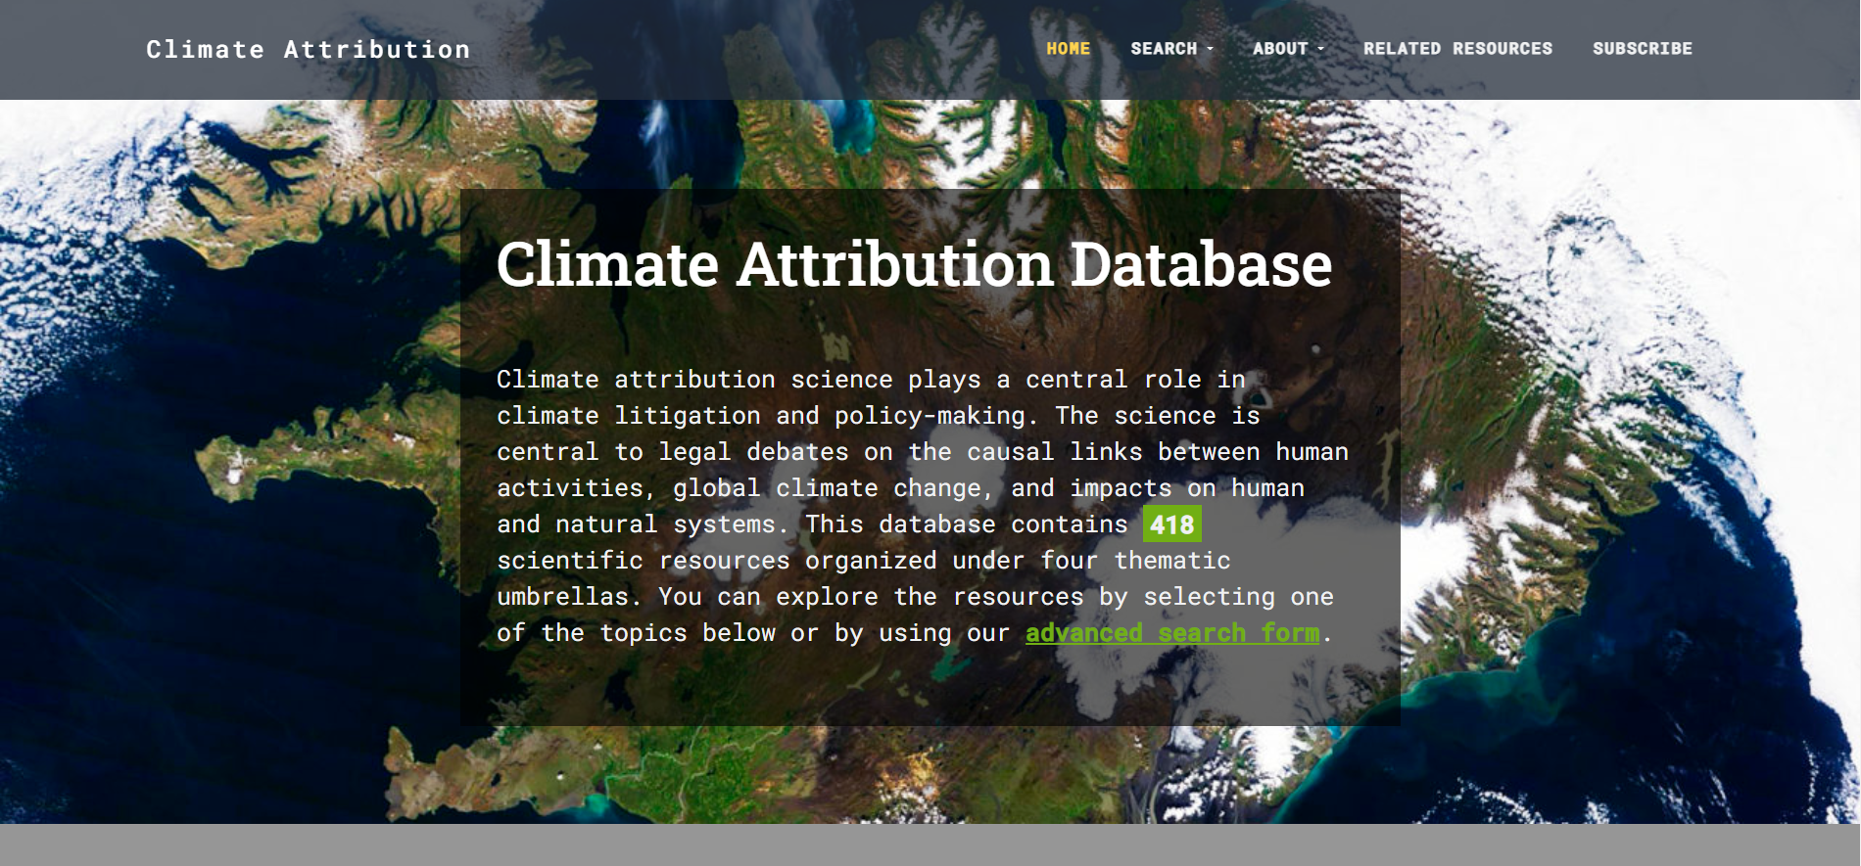
https://climateattribution.org

Slide 21






Contact Information:
mburger@law.columbia.edu
Important Links
https://climate.law.columbia.edu/
www.climatecasechart.com
blogs.law.columbia.edu/climatechange/
twitter.com/SabinCenter
https://www.linkedin.com/company/sabin-center-for-climate-change-law/
www.facebook.com/ColumbiaClimateLaw

